Slide 1
Review !
Sound and waves

Slide 2
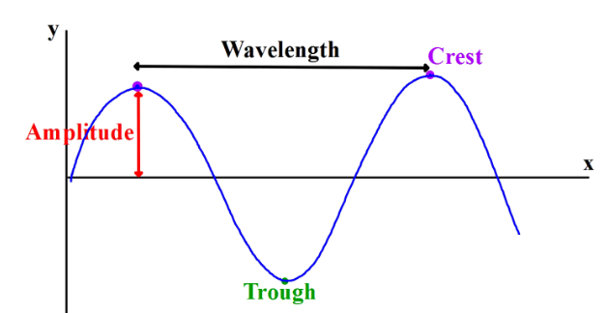
Labeled for you

Slide 3
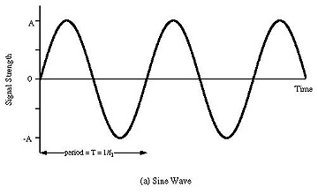
Two types of waves are….
Transverse

Slide 4
Compression or longitudinal wave

Slide 5
Measuring waves
Loudness - Amplitude -Energy, which is measured in the unit of Decibels. This is how loud something is.
Pitch- Frequency, which is measured in Hertz. The higher the frequency, the higher the pitch of the sound.

Slide 6
Wave Song
3.16

Slide 7
Kahoot - Sound and waves
18 questions

Slide 8
The eyes and light

Slide 9
Your FAVORITE song
electromagnetic specrum

Slide 10
Wave and Sound Review Assignment
Use the provided Waves and Sound Study Guide to create your own poster. You can use larger computer paper to help you or you can just complete the requirements in your interactive notebook. If you can do what is on this sheet, then you will be amazing on next classes Test.

