Slide 1
Understanding Graphs in Geography

Slide 2
Learning Target
How are graphs used to help us understand the world and the cultures in them?

Slide 3
Graphs
Graphs are used to help us make sense of the world around us and put things into perspective. They organize information for us to see and understand as well as compare and contrast different regions or areas.

Slide 4
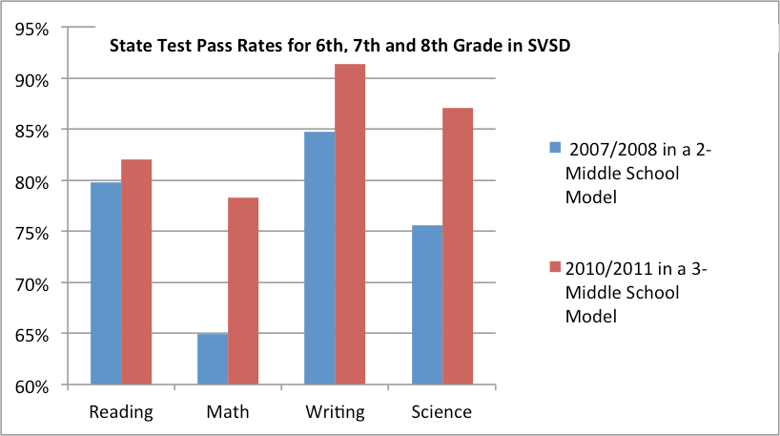
What do you notice about this graph?

Slide 5
What pass rate was closest to 85%

Slide 6
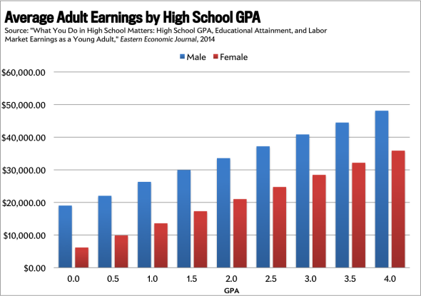

Slide 7
What is the avg. salary of a male with a 2.5 GPA?

Slide 8
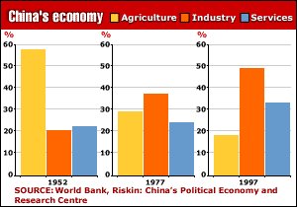

Slide 9
Kahoot

