Slide 1
Types of Maps
Continents and Oceans

Slide 2
Warm Up
Make sure you have your ISN, your agenda and a pencil ready
Take a terms sheet from the front table
Label Page 4 in your ISN geographic terms and glue stick it in.
Put your answer to why study history on a pink post it note (at the front table
Start studying!!!

Slide 3
Objective
How are different types of maps used in geography?
6.g.2
Can I identify the 7 major continents and 4 oceans?

Slide 4
Why study history?
Share your ideas by writing them on a post it note in order for us to make a graph

Slide 6
First things first
You need to be able to identify the major land masses and oceans in the world.
Label page 5 map of the world
Try to identify the 4 major oceans and 7 continents

Slide 7
Here is a rap to help you out
World rap
Use the song to fill in any continents you did not label on your own

Slide 8
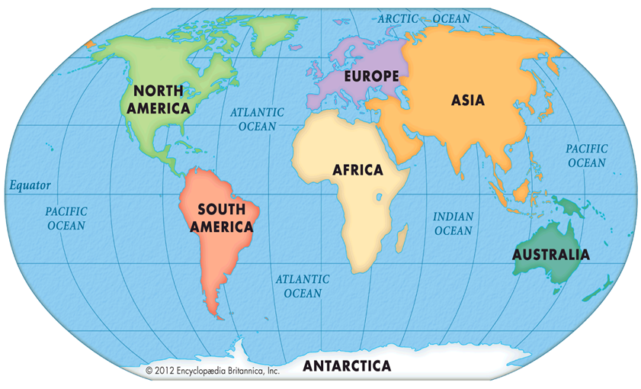
Did you get everything correct?

Slide 9
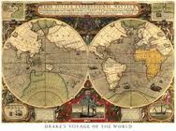
Types of Maps

Slide 10
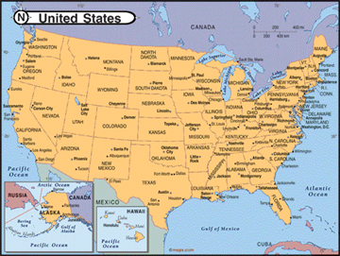
Political Maps
Political maps show how people have divided places on the Earth into countries, states, cities and other units for the purpose of governing them.

Slide 11
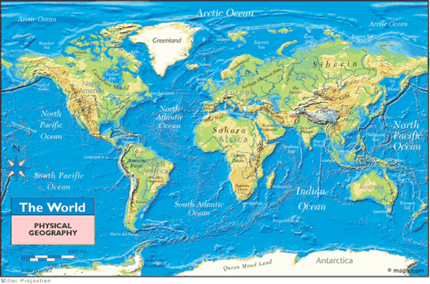
Physical Maps
Physical maps show what the surface of the earth looks like.

Slide 12
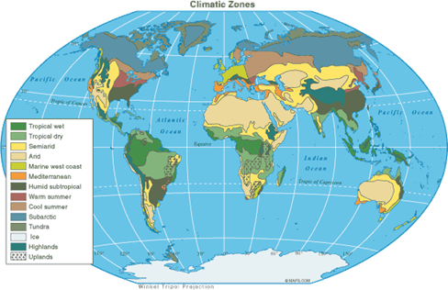
Climate Maps
Show general climate of a region or area.

Slide 13
Thematic Maps
These types of maps focus on specific topics such as types of vegetation, natural resources, population or historic trends. Others focus on movements of people or ideas

Slide 14
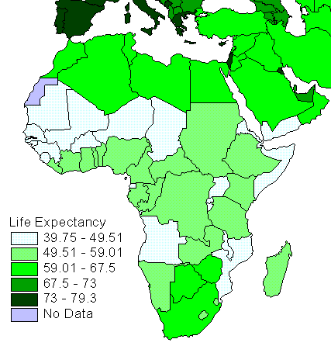
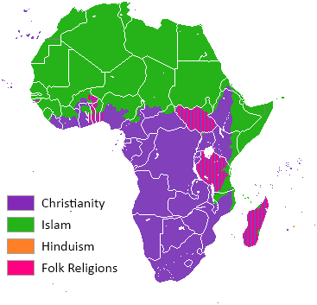
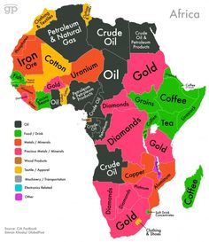
Examples of Thematic Maps

Slide 15
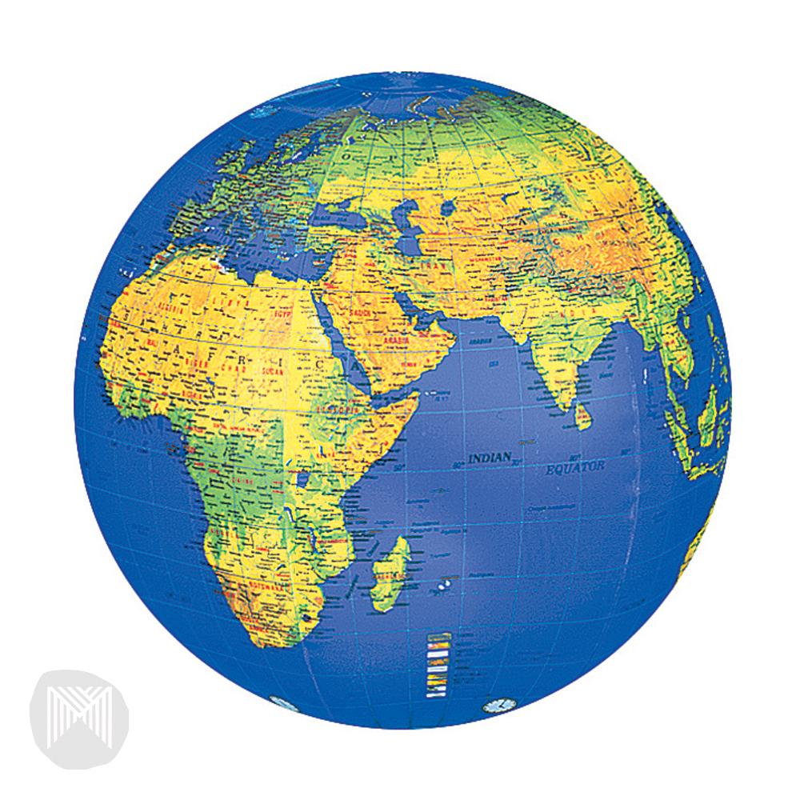
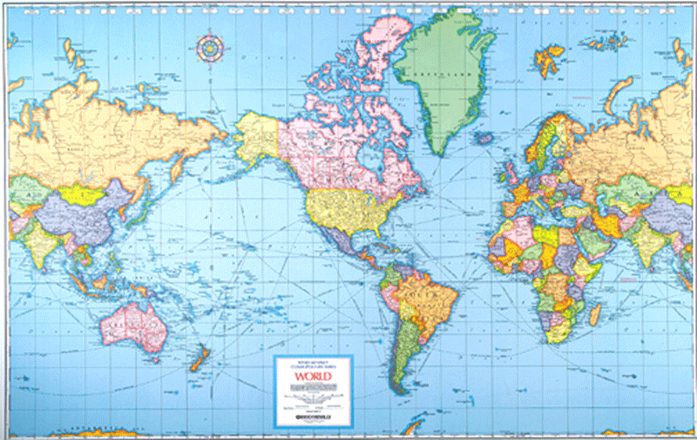
Projections
Map projections allow us to show a curved surface on a flat map

Slide 16
Projection
There are several types of projection maps. The two most common are the Mercator and Robinson projections

Slide 17
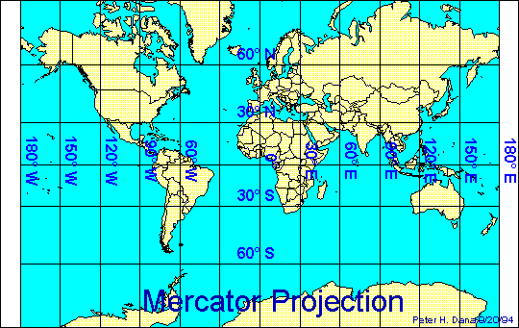
Mercator Projection
Used for navigation, this map shows most of the continents as they look on a globe. The land at the north and south poles are stretched out. It is used for navigation.

Slide 18
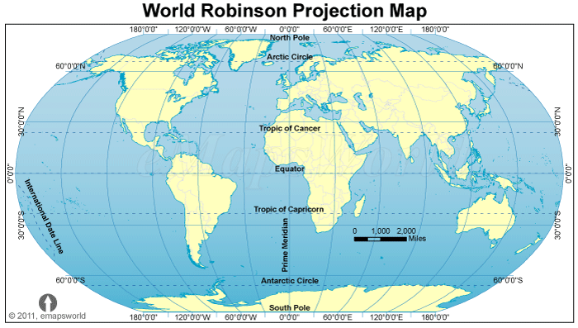
Robinson Projection
Most commonly used, these can be found in textbooks and display all the oceans and continents

Slide 19
Here is a projection map from my trip to china
What do you notice that is different?

Slide 20
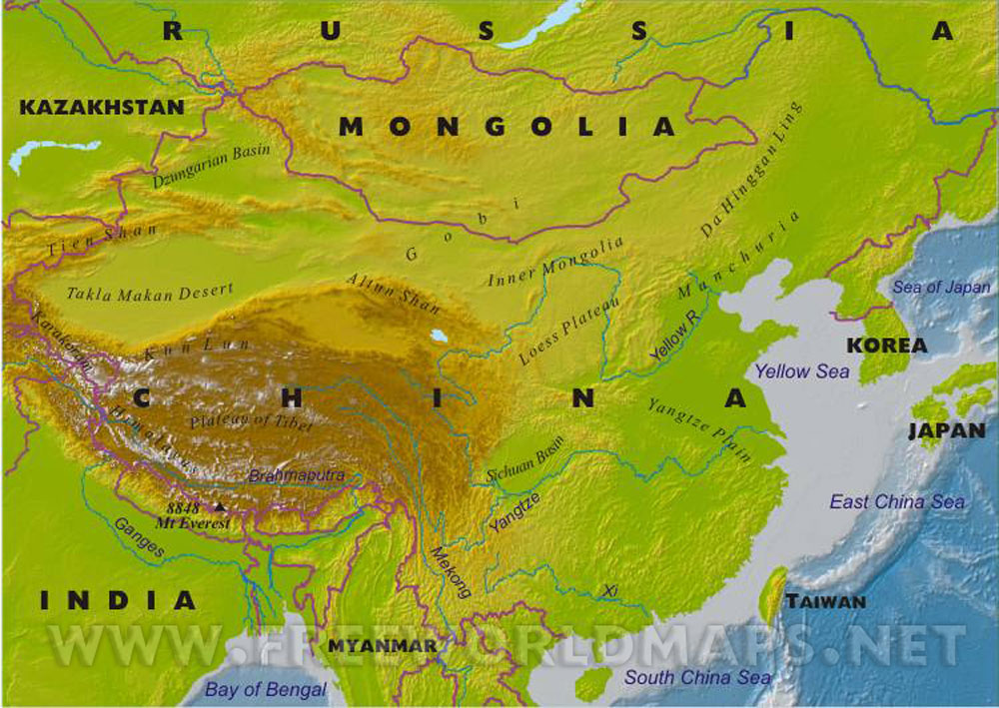
Let’s see if we have this
What type of map is this?

Slide 21
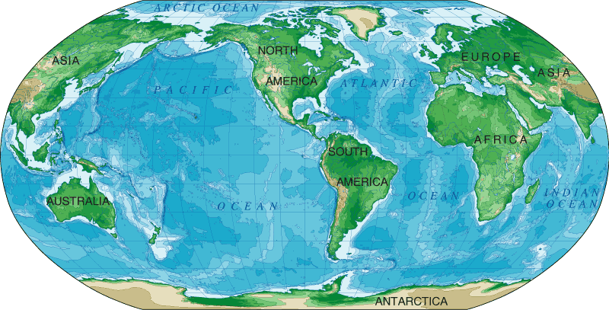
What about this?

Slide 22
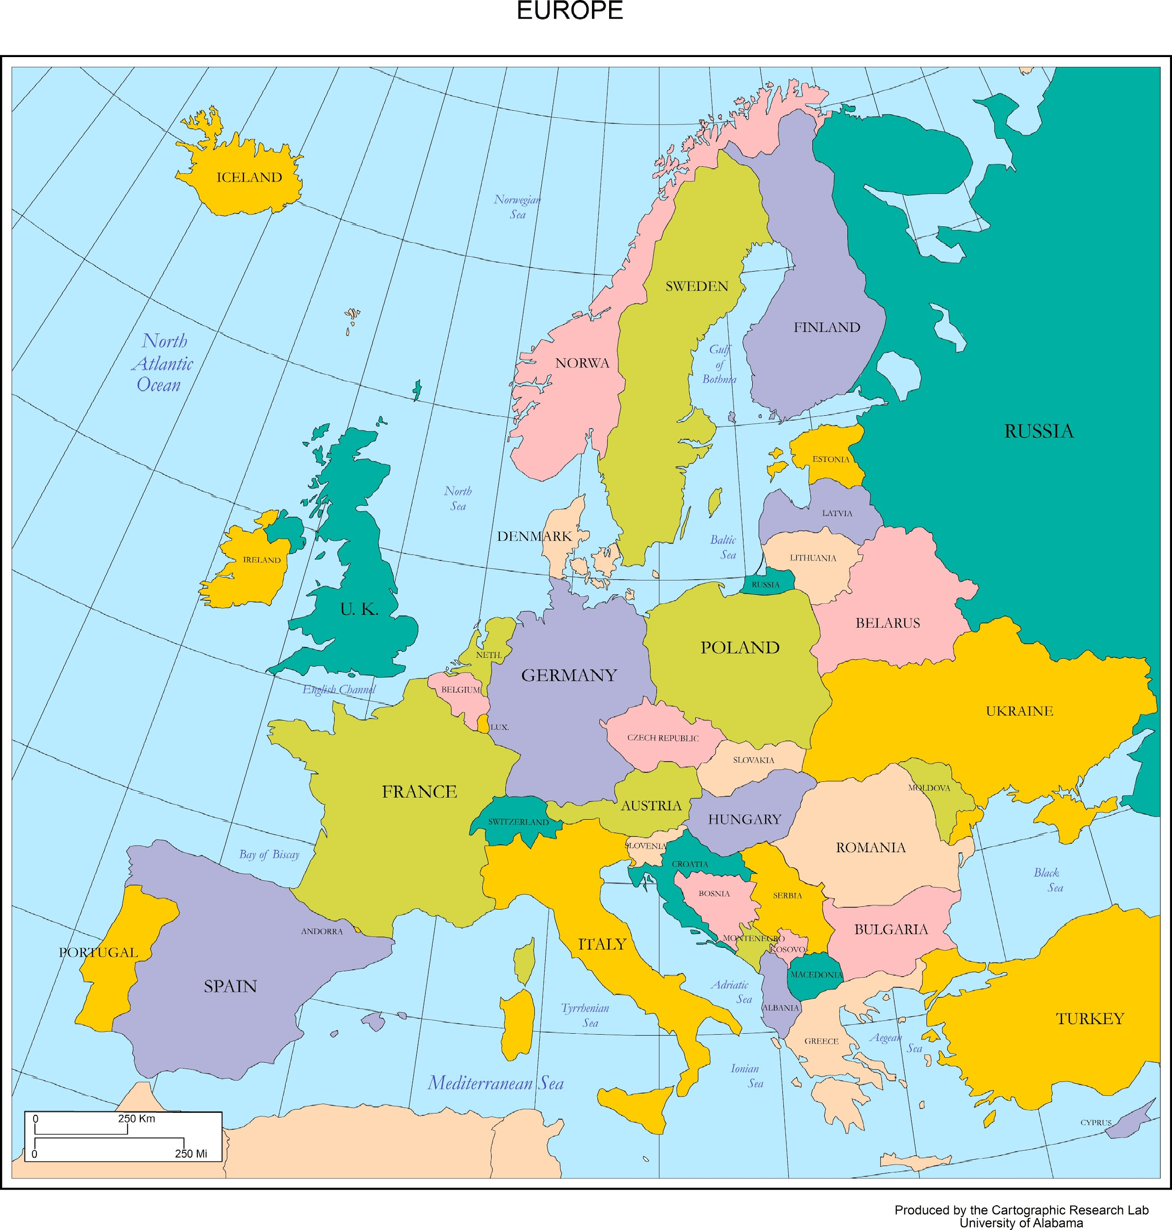
And this?

Slide 23
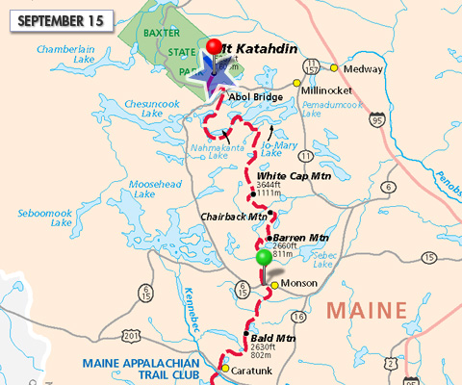
What about this one?

Slide 24
Answers
Physical
Projection
Political
Thematic

