Slide 1
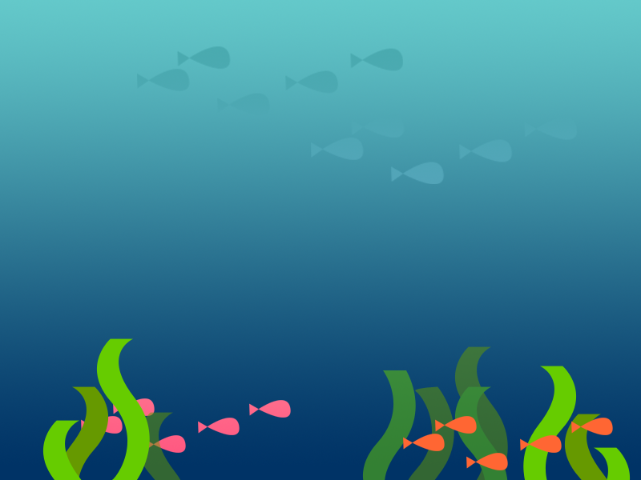
Soda and Mentos
Getting Ready

Slide 2
Think about this...
Cucumber Seeds
Two friends bought packets of cucumber seeds. They argued about whether or not the
cucumber seeds inside the sealed packets were living. Here is what they said:
Katie: “I think they are alive when they are in the sealed seed packet.”
Vaughan: “I don’t think they are alive until they are planted in the soil.”
Which person do you agree with the most?
Explain your thinking.

Slide 3
Today’s Objective
How can technology , especially google docs, help us to collaborate on scientific experiments?
I can use what I know about the scientific method to make a hypothesis about our upcoming experiment
21st century skills

Slide 4
Groups and sharing
First, we will pick groups for our investigation
Next, we will all practice getting onto good docs
Once linked - please share with me. lauram.bauer

Slide 5
Remember
Your ability to help your group be successful with a positive attitude starts now. You will be graded by your peers on the positive impact you make on your group through your work and effort.

Slide 6
Your Objective today is ….
Decide to use google docs, or work individually
State the purpose (problem) you will be working on
Do some research on how soda and mentos interact on a chemical basis (include things you are wondering about)
Make an inference on what will happen
Write your hypothesis

Slide 7
Lab Reports
Group lab reports will be due on October 1st.
You will need one printed copy if you worked together on google docs. You will each need a copy if you decided to work individually.
I will pick one report to represent your group.
Make sure you follow the rubric on the website.
This will count as a formal grade.

Slide 8
Questions?

