Slide 1
Rise of Democracy

Slide 2
Warm UP
Label you ISN “Rise of Democracy” Copy the objective from the board
Get out your homework - 12 interesting facts from the video
3. Tape by folding and using 2 SMALL piece of tape, Lay of the land, Democracy in Athens and Birth of democracy into your ISN
4. Complete Lay of the Land using what you know about Greek Geography

Slide 3
An introductory Video
7 mins

Slide 4
4 Types of Governments
Monarchy
Oligarchy
Democracy (direct and representative)
Tyranny

Slide 5
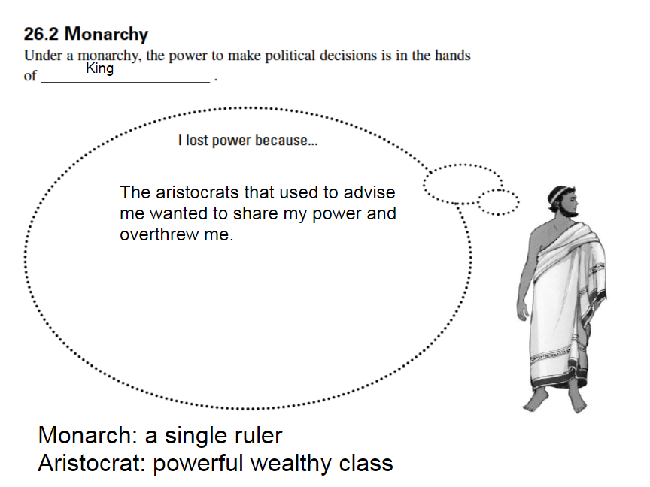
Monarchy

Slide 6
Monarchy
From 2000 BCE to 800 BCE early city states were ruled by Monarchs
Each King had a council of aristocrats - “best” people
Since they were wealthy kings depended on them for horses and armor
In most cities aristocrats overthrew the king and took power for themselves
Monarchs in 3 minutes

Slide 7
Oligarchy - few rules

Slide 8
Oligarchy
Oligarchs were from wealthy land owning families or merchants
They spent their days hunting, chariot racing, drinking wine and throwing parties
There laws favored the rich
They often ignored the needs of the people
Used armies to enforce laws
Poor would get fed up and look for a leader who would help (often in the army) they used soldiers to overthrow the oligarchy. Poor united with soldiers got the job done
1.54

Slide 9
Break with Mr. Nicky
here it is

Slide 10
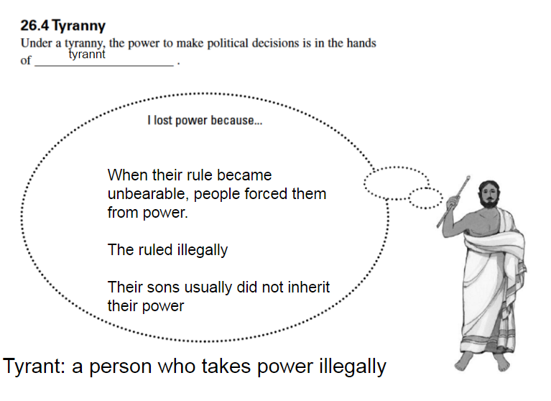
Tyranny

Slide 11
Tyranny
Term for men who forced oligarchs from power
Although a single ruler, tyrants and different than monarchs in that
They do not have a legal right to rule
They do not pass on the rule to their sons
2 minutes

Slide 12
Democracy

Slide 13
Democracy
All citizens share ruling power
In Athens, there was a direct democracy where all citizens vote on every issue
Greek, like the United States has a representative democracy today. This is where people vote for representatives who vote and represent them.
Assembly - a law making group made up of free men who could speak and vote on issues
2.00

Slide 14
Let’s see how it works
Democracy simulation
Classwork - Democracy in Athens
Homework - Read Birth of Democracy and answer the questions

Slide 15
Kahoot
10 questions

Slide 16
A few more resources
7 types of government song - 4 mins...of course there is a song!
3.53 Florida School m

