Slide 1
Physical and Chemical Changes

Slide 2
Introduction with Tim and Moby
https://www.brainpop.com/science/matterandchemistry/propertychanges

Slide 3
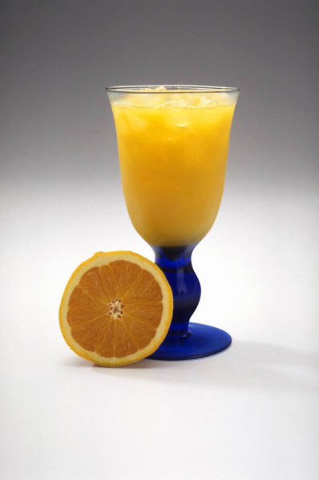
What is a Physical Change?
A physical change alters the form of a substance, but does not change it to another substance.
Example:
Making Orange Juice

Slide 4
Physical Change Definition
A physical change is a change in size, shape or form (state of matter)
Motion, temperature or pressure can make these changes occur
Molecular structure does not change
Can usually be reversed

Slide 5
Demo Experiment 1
Baggie, water and pencils
What will happen when you stick pencils through a baggie filled with water?

Slide 6
What happened?
The bag experienced a physical change
Change in size or shape
The water did not leak out because of air pressure. This pressure caused a vacuum around the pencils creating a seal.

Slide 7
More examples of physical changes
crushing a can breaking a glass
dissolving sugar and water shredding paper
Boiling water Breaking a glass
mixing red and green marbles Melting an ice cube
sublimating dry ice Mixing water and sand

Slide 8
Demo Number 2
Materials:
Steel wool
Vinegar
This one will take a few minutes

Slide 9
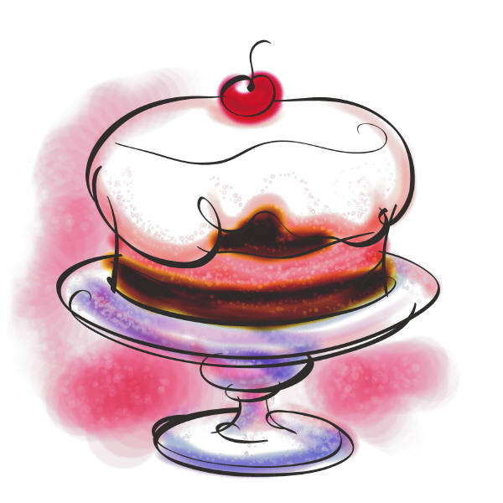
What is a Chemical Change?
When a substance undergoes a chemical change, it is changed into a different substance with different properties.
Example:
Baking a Cake

Slide 10
Chemical Change
Molecules of matter change
Changes cannot usually be reversed
Matter turns into something different
We classify these 5 ways

Slide 11
Demo number 2 – Steel Wool
Let’s look back at the steel wool and see what happened….
Chemical change – Color Change

Slide 12
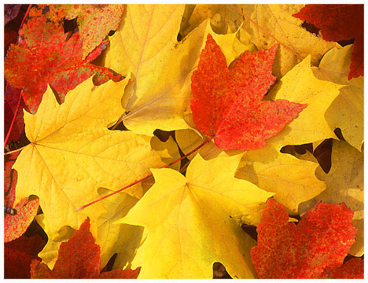
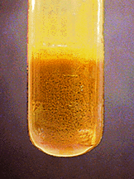
5 Signs of a Chemical Change
Color Change
Precipitation

Slide 13
Demo Number 3
bromothymol blue – is a ph indicator
Materials
Bromothymol Blue
Straw
Baking soda

Slide 14
What happened
A chemical change occurred
First based on the carbon dioxide
Second with the baking soda
Change in color

Slide 15
Precipitation
Precipitation – the solid that forms from a solution during a chemical reaction.
It looks like a cloudy solid in an otherwise clear solution.
Two liquids give you a new solid

Slide 16
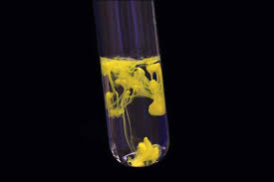
Examples

Slide 17
Demo number 4
Whole milk
Red bull

Slide 18
What happend
A chemical reaction occurred
The white globby matter on the top is a precipitant – A new solid was formed

Slide 19
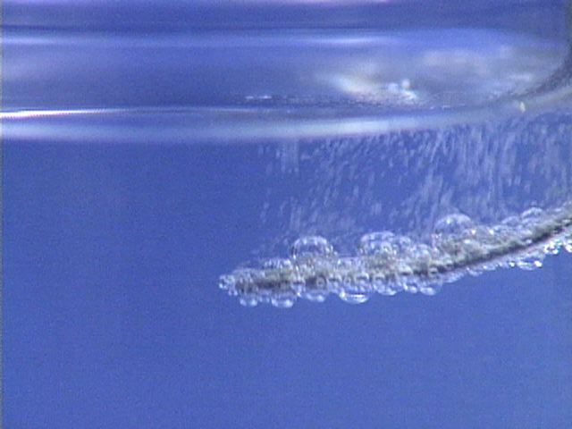
5 Signs of a Chemical Change
Gas Production
Temperature Change

Slide 20
Demo number 5
Materials
Film canister
¼ alka seltzer tablet
Filled 1/2 way with water
Turned face down

Slide 21
What happened?
A chemical changed occurred.
The water mixed with the baking soda and gas was given off (number 3 on our list)

Slide 22
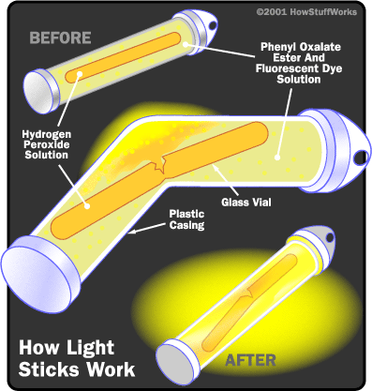
5 Signs of a Chemical Change
Changes in Characteristic Properties (odor, light given off)

Slide 23
Demo 6
½ Cup Hydrogen Peroxide
Food coloring
1 tablespoon dawn dish soap
In a beaker
Second bowl
¼ cup warm water
Yeast package

Slide 24
What happened
Chemical Change
Change in temperature
Produces gas

Slide 25
Chemical or Physical Change?
Cutting paper?
Physical

Slide 26
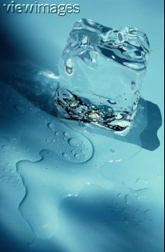
Chemical or Physical Change?
Ice melting?
Physical

Slide 27
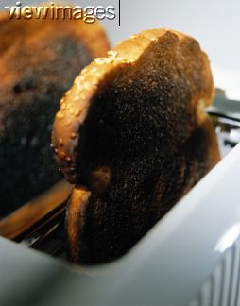
Chemical or Physical Change?
Toast burning?
Chemical

Slide 28
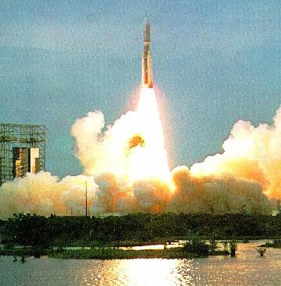
Chemical or Physical Change?
Rocket fuel burning?
Chemical

Slide 29
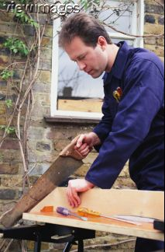
Chemical or Physical Change?
Sawing wood?
Physical

Slide 30
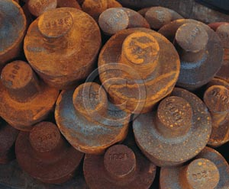
Chemical or Physical Change?
Metal rusting?
Chemical

Slide 31
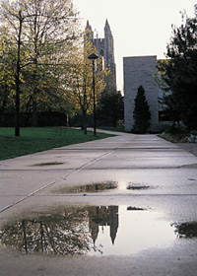
Chemical or Physical Change?
Disappearing puddle?
Physical

Slide 32
Chemical or Physical Change?
Candle burning?
Chemical

Slide 33
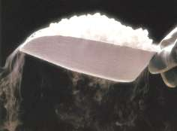
Chemical or Physical Change?
Dry ice?
Physical

Slide 34
Extension
https://www.youtube.com/watch?v=qqqmFFCwd7k
Good examples

Slide 35
Extension
https://www.youtube.com/watch?v=qqqmFFCwd7k
Examples in a song

Slide 36
Extension
https://www.youtube.com/watch?v=gCbqjs-pqJo
Examples

