Slide 1
Physical and Chemical Changes Day 2

Slide 2
Go over Homework

Slide 3
What is Density?
Density is a measurement of how much matter is in a certain area. Specifically it is the mass per unit of volume in a substance. If you have two objects of the exact same size (volume), the more dense object will have more matter compacted.

Slide 4
So...
So there are two things contributing to density:
The mass of the atoms or molecules that makes up the material.
The volume or amount of space the material takes up. If the molecules or atoms are “packed” in more closely, it will be more dense.

Slide 5
Demo - Showing Density
Predict which is most dense…
Dish Soap - Blue
Honey
Rubbing Alcohol - Red
Vegetable Oil
Water - Yellow
Karo Syrup - Green

Slide 6
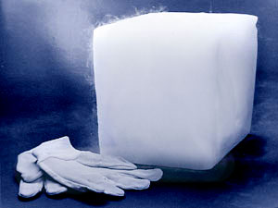
Sublimation
Dry ice is a great way to show chemical and physical changes - Predict whether the following experiments represent the a physical or chemical change

Slide 7
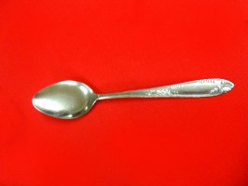
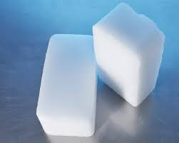
Dry ice and metal spoon
What happens when we push a metal spoon against dry ice?
Thoughts?

Slide 8
Spoon and Dry Ice
Physical Change
The dry ice vibrates the metal as it tries to get around it. This causes pressure and the vibration of the air against the metal surface makes the noise.

Slide 9
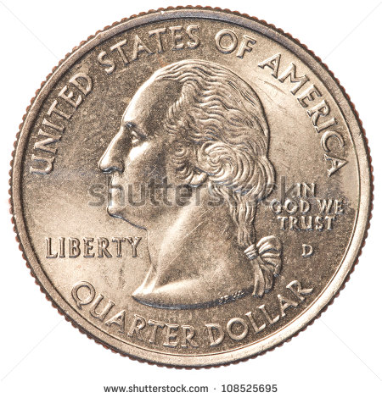
Dry Ice and Quarter
What happens when you push a quarter into the dry ice?
Physical or Chemical Change?

Slide 10
Quarter
This is a physical change.
Similarly to the spoon, the quarter is made of metal. Instead of making a squealing noise. The warmth of the metal causing room and pressure change between the metal and the dry ice. This make quarter vibrate or dance.

Slide 11
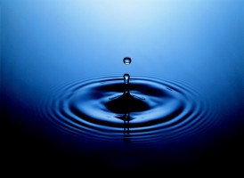
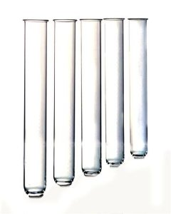
Dry ice and water
How long will it take for the colder dry ice to freeze water?

Slide 12
Dry ice and water
This is a physical Change.
The dry ice is much colder than the water. This is just like putting water into a freezer, except the solid dry ice takes energy from the water. This causes the molecules to slow down and become more attracted. We all know that this changes the liquid water into solid ice.

Slide 13
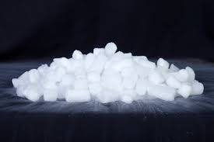
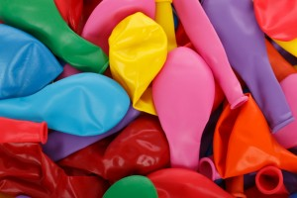
Balloon and Dry Ice
Can Dry ice blow up a balloon?
Why or Why not?

Slide 14
Balloon and Dry Ice
This is a physical change for both the dry ice and the balloon. The dry ice is changing from a solid to a gas and the balloon is changing size.
Do you see any other physical changes?

Slide 15
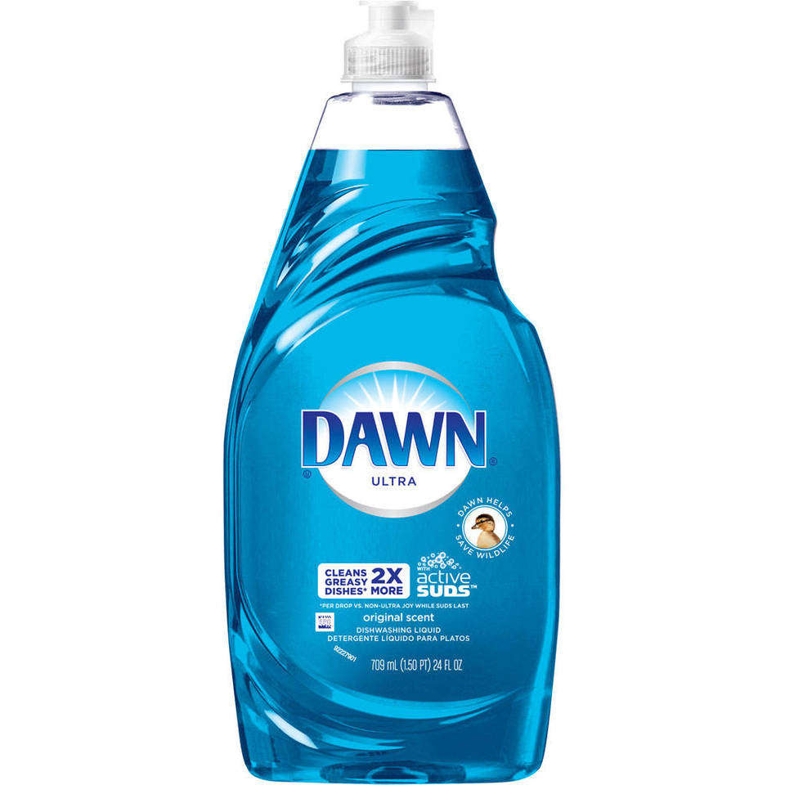
Dry Ice , Dish Soap and water
What happens when we combine dry ice with water and soap?
Is this a physical or chemical change?

Slide 16
Dry Ice , Dish Soap and water
This is a physical change.
The dry ice, soap, and water combine to make a soapy mess. The cool thing about this situation is that as the dry ice sublimates, the Carbon Dioxide gets trapped in the soapy bubbles. So when you pop the bubbles, we can see a puff of gas. This is a physical change because there is not new substance being created. Dry ice is a simple change from one state of matter to another.

Slide 17
The Crystal Ball
The one is more for entertainment reasons, but it is still a cool dry ice experiment.
Through Mr. Tubb’s Dry Ice Crystal Ball he can see into the future. The Crystal Ball predicts that you will:
ha_ _ a qu_ _ n_ x_ cl_ _ s.

Slide 18
Practice Quiz
Number you paper 1 - 10

Slide 19
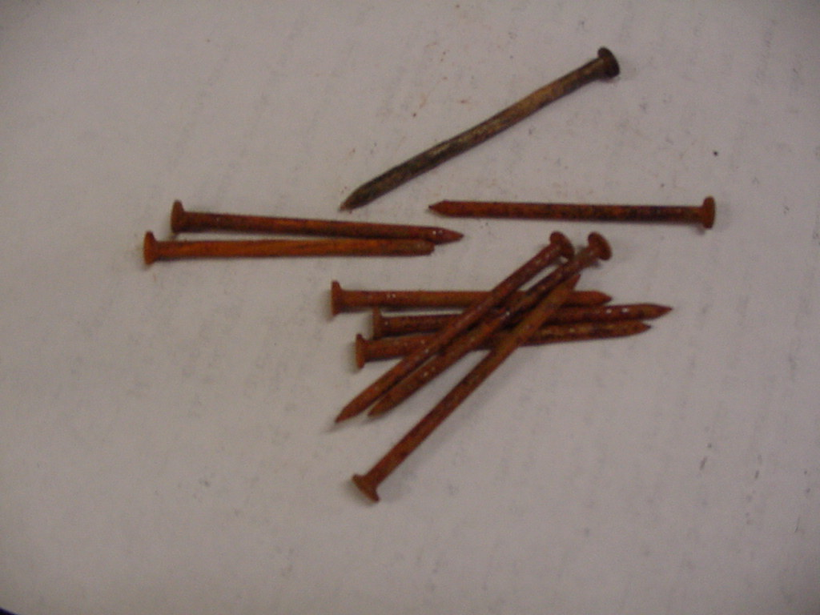
1. A. Physical Change B. Chemical Change
Rusting nails

Slide 20
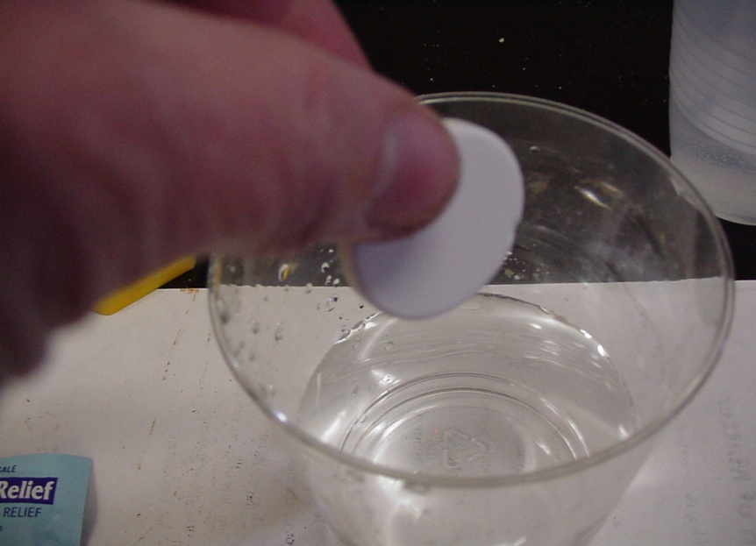
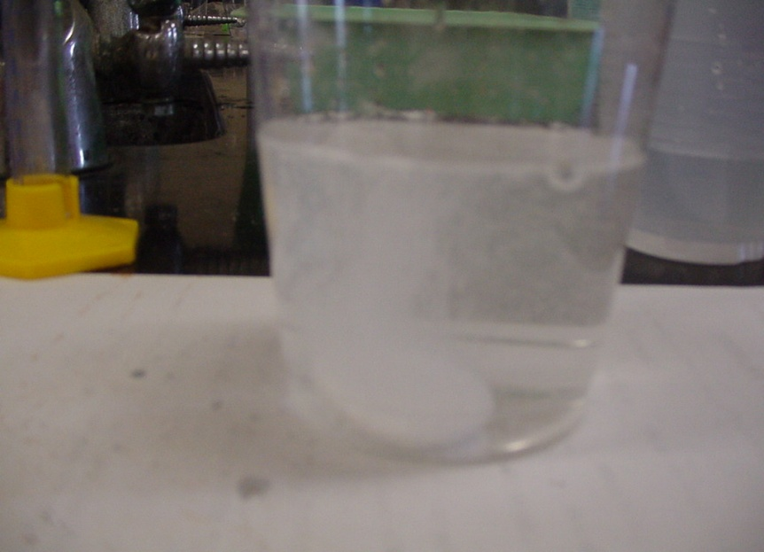
2. A. Physical Change B. Chemical Change
Effervescent tablet

Slide 21
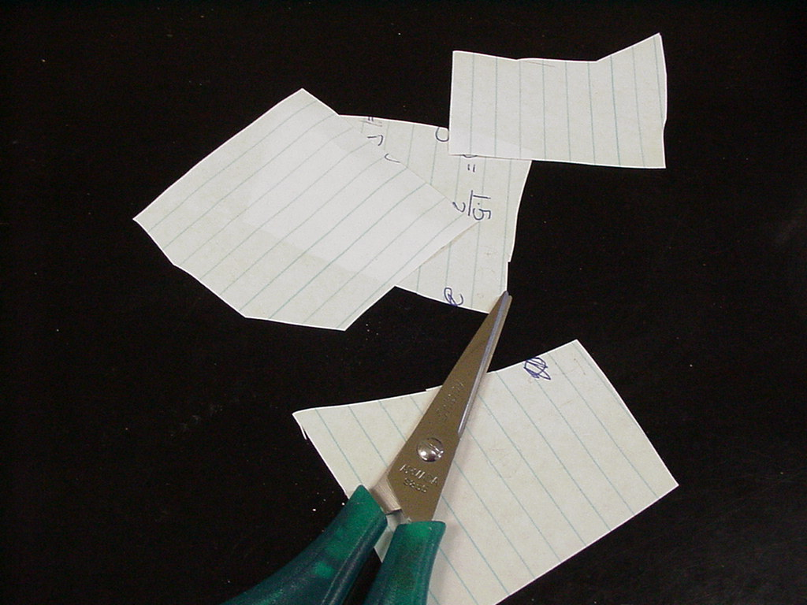
3. A. Physical Change B. Chemical Change
Cut paper

Slide 22
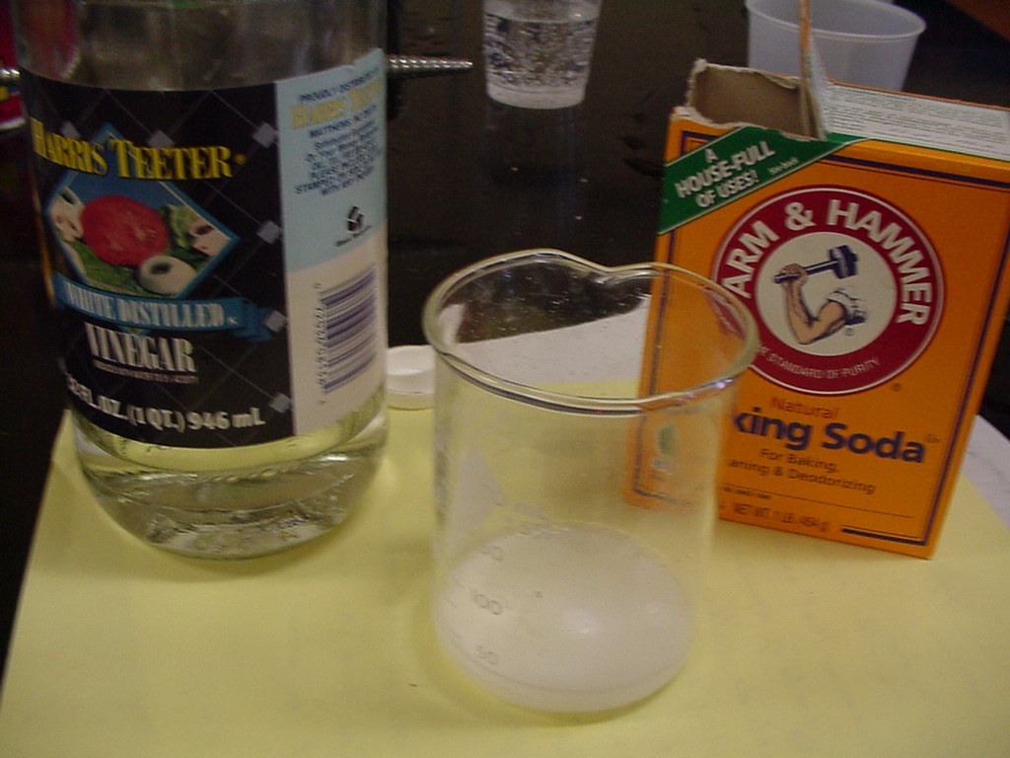
4. A. Physical Change B. Chemical Change
Vinegar and Baking soda

Slide 23
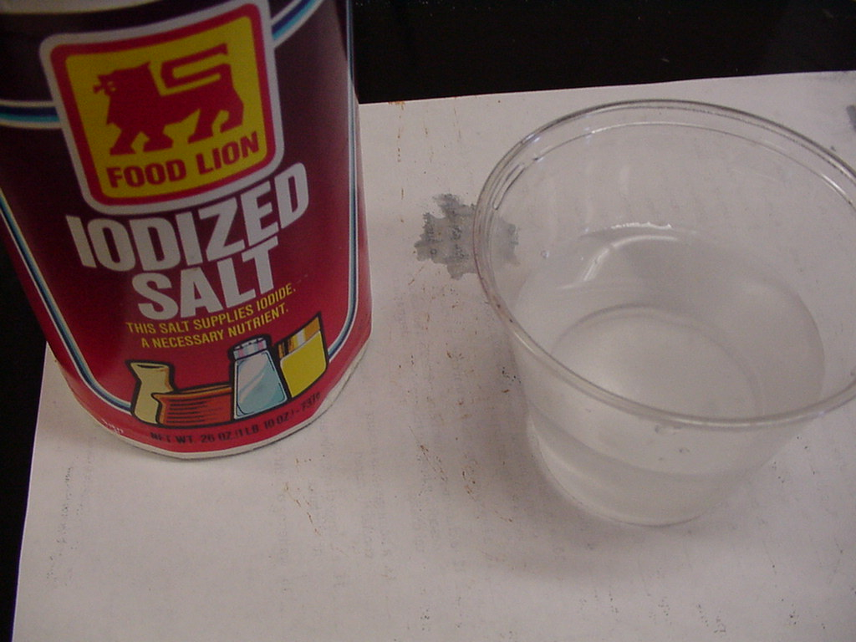
5. A. Physical Change B. Chemical Change
Salt and water

Slide 24
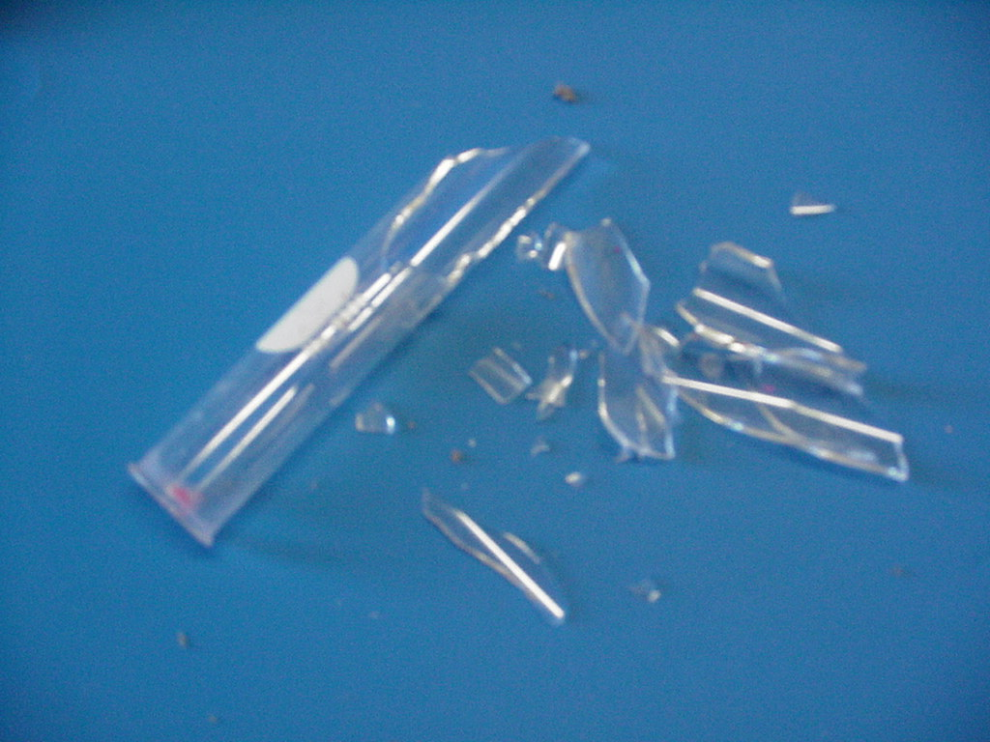
6. A. Physical Change B. Chemical Change
Broken glass

Slide 25
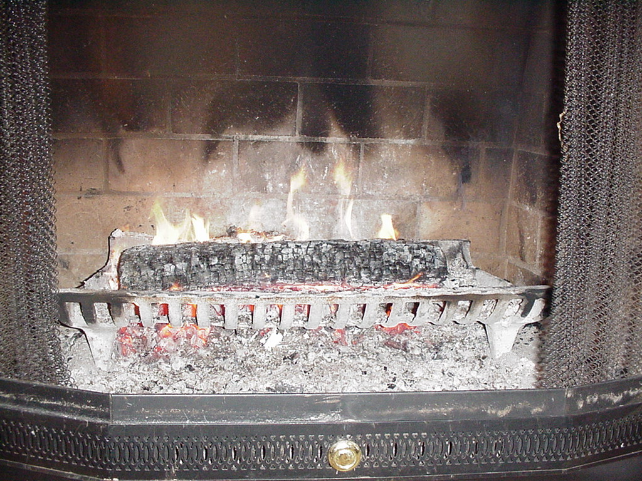
7. A. Physical Change B. Chemical Change
Burning wood

Slide 26
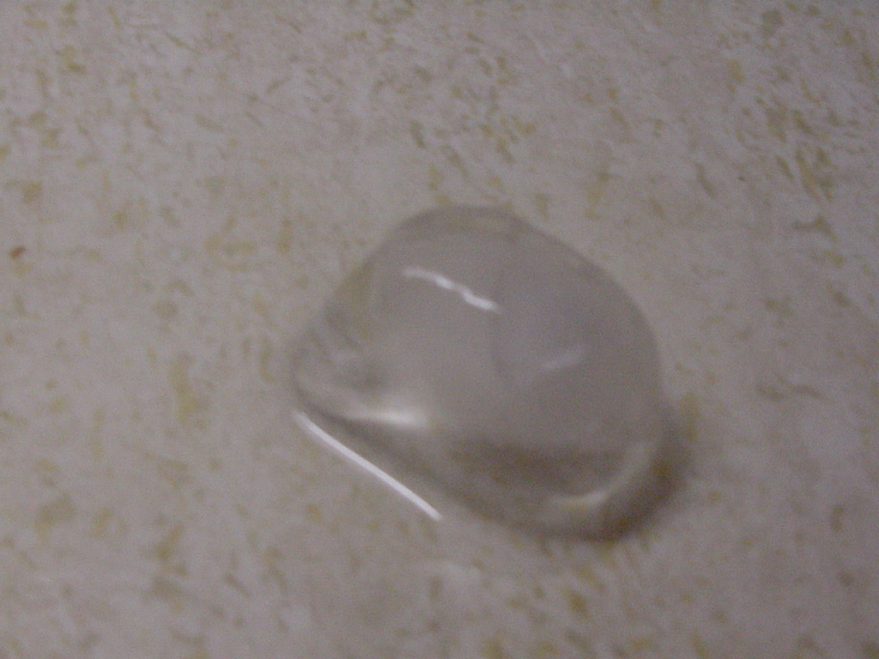
8. A. Physical Change B. Chemical Change
Ice melting

Slide 27
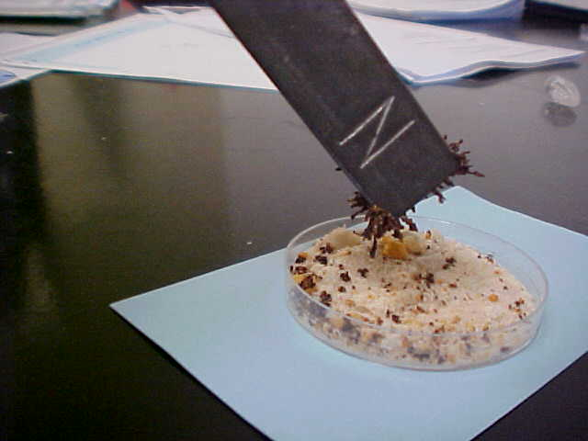
9. A. Physical Change B. Chemical Change
Removing iron filings from a mixture

Slide 28
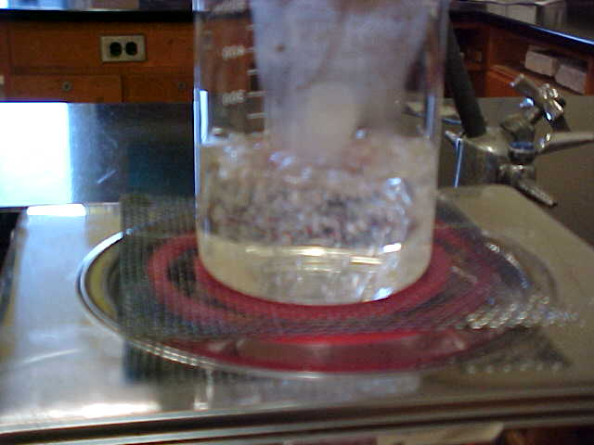
10. A. Physical Change
B. Chemical Change
Boiling water

Slide 29
Check your paper and place in notebook
1. B - Chemical
2. B - Chemical
3. A - Physical
4. B - Chemical
5. A - Physical
6. A - Physical
7. B - Chemical
8. A - Physical
9. A - Physical
10. A - Physical

Slide 30
Credits
https://www.google.com/search?q=picture+of+dry+ice&espv=2&biw=1920&bih=971&tbm=isch&tbo=u&source=univ&sa=X&ved=0CDEQ7AlqFQoTCNvVj-GK0sgCFUHVgAodkNEPLg#imgrc=FJCamOWfk835WM%3A - Dry ice
https://www.google.com/search?q=test+tube&espv=2&biw=1920&bih=971&site=webhp&source=lnms&tbm=isch&sa=X&ved=0CAYQ_AUoAWoVChMImfb884vSyAIVzJINCh0KrQs9#imgrc=HjsGxhw6SN5NGM%3A - test tube
https://www.google.com/search?q=test+tube&espv=2&biw=1920&bih=971&site=webhp&source=lnms&tbm=isch&sa=X&ved=0CAYQ_AUoAWoVChMImfb884vSyAIVzJINCh0KrQs9#tbm=isch&q=dish+soap&imgrc=E12VWpuzYhJ-pM%3A - dish soap

