Slide 1
5 themes of Geography
Part 2

Slide 2
Warm up
Share your drawings of the first 3 themes of geography
Label Page 10 - Movement
Label Page 11 - Region
Label Page 12 - 5 theme review
Do this both in the table of contents and on the heading of page 10 and 11

Slide 3
Quiz
Rules for quizzes
Keep you eyes on your own paper
Stay in your seat while working
When you are done turn your paper face down
Read
Be courteous to others still working at all times

Slide 4
Essential Question
How do the themes of Region and Movement, location and help us to understand the world and the people in it as well as how if influenced the history of the world?
6.E.1

Slide 5
Still not convinced?
Here is another video with more reasons to study Geography
2.14 minutes

Slide 6
Let’s Review
L
Play Place
In Interaction
Mario’s Movement
Room Region
s Location
Play Place
In Interaction
Mario’s Movement
Room Region
et’s Location
Play Place
In Interaction
Mario’s Movement
Room Region
Let’s - Location
Play - Place
In - Interaction
Mario’s - Movement
Room - Region

Slide 7
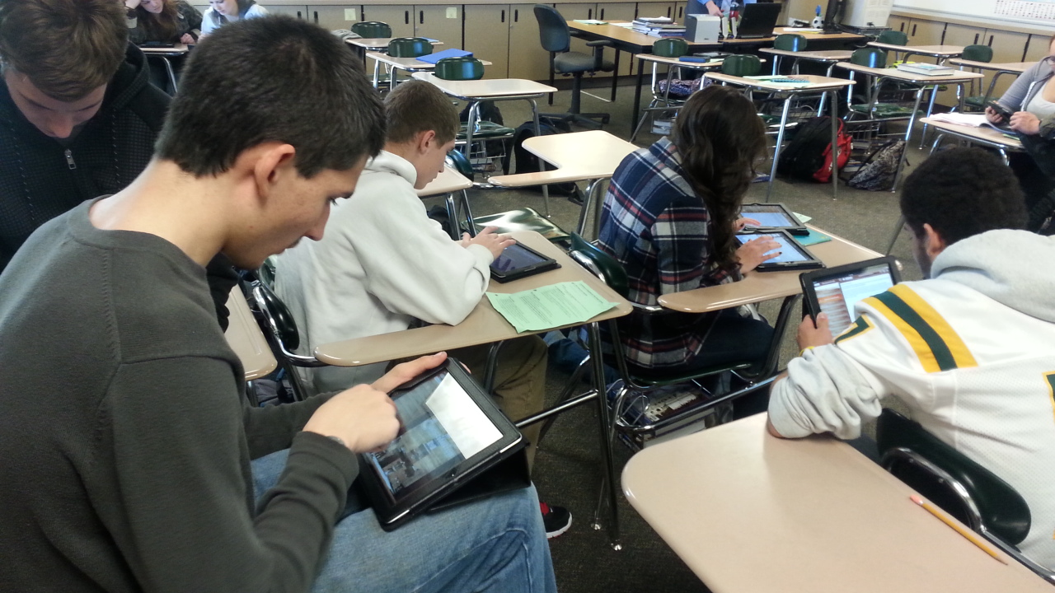
Movement - People and ideas get around
The movement of people, goods and ideas from one place to another.

Slide 8
Region
What do locations have in common?
Climate, religion, language and education are examples.
These are usually classified by border, states or territories
They are united by physical or human characteristics

Slide 9
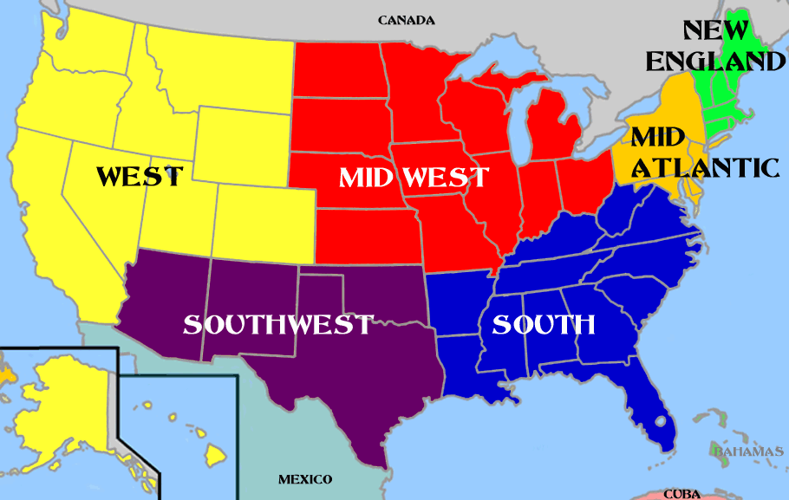
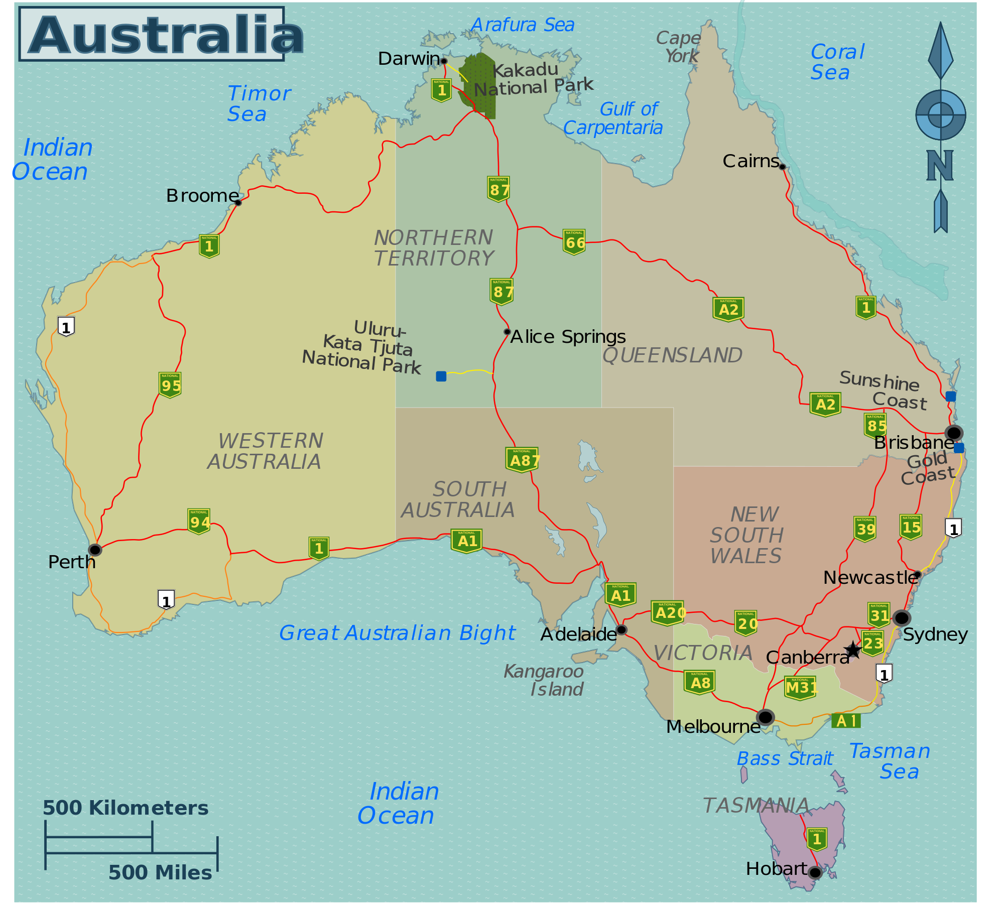
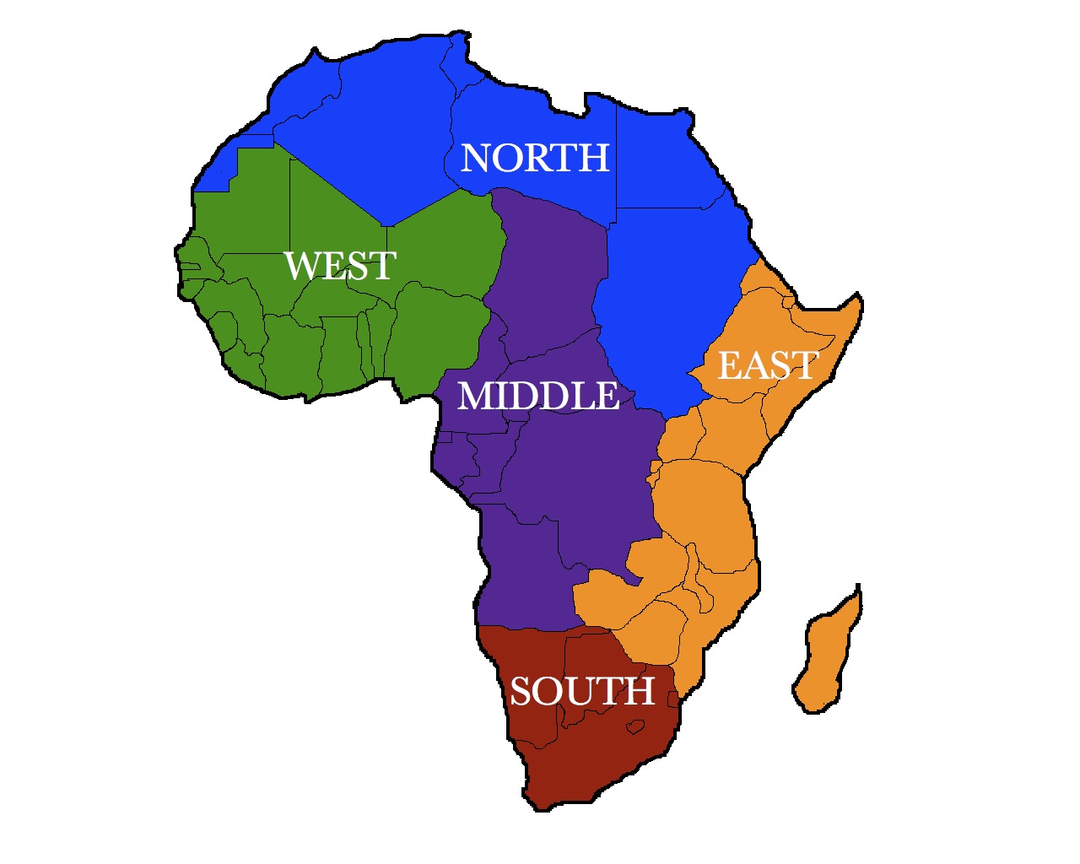
Region continued

Slide 10
Rap again, just for you
Rap 5 themes 2.34

Slide 11
5 Theme Review project
Take the 5 theme review sheet and cut just along the horizontal lines between the 5 themes.
Glue only the portion labeled 5 themes down
Under each of the 5 themes write a definition from your notes and a small picture

Slide 12
Homework
Sketch the last two themes in your interactive notebook.
Complete the review page

