Slide 1
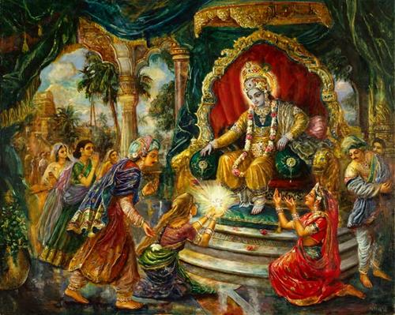
Ancient India: The Mauryan Empire
Caste system explained
Presentation created by Robert L. Martinez

Slide 3
Caste System

Slide 4
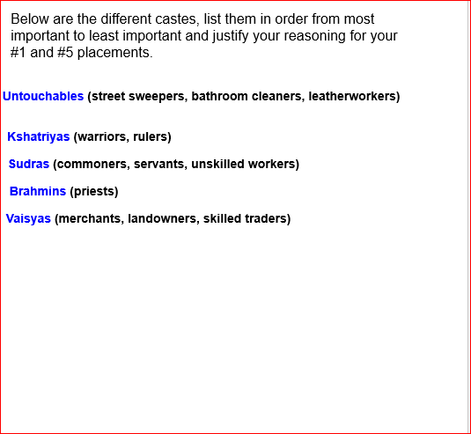

Slide 6
A visual - The Caste system
6.33

Slide 7
Let’s review

Slide 8
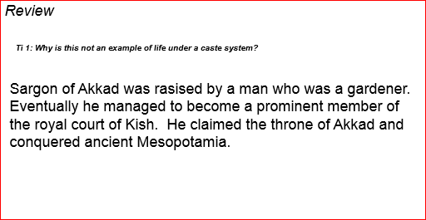
Why is this not an example of the caste system?

Slide 10
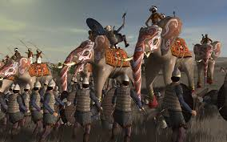
Mauryan Empire

Slide 11
Vocabulary
Edict - an official message carved on walls rocks or pillars - often a command obeyed like a law
Monk - a holy man who devotes his life to religious practice

Slide 12
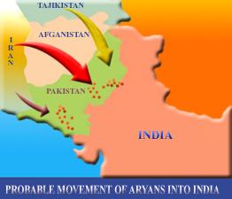
During this time, the Aryan culture and belief systems continued to spread throughout India.

Slide 13
Here is their progress
class zone

Slide 14
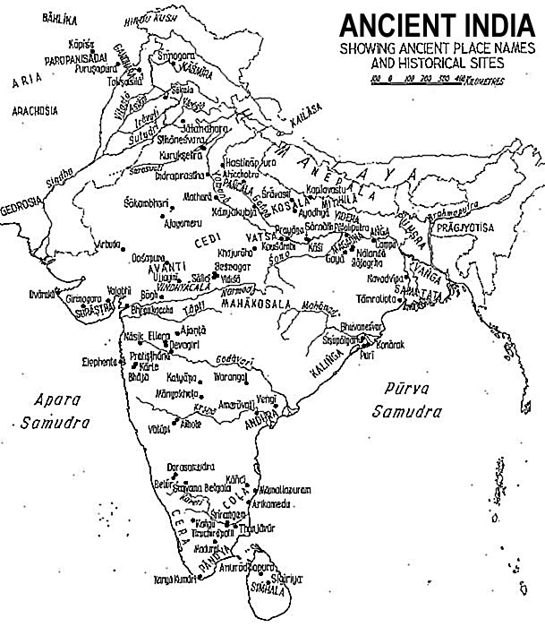
Then, around 321 B.C.E., a new empire arose in India, one that would come to be the largest in that country to date.

Slide 15
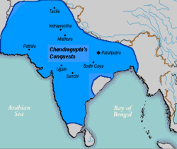
Spanning from the Indus River Valley eastward through the Ganges River Valley and southward through the Deccan Plateau …

Slide 16
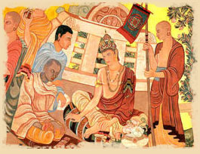
… the Mauryan Empire was founded by Chandragupta Maurya, who unified the smaller Aryan kingdoms into a civilization.

Slide 17
How was this possible?
The subcontinent of India is over one million square miles
It was divided into smaller kingdoms who often fought, especially in the north
This had a huge impact in terms of money and men

Slide 18
How did he accomplish this?
Chandragupta used force
He had over 700,000 soldiers in his army
He used over 9,000 elephants

Slide 19
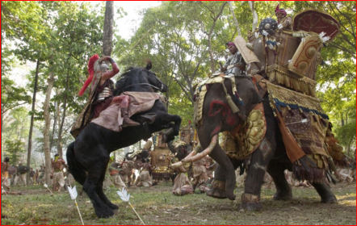

Slide 20
Chandragupta’s rule
Harsh but successful
strong central government
Wrote many laws
built a 1000 mile royal road to control his empire
Gave up power toward the end of his life
Lived in poverty and traveled with monks
His grandson King Ashoka took over
His rule was over almost all the subcontinent

Slide 21
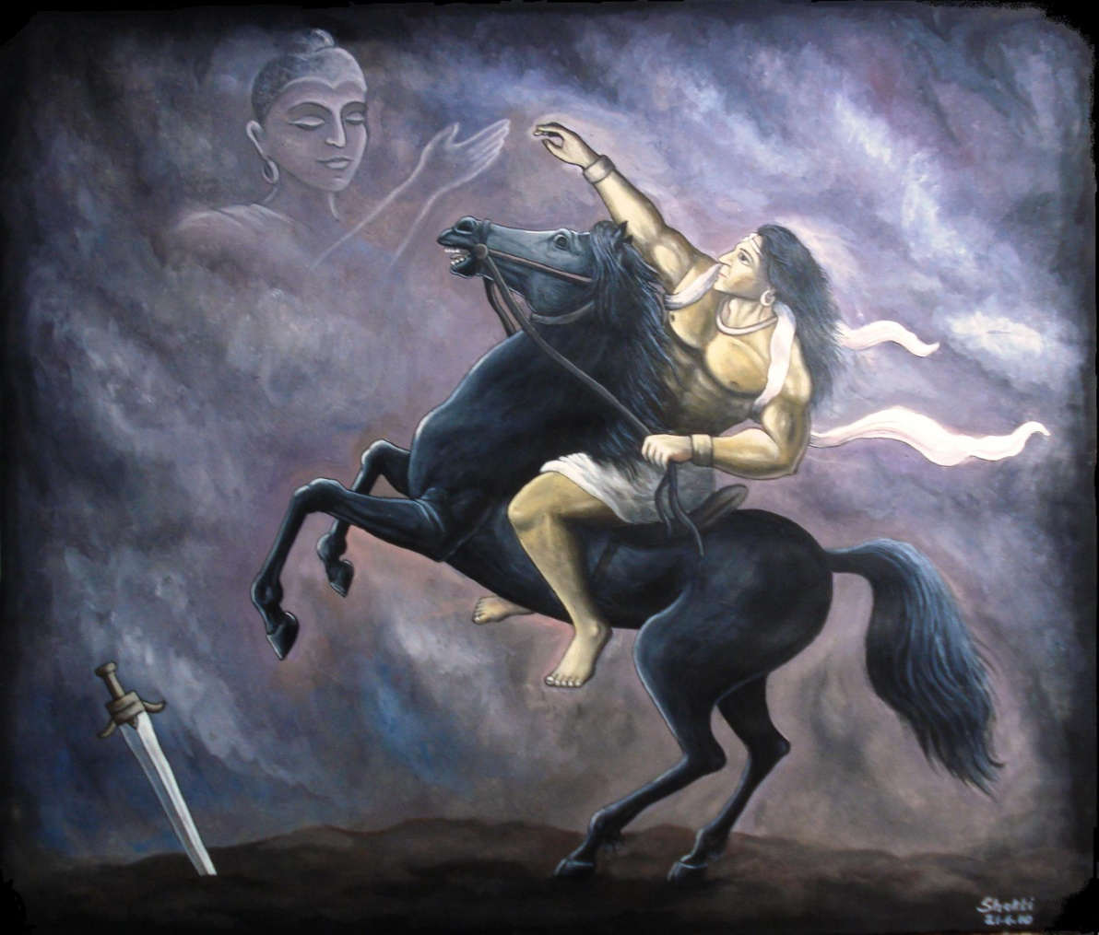
But it would be his grandson, Ashoka Maurya, who would take the empire to its greatest heights.

Slide 22
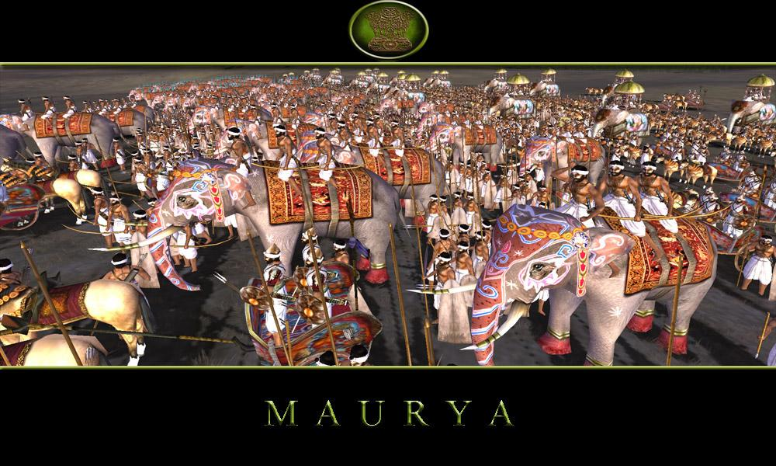
A major reason that the Mauryan Empire became so powerful and wealthy was trade.

Slide 23
Indians merchants traded in silk, cotton, and elephants (among hundreds of other things) to Mesopotamia and the eastern Roman Empire.

Slide 24
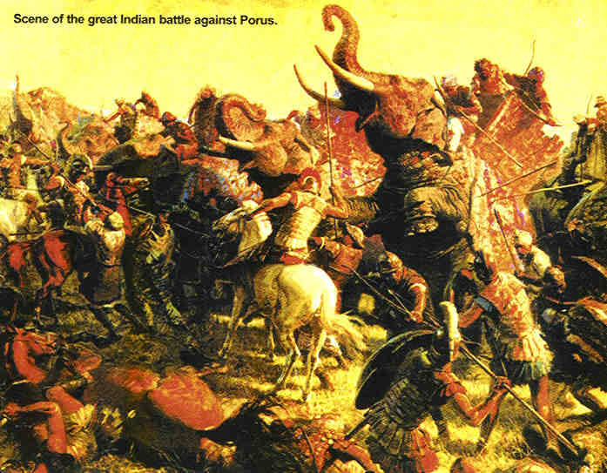
Another reason was its powerful military. Interestingly, it was its military strength that eventually caused a dramatic change in the empire.

Slide 25
Ashoka
6.32

Slide 26
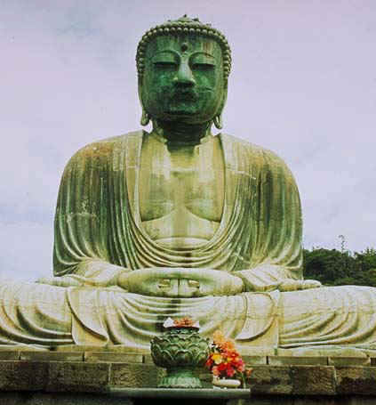
Stricken with disgust by, and filled with remorse for, a very violent and bloody victory his forces claimed over the Kalinga in southeast India, Ashoka converted to Buddhism.

Slide 27
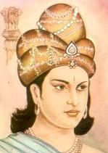
For the rest of his reign, Ashoka preached nonviolence and moderation.

Slide 28
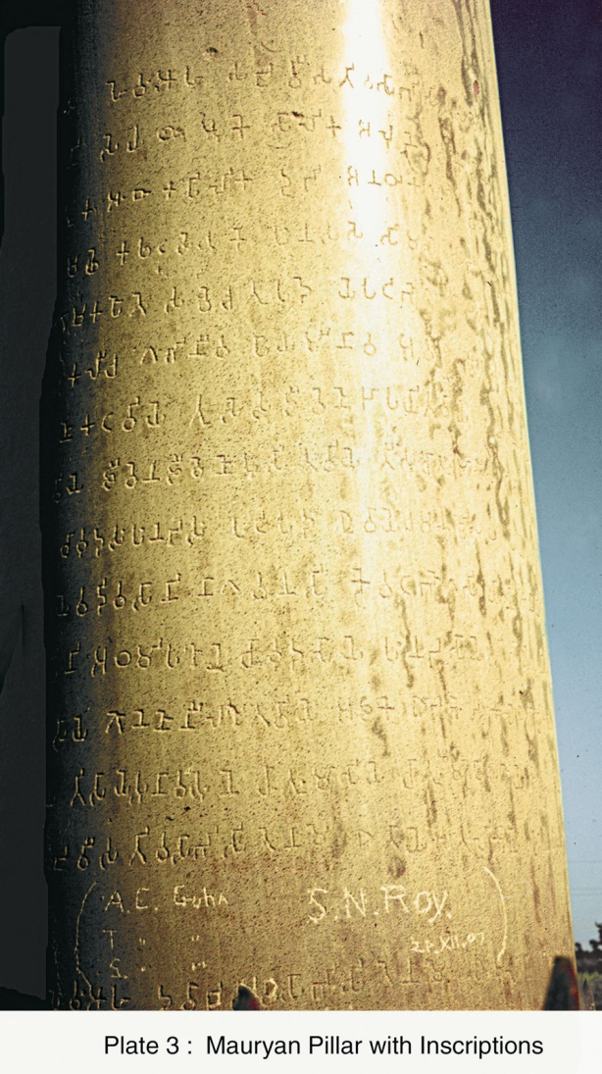
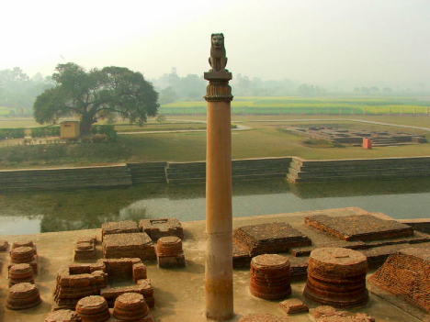
Ashoka is also known for his Rock and Pillar Edicts, which were carved on rocks and pillars throughout the empire.

Slide 29
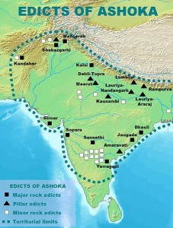
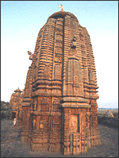
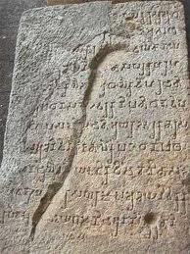
These edicts reminded Mauryans to live generous and righteous lives.

Slide 30
Edict ideas
General Welfare - people’s well being
Buddhist values - promoted Buddha’s teaching
Justice - concerning fair laws
Security - concerned with enemies and dealt with peace and conquest

Slide 31
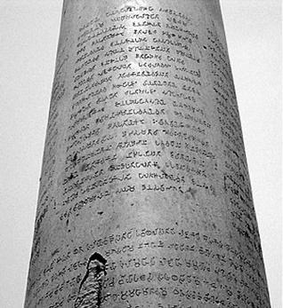
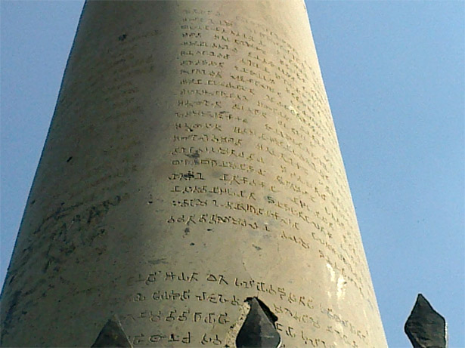

Slide 32
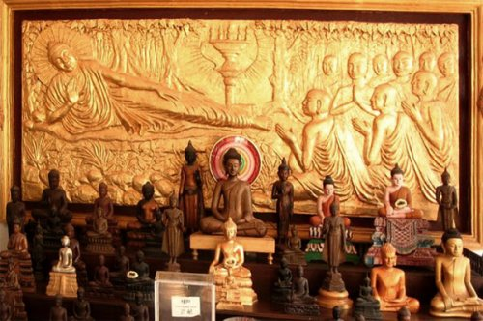
Following Ashoka’s conversion and commitment to Buddhism, the religion spread beyond India into many parts of Southeast Asia.

Slide 33
Mr. Nicky sums it up
4.04

