Slide 1
What is Energy?
Different Kinds of Energy Dec 9/10

Slide 2
Objective
I can identify 7 types of energy and understand how energy can change from one form to another. (energy transformation)

Slide 3
What is Energy?
It makes matter move or change
The ability to do work

Slide 4
Potential and Kinetic
Potential = stored energy
Kinetic = energy of motion

Slide 5
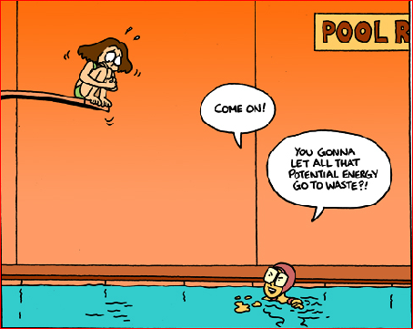

Slide 8
An introduction with Tim and Moby
Brainpop 1.52

Slide 9
Chemical Energy
What holds atoms in molecules together
Can be released by chemical reactions like burning wood

Slide 10
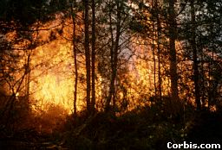

Slide 12
Electrical Energy
The movement of electrons through matter
Electricity is a form of electrical energy

Slide 13
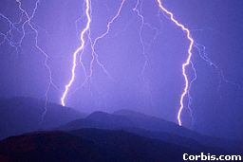

Slide 15
Thermal (heat) Energy
The random motion, or vibration, of atoms in matter
The faster the atoms vibrate the more heat energy they have

Slide 16
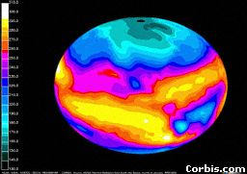

Slide 18
Light / Electromagnetic Energy
The energy carried by light
Yes, whenever you are looking at light, you are looking at energy

Slide 21
Mechanical Energy
The energy of moving things
When you ride a bike you use mechanical energy

Slide 22
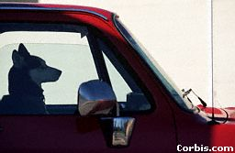

Slide 24
Nuclear Energy
Holds protons and neutrons together in an atom’s nucleus
Powers the sun and nuclear power plants

Slide 25
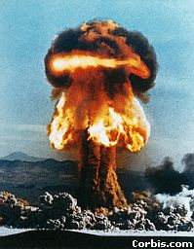

Slide 27
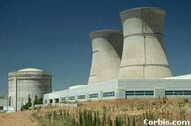

Slide 28
Sound Energy
Vibrates air molecules
The air molecules move tiny bones in your ear
The message of sound then moves to your brain
Can also vibrate objects

Slide 31
The Sun - a bit confusing
Nuclear?
Light?
Thermal? (yes, yes and yes)
Crash course - sun 3.03

Slide 32
Energy can be changed from one form to another
Chemical energy in gasoline is changed to heat energy and then to mechanical energy in a car

Slide 33
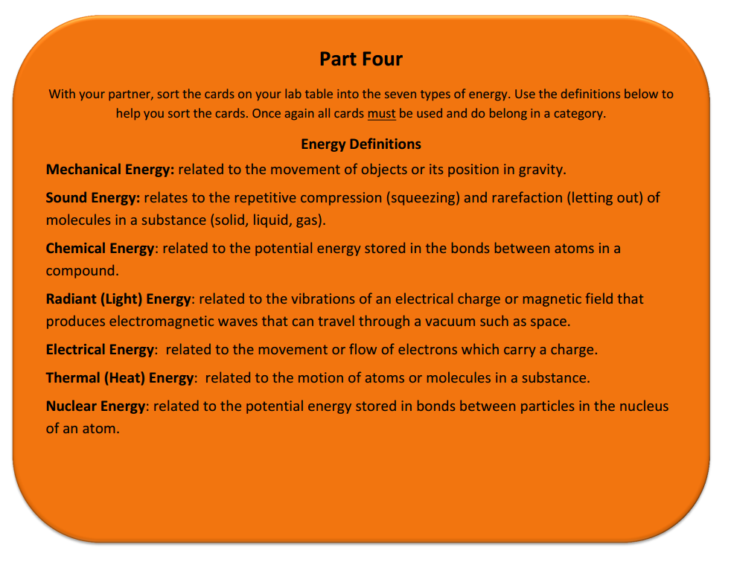

Slide 42
Now let’s try a few

Slide 46
Homework
Indicate which type of energy you see on the pictures on the worksheet

