Slide 1
Human Geography

Slide 2
Warm up
Grab a Social Studies Textbook and open to page 57. You will be taking notes on Human Geography for about 15 minutes. Read for understanding and see how many terms you can connect with. Be sure to look for bold words and key ideas.

Slide 3
Population - The total number of people who live in a specified area
What challenges does rapid population growth cause?
Make a quick list in your notebook of things you think might be challenges
video - stop at 3.43

Slide 4
Let’s see how you did
Kahoot it

Slide 5
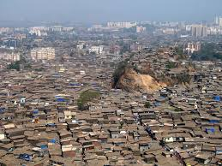
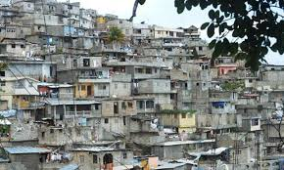
Greatest Challenges
Food
Clean water
Energy
Waste Management
Space
Squatter settlements as people move toward jobs and cities

Slide 6
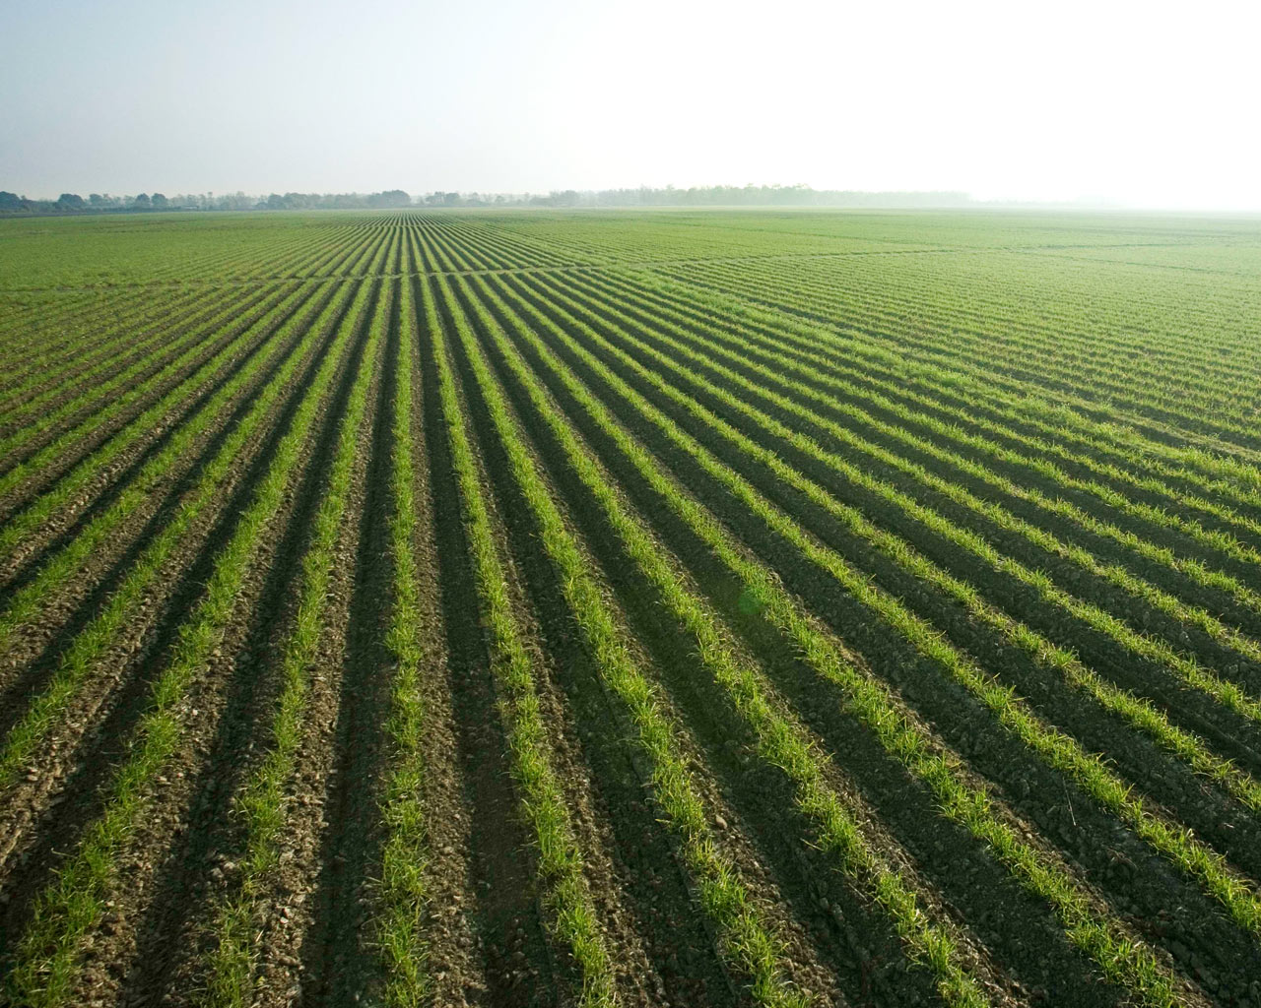
Why has our population increased?
Food Production and efficiency
Medical science discoveries
Improvements in sanitation
Technology

Slide 7
How do we Measure Growth
Birth Rate - Births per 1000 people per year
Death Rate - Deaths per 1000 people per year
Rate of Natural Increase - Death rate subtracted from birth rate
2014 article on us birth/death rates (time permitting)

Slide 8
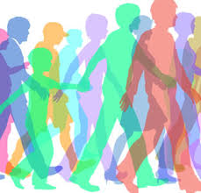
Demographer
A geographer who studies the characteristics of Human Population

Slide 9
Population Distribution - where people live
This is how the population of the world is distributed.
75% of the earth’s surface is water
35 - 40% of the land is too cold, hot wet or dry
⅔ of the world’s population live within 300 miles of ocean water

Slide 10
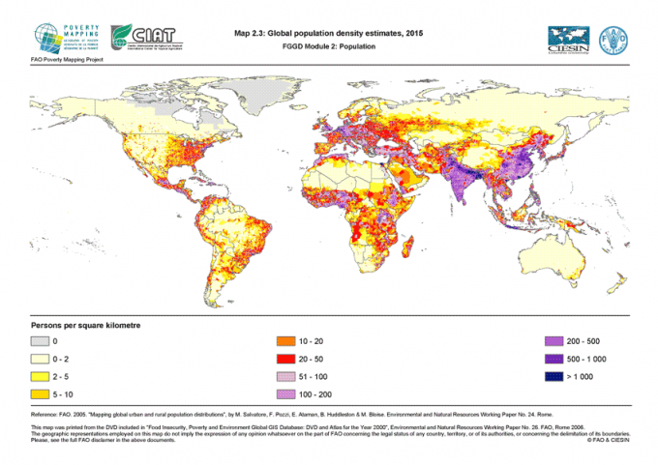
Population Density - How many people live in a space
Population Density shows on average how many people live within an average area like square mile

Slide 11
Rural vs Urban
Urban - Half the world’s population live in urban areas. (cities and their suburbs)
Rural areas - Farms and small villages
Urbanization - The process of developing small settlements into larger ones
100 years ago only 14% of the people lived in urban areas
by 2050 60% will!

Slide 12
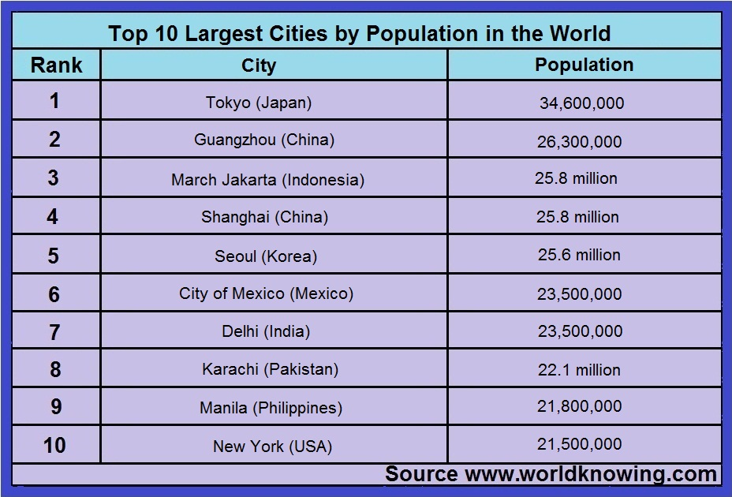

Slide 13
Let’s Try again
Kahoot

Slide 14
Homework
Answer 4 key questions from today. Use complete sentences!!!!!

