Slide 1
Heat Transfer

Slide 2
How does Heat Transfer
From Hot to Cold
Hot to Cold Song

Slide 3
Introductory demo video
Introduction

Slide 4
Three types of Heat Transfer
Conduction
Convection
Radiation

Slide 5
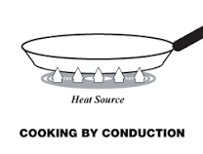
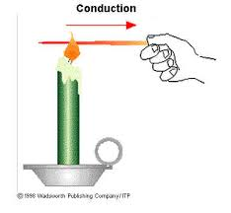
Conduction
The transfer of heat from one substance to another through direct contact.
The objects must be touching
for conduction to happen.
Eureka - Conduction

Slide 6
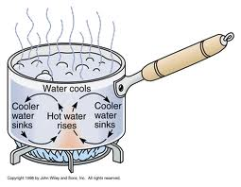
Convection
The transfer of heat from warmer places to cooler places in liquids and gases. Hotter molecules expand and rise and cooler molecules contract and sink until they heat again
Eureka - Convection

Slide 7
See Convection in a video demonstration
convection in motion
convection in bottles - make a prediction halfway through

Slide 8
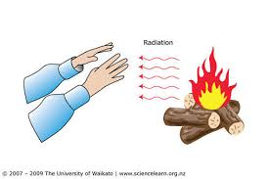
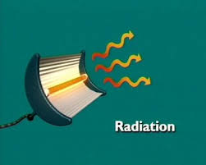
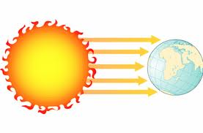
Radiation
Thermal energy transfer involving electromagnetic waves not particles. Remember the Electromagnetic Spectrum!
Eureka - Radiation

Slide 9
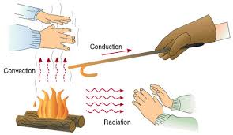
An example of all three at once!

Slide 10
Try this with a partner
Drag the examples to the correct place

Slide 11
Music to learn by
Mr - Parr Heating
OR
Mr. Parr Heat Transfer
If you prefer rap
One more for fun

Slide 12
To sum it up
Study Jams

Slide 13
More information if you want!
Text book like page!
Another one
One More

