Slide 1
Life in Two City-States: Athens and Sparta
History Alive Chapter 27

Slide 2
Athens and Sparta
Government
Economy
Education

Slide 3
Comparing Two City-States
Athens and Sparta
Greek City-States
150 miles apart

Slide 4
Athens
Located in central Greece
Four miles from the Aegean Sea
Athenians liked to travel
Encourage artists
Grew powerful through trade

Slide 5
Sparta
Sparta was more isolated
Located on a plain between a mountain
Part of the Peloponnesus
Grew much of what they needed
Attacked others for food

Slide 6
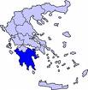
Peloponnesus
The peninsula forming the southern part of the mainland of Greece

Slide 7
Athens and Sparta
Athenians boasted of their art and culture
compare and contrast with Mr. Corwin
Spartans valued strength and simplicity
Horrible history
What was spartan training like - 8 mins

Slide 8
Athenian Government
Athens had a democracy
Citizens
Only men were considered citizens
Council
Assembly

Slide 9
Economy
A system of managing the wealth of a community or region.
Is the way a community or region organized the manufacture and exchange of money, food, products, and services.

Slide 10
Athenian Economy
Based on trade
Traded with city-states and some foreign lands.

Slide 11
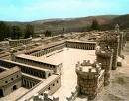
Athenian Economy
Bought and sold goods at huge market places called the agora.

Slide 12
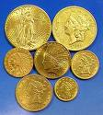
Athenian Economy
Developed their own coins for trade.
One side of their coins had an image of the goddess Athena.

Slide 13
Education in Athens
Athenians believed in creating good citizens
Sharp mind and healthy body
Physical training and book learning
At 18, men began military training.

Slide 14
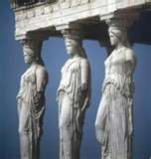
Education in Athens for Girls
Most girls did not learn to read and write
Taught to cook, clean, spin thread, and weave cloth.
Girls married at age 15.

Slide 15
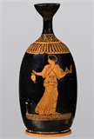
Women in Athens
Few rights
Could not inherit or own property
Could not pick their husband
A few women had jobs
Most women managed the home and children

Slide 16
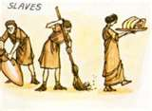
Slaves in Athens
Many slaves in Athens
Most people owned slaves
Slaves performed many jobs
The unluckiest slaves were worked in the silver mines

Slide 17
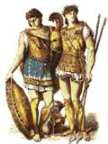
Spartan Government
Sparta was an oligarchy.
Council of elders made important decisions.
Assembly

Slide 18
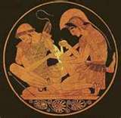
Spartan Economy
Relied on farming and fighting.
Turned their conquered neighbors into slaves
Non-citizens served in their army and made necessary items for soldiers.
They also traded.

Slide 19
Spartan Economy
In general, discouraged trade.
Feared contact with other would lead to new ideas and weaken
Sparta did not have coins, they used heavy iron bars.

Slide 20
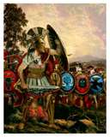
Education in Sparta
Purpose of education to produce men and women who could protect the city.
Spartans valued strength.

Slide 21
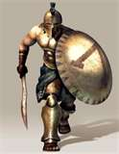
Education in Sparta
From age 7 boys were trained to fight
Boys and girls received military training.
Spartan boys lived and trained away from their family.

Slide 22
Spartan boys
Were taught to suffer without complaining.
Marched without shoes.
Were not fed well.
Encouraged to steal food.
Beaten for being good or bad.

Slide 23
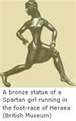
Women in Sparta
Simple life
Plain clothing
Strong and healthy
Ready to fight
Look after husband’s property
Guard against invaders

Slide 24
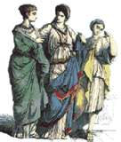
Spartan Women Rights
Free to speak with husband’s friends
Could own and control property
Marry another man if first husband was away too long

Slide 25
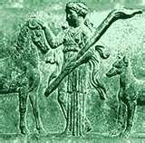
Slaves in Sparta
Helots were Spartan slaves who had been conquered.
Spartans treated their slaves harshly.
The government would declare war and kill the helots.

Slide 26
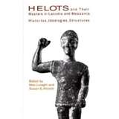
Spartan Slave Rights
Marry who they wanted.
Pass on name to their children.
Sell any extra crops.
Saved enough money they could buy their freedom.

Slide 27
The End

