Slide 1
Daily Life in Ancient Egypt
History Alive
Chapter 9

Slide 2
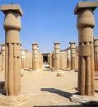
Daily Life in Ancient Egypt
During the New Kingdom
1600 – 1100 B.C.E.

Slide 3
Flocabulary
walk like an Egyptian

Slide 4
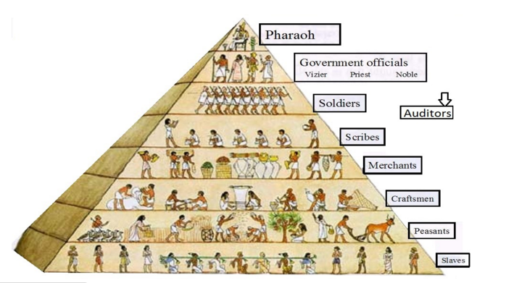
Ancient Egyptian’s Social Pyramid
Pharaoh
Gov. Officials
Priests
Scribes
Artisans
Peasants
Egyptian society was structured like a pyramid.
Pharaoh’s were looked upon like gods.

Slide 5
Ancient Egyptian’s Social Pyramid
Classes (groups of people) near the top had few people and high status.
Classes near the bottom had more people and lower status.

Slide 6
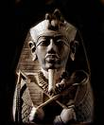
Egypt’s Social Classes
Pharaoh’s were considered to be a god.
They had supreme authority.

Slide 7
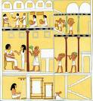
Life in Egypt’s Social Class
Fairly rigid
Little chance to move to a higher class

Slide 8
Lives of Luxury
Nobles with great wealth, fine homes, and time to socialize.
Lavish banquets
Wore perfume
Banquets with servants who waited on them.
Musicians, dancers, and acrobats entertained the guests.

Slide 9
Government Officials & Priests
also called Nobles
Carried out orders of the Pharaoh
Noble families
Powerful
Wealthy
Enjoyed a good life

Slide 10
Government Officials
Belonged to the highest class
Inherited their positions from their family
A vizier served as a kind of chief judge
Imhotep was famous for his role in designing the great pyramid.

Slide 11
Priests
Powerful and well respected
The High Priest served directly under the Pharaoh
Oversaw all religious ceremonies.
Gave advice performed healings.

Slide 12
Priests
Temple priests had to take care of the god.
A temple’s god was thought to live in a statue.
The statue was housed in a holy room called a sanctuary.

Slide 13
The Priest’s Role in Burial Practices
Egyptians believed in life after death.
Spirits of the dead needed their body in the afterlife.
They preserved bodies from decay through embalming.

Slide 14
Scribes
Respected position in society
Recorded information for government officials and religious leaders
It took many years to be a scribe.

Slide 15
Scribes
Below priests
Egypt’s official writers and record keepers
Only worked for priests or nobles
Rise above parent’s social class

Slide 16
Scribe School
Schools were run by priests
Most students came from artisan or merchant families
A few came from peasants
Start at age 5 and study for 12 years
Students had to learn 700 hiegroglyphs

Slide 17
Artisans
Craftspeople like carpenters, metal-workers, painters, sculptors, and stone carvers.
Highly skilled.
Little social status.

Slide 18
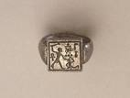
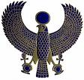
Artisans
Artisans were highly skilled laborers
Rarely got the respect they deserved
Carpenters, jewelers, leatherworkers, metalworkers, painters, potters, sculptors, and weavers.

Slide 19
Peasants / farmers
Largest social class
Worked the land, provided Egypt with a stable food supply.
When they weren’t farming they were working on the pharaoh’s building projects.

Slide 20
Peasants / Farmers
Lowest and largest social class in Egypt
Peasants grew crops
Egypt has three seasons—flooding, planting, and harvest season.

Slide 21
Slaves and Servants
Did chores and lower forms of work
May have been captured in war
Owned by a person or a temple
Could be rented out
Treated decently and sometimes even adopted as members of the family

Slide 22
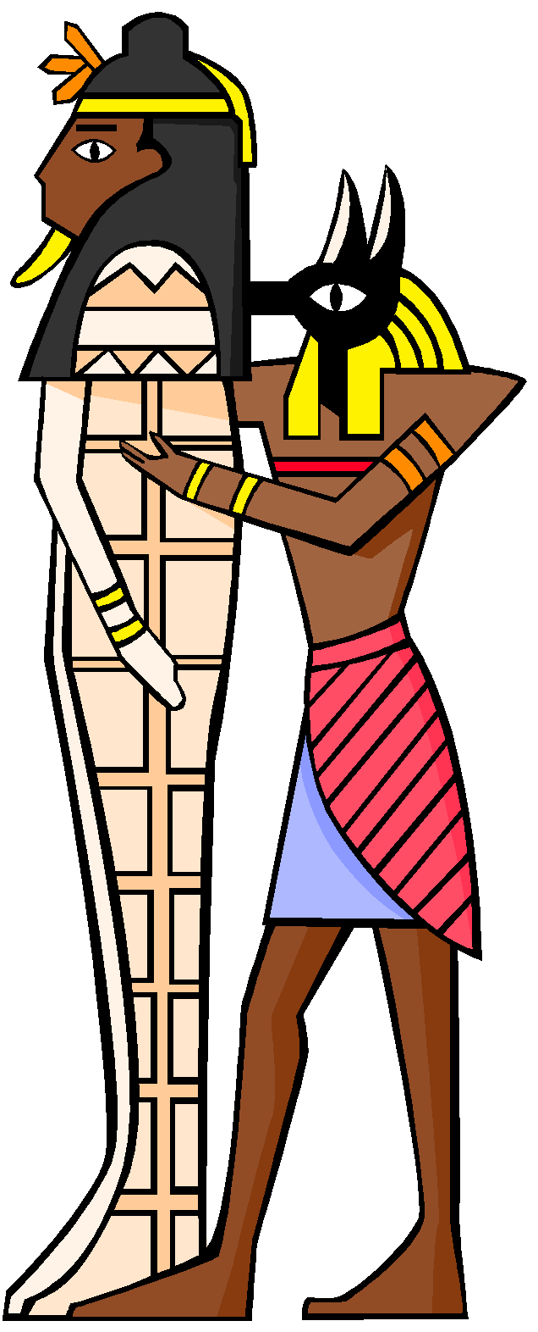
The End

