Slide 1
THE ANCIENT EGYPTIAN PHARAOHS
History Alive
Chapter 8

Slide 2
Warm Up

Slide 3
Objective
I can use multiple sources to learn about the Pharoahs of Egypt and how they influenced Egyptian Culture

Slide 4
Review Homework
Questions 1 - 8 and 4 vocabulary words

Slide 5
Ancient Egypt
Old Kingdom
Middle Kingdom
New Kingdom

Slide 6
Overview
5 minutes overview of the kingdoms

Slide 7
Old Kingdom
2700 – 2200 B.C.E.
Early pharaohs set up a strong central government.
Built great pyramids.

Slide 8
The Old Kingdom - 4minutes

Slide 9
Middle Kingdom
2000 – 1800 B.C.E.
Period of Reunification because it followed chaos and disunity.
Many great achievements in literature, art, and architecture.

Slide 10
New Kingdom
1600 – 1100 B.C.E.
Egypt’s Golden Age.
Peace and Stability
Egypt was very powerful.
Trade
Building Monuments.

Slide 11
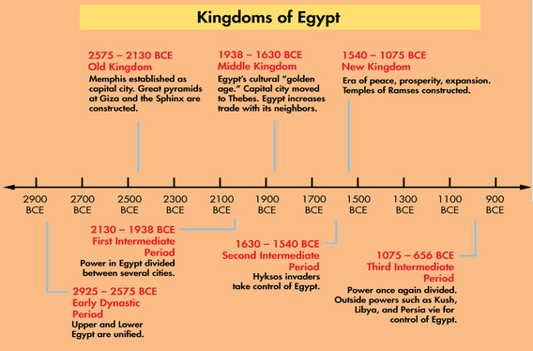
From Discovery Education

Slide 13
Pharaoh Khufu
Ruled from 2551 – 2528 B.C.E.
Builder of the Great Pyramid at Giza.
Organized a central government.

Slide 14
Pharaoh Senusret I: Patron of the Arts
Ruled from 1971 – 1926 B.C.E.
Ruled a stable and unified Egypt.
Religious architecture.
White Chapel.

Slide 15
Pharaoh Hatshepsut: Promoter of Egyptian Trade
Ruled from 1473 – 1458 B.C.E.
First Female Ruler

Slide 16
Hatshepsut
She had loyal advisors.
She demanded respect.
She wore men’s clothing and a fake beard.

Slide 17
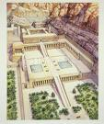
Hatshepsut
Built a great temple at Dayr al-Bahri.

Slide 18
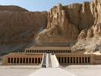
Hatshepsut
Promoted Trade
Detailed carvings portrayed trade voyages to Punt.

Slide 19
Pharaoh Ramses II: Military Leader & Master Builder
He ruled from 1290 to 1224 B.C.E.
Called Ramses the Great.
He reigned for more than 60 years.
Best known for military leadership and building monuments.

Slide 20
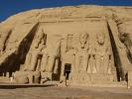
Abu Simbel
Temple complex at Abu Simbel.
A smaller temple honored his wife Nefertari.

Slide 21
Ramses II
One of the best preserved mummies.

Slide 22
THE END

