Slide 1
Geography and the Early Settlement of Egypt, Kush, and Canaan
History Alive
Chapter 7

Slide 3
Objective
I can evaluate the impact the geography had on the development of settlements by examining media and reading maps to draw conclusions and make comparisons.

Slide 4
Three Civilizations
Egyptian
Kush
Hebrew Civilizations

Slide 5
Environmental Factors and Human Settlement
Water
Topography
Vegetation

Slide 6
Water
Most important environmental factor.
People need water to live.
Water is also a source of food, because people catch fish and hunt birds near water.
Farmers use water.

Slide 7
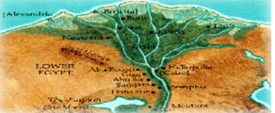
Topography
Refers to the shape of the land or surface features.
Includes features like mountains, hills, plains, and deserts. These impact how people live.

Slide 8
Topography
Farmers settled in flat, open areas such as plains and valleys.
Large spaces gave room to grow crops.

Slide 10
Vegetation
Plant life
Trees, bushes, flowers, grass, and reeds.
Crops people grow are types of vegetation.

Slide 11
Vegetation influenced human settlement
Plants were a source of food.
People ate both wild and domesticated crops.
People learned to make products out of plants like baskets, ropes, tools, and paper.
Papyrus – a tough reed like water plant used to make many of the things listed above

Slide 12
Review?
Three environmental factors that shaped human settlements in the ancient world?
Water
Topography
Vegetation

Slide 13
Physical Features of Egypt and Kush
An aspect of the land, such as mountains, plateaus, and rivers.

Slide 14
Important Features of Egypt and Kush
Deserts
Formed a natural boundary.
Libyan Desert
Arabian Desert
Nubian Desert

Slide 15
Delta
A long fertile valley that ended in a marshy delta.

Slide 16
Bodies of water
Mediterranean Sea
Red Sea
Nile River

Slide 17
Nile River
Source of fresh water.
Nile river provided natural irrigation and fertilization.
Fresh water provided fish to catch and animals to hunt.
Vegetation near the Nile river included papyrus.

Slide 18
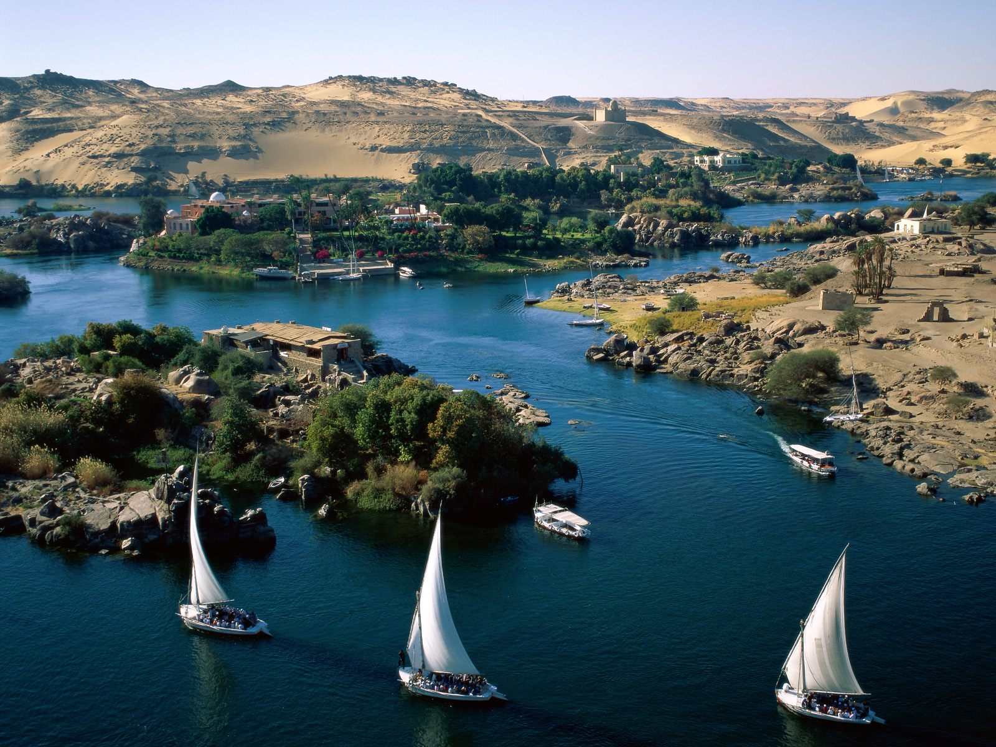
Daily Life
The Nile Today

Slide 19
A video Map Tour
4.28
a video tour (like Soarin but not as good)
7.28

Slide 20
Physical features of Canaan
Plains and valleys
Hills and mountains
Deserts
Bodies of water

Slide 21
Canaan’s Bodies of Water
Sea of Galilee
Dead Sea
Jordan River
Mediterranean Sea

Slide 22
Dead Sea
Where everybody floats. Why?

Slide 23
Jordan River
Most important source of fresh water.
Dead Sea was so salty that nothing grew in it.

Slide 24
Canaan’s topography influenced settlements
People became herders rather than farmers.
Herders were nomads they lived in different places.

Slide 25
The End

