Slide 1
From Hunters and Gatherers to Farmers
History Alive
Chapter 3

Slide 2

Stone Age
Gets its name from the tools people made of stone.
Began with the first tool making hominids about 2 million years ago.
It lasted until 3000 B.C.E.

Slide 3
Stone Age
Is divided into two parts.
Paleolithic Age
Neolithic Age

Slide 4

Paleolithic Age
The Old Stone Age
Hunted wild animals
Gathered nuts, berries, and other plants.
Lived much of their lives on the open.
Rarely stayed in one place very long.

Slide 5
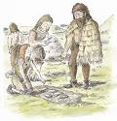
Neolithic Age
8000 B.C.E. Some groups had learned how to raise animals and crops for food.
With this discovery the Neolithic Age or New Stone age began.
People stared to settle down in one place.

Slide 6
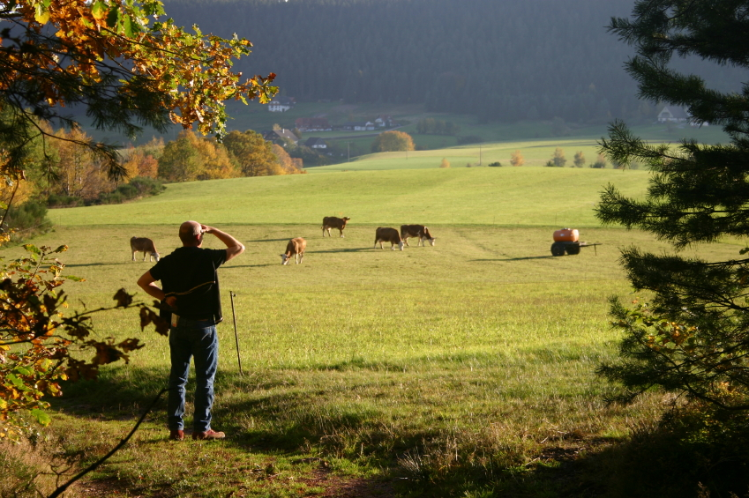
Shift
From Hunters and Gatherers to Farmers
One of the most important advances for mankind.

Slide 7
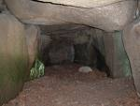
Paleolithic or Old Stone Age
Began 2 million years ago.
Early modern humans began to develop.
Often they took shelter in caves.

Slide 8

Neolithic or New Stone Age
Began when people learned to farm and produce their own food.
Eventually, they relied on farms for their food.
Began around 8000 B.C.E. and ended about 3000 B.C.E.

Slide 9
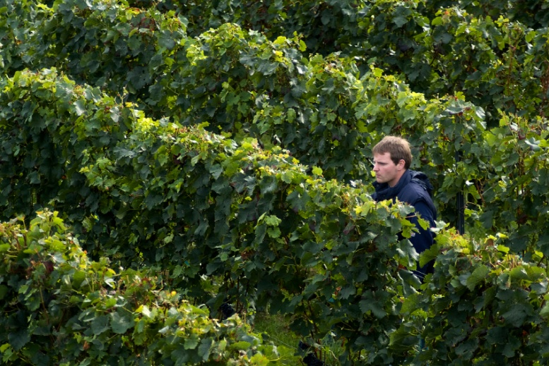
During the Neolithic Age
People could…
Create a stable food supply.
Make Permanent shelters.
Establish communities.
Establish New Jobs.
Begin to Trade.
This helped people to build larger cities
And create the first civilizations.

Slide 10
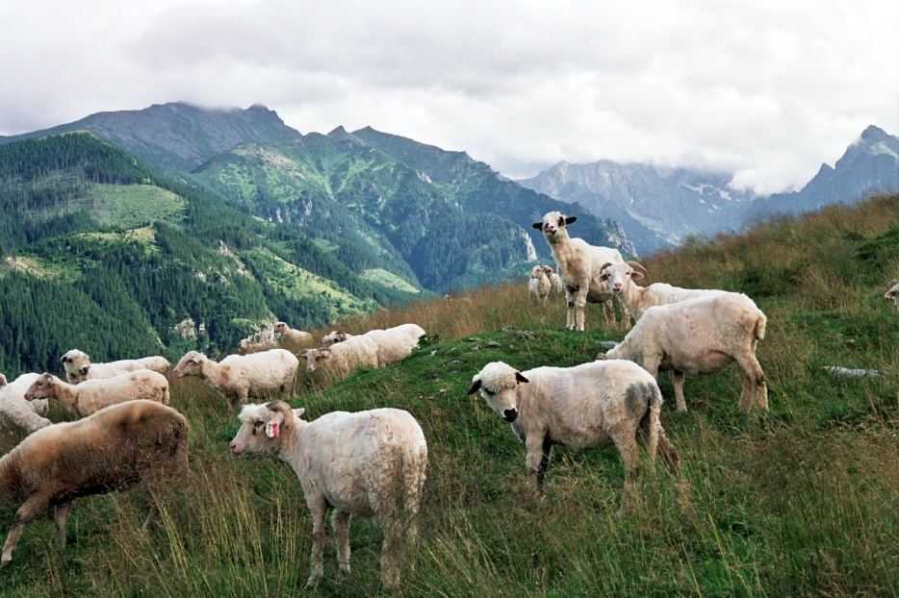
Creating a Stable Food Supply
People learned to plant seeds and harvest crops.
Farmers learned to domesticate sheep, goats, and cattle.

Slide 11
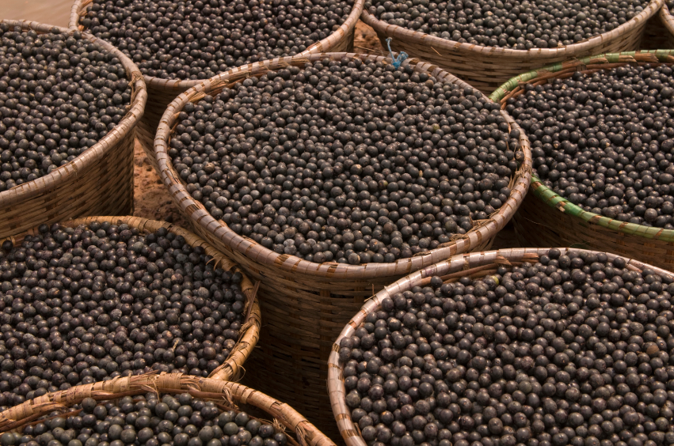
Agriculture
Together the growing of crops and the domestication of animals is called agriculture.

Slide 12
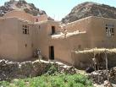
Making Permanent Shelters
Mud brick houses.
Houses had openings high in the walls.
Living in permanent shelters protected people from the elements.
People formed larger communities.

Slide 13

Establishing Communities
People were able to live in communities.
Villagers worked together to complete a task.
Larger communities could also defend themselves more easily.

Slide 14

Developing New Jobs
Having a stable food supply allowed people to develop new jobs.
Farmers, weavers, basket makers, toolmakers, potters, and traders.

Slide 15
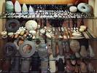
Beginning to Trade
Resources
Contact with other groups
Spread Ideas and knowledge
Notes:
Beads that would have been traded.

Slide 16
The End
Courtesy of Frost Middle School

