Slide 1
Early Hominids
History Alive
Chapter 2

Slide 2
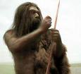
Hominids
Prehistoric humans

Slide 3
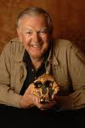
Paleoanthropologists
Anthropologists study human development and culture.
Paleoanthropologists specialize in studying the earliest hominids.

Slide 4
Donald Johanson
In 1974
An exciting discovery
Female hominid
Named “Lucy” because he was listening to “Lucy in the Sky with Diamonds.”
3 million years old

Slide 5
Hominids
Hominids differ by what capabilities they have.
Capability is a skill.

Slide 6
Australopithecus Afarensis: Lucy and her relatives
Lived about 3 to 4 million years ago.
Combination of Ape and human features
Biped which means that she walked on two feet.
With their hands free, she could gather and carry food.
They could also used their hands to defend themselves and their children.

Slide 7
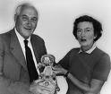
Homo Habilis: Handy Man
Were discovered by Louis and Mary Leakey.
Were called Handy Man because they could make tools.

Slide 8
Homo Habilis: Handy Man
Lived 1 to 2 million years ago.
Combination of Ape and Human features.
Bipeds
Taller than Lucy.
Brains twice the size as Lucy’s.
Remains only in Africa.

Slide 9
Homo Erectus: Upright Man
Discovered in 1891 by Eugene Dubois off the Island of Java.

Slide 10
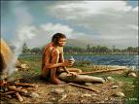
Homo Erectus: Upright Man
Lived from 1.8 million to 200,000 B.C.E.
First hominid to migrate out of Africa.
Taller and thinner than earlier hominids.
Face looked more like modern humans.
Able to invent more complex tools and travel with fire.

Slide 11
Homo Sapiens Neanderthalensis: Neanderthals
In 1856, some mine workers in Germany’s Neander Valley found a skeleton.

Slide 12
Homo Sapiens Neanderthalensis: Neanderthals
Lived from 230,000 to 30,000 years ago.
Lived in Africa, the Near East, Europe, and parts of Asia.
Walked upright.
More than 60 types of tools have been found.
They were able to work, travel, and lives in groups.

Slide 13
Homo Sapiens Sapiens: Early Modern Humans
In 1879, a Spanish Girl named Maria was exploring a cave with her father.
She found the first prehistoric cave paintings in Lascaux, France.

Slide 14
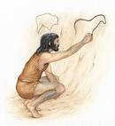
Homo Sapiens Sapiens: Early Modern Humans
Lived between 35,000 to 12,000 B.C.E.
Doubly Wise Humans
Originated in Africa
Europe, Asia, and Australia
Expert Tool Makers
Better hunters
The first artists.

Slide 15
The End

