Slide 1
Geography and the Early Settlement of China
History Alive
Chapter 19

Slide 2
Warm UP
Copy your homework
Read the passage of the Terra Cotta Warriors and answer the questions

Slide 3
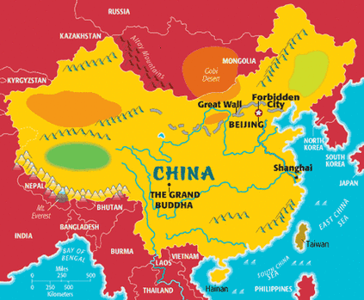
An Introduction
Listen to the video on the website and take notes.
https://www.google.com/search?q=map+of+ancient+china&espv=2&biw=1920&bih=971&tbm=isch&tbo=u&source=univ&sa=X&ved=0ahUKEwiL_ufK0qDLAhWBZiYKHSRuACIQsAQIGw#imgrc=Epc7qJPAKX6SgM%3A

Slide 4
Ancient China’s Isolation
China’s geography kept the early settlements in Inner China isolated.
You learned about the different ways that China was isolated, now go on through the powerpoint to label your map of China and learn more

Slide 5
An Overview of China’s Geography
Third largest country in the world.
About 1.2 billion people live in China.
Divide China into two main areas—Outer China and Inner China.

Slide 6
The Geography of Outer China
Outer China includes western and northern parts of present day China.
In the southwest China is bounded by the Himalaya Mountains.

Slide 7
The Geography of Inner China
Southeastern part of present-day China.
Closer to sea level
Land of rolling hills, river valleys, and plains.
Rivers enrich the soil by flooding.

Slide 8
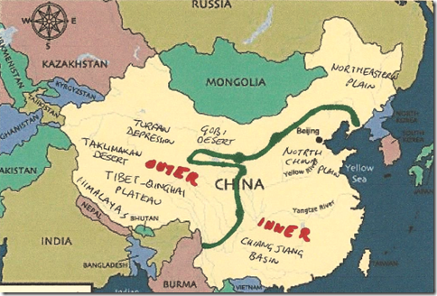

Slide 9
Label these Waterways in China
Color these blue
Yellow (Huang He)
Yangtze River (Chang Jiang)
Pearl River
Songhua River
South China Sea

Slide 10
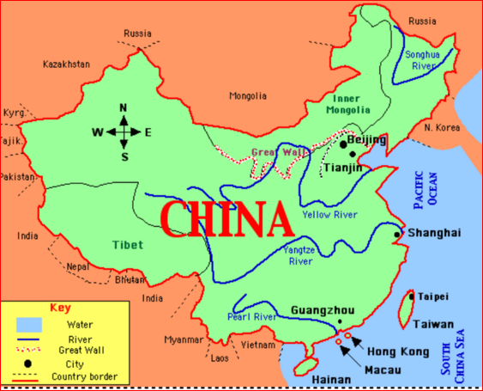

Slide 11
Label these Plateaus in China
Color these light green
Loess Plateau
Tibetan Plateau
(Make sure you have a definition from the video!)
*****also label the Himalaya Mountains

Slide 12
The Tibet-Qinghai Plateau
Climate is very cold
Air is thin and dry
Snow falls year long

Slide 13
The Tibet-Qinghai Plateau
Southwestern part of China
Roof of the World
Covers 25% of China
Elevation is 2 miles above sea level

Slide 14
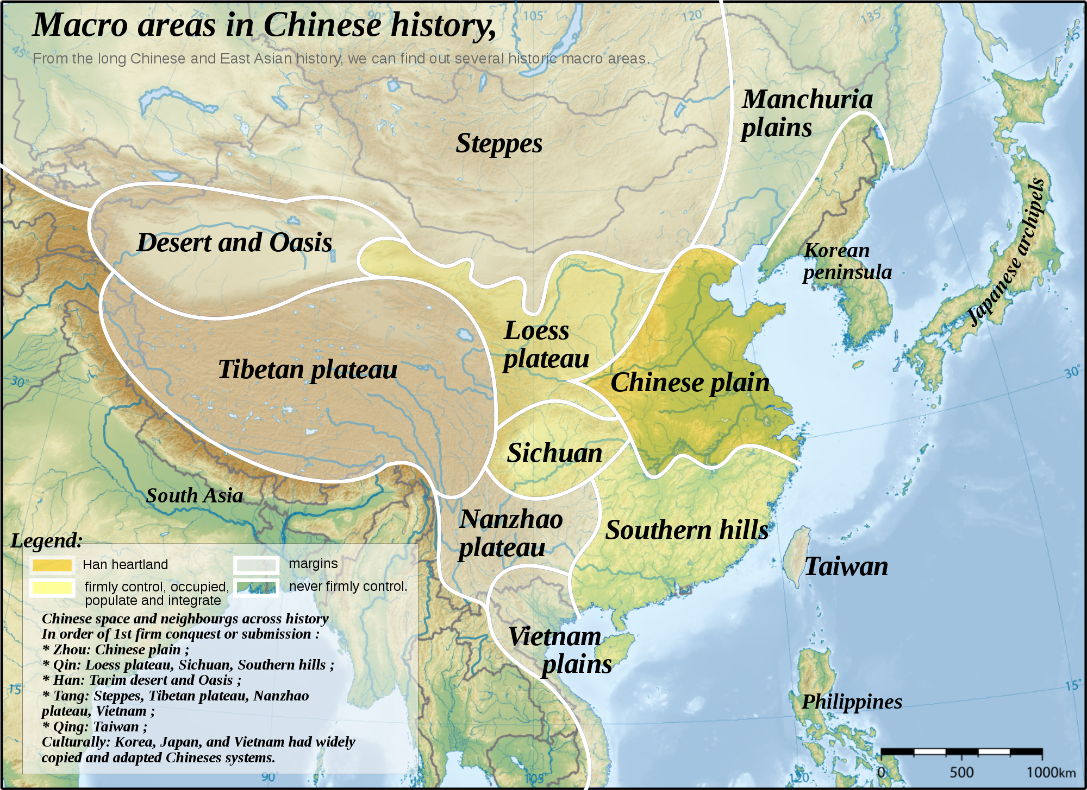

Slide 15
Deserts in China
Taklimakan
Gobi
color these
brown

Slide 16
China’s Northwest
Northwestern Deserts
Area includes the second lowest place in China called the Turfan Depression. (550 feet below sea level)
It’s so hot that raindrops evaporate before reaching the ground.

Slide 17
The Gobi Desert
Stretching 500,000 square miles.
One of the world’s largest deserts.
Most of the desert is made up of small pebbles.

Slide 18
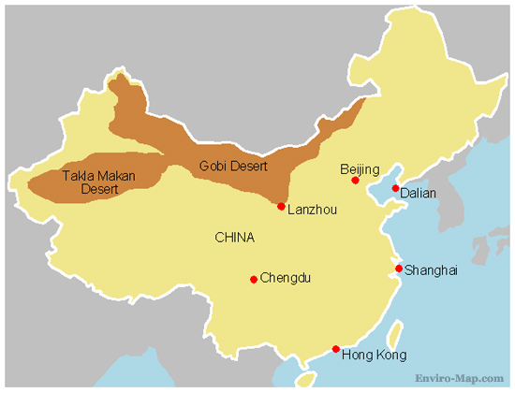

Slide 19
Plains in China
Color these dark green
North China Plain
Northeastern Plain
Chang Jiang Plain (Basin)
Plain - a large flat area with few trees
Basin - an area of land drained by a river and its branches and tributaries

Slide 20
Tibet-Qinghai Plain
Major geographical area and the world’s largest plateau.
Bitterly cold.
50 days a year without frost or snow.
Snowstorms common even in July.

Slide 21
The Tibet-Qinghai Plateau
Natural Vegetation is sparse scrubs and grasses.
Antelopes and Yaks (a type of ox) roam the area.
Wolves and Wildcats hunt the animals in the area.

Slide 22
The Tibet-Qinghai Plateau
Legend says 300 cities are buried 600 feet beneath the sand dunes.

Slide 23
Northeast Plain
Northeastern Plain
Low Hills and plains.
Short, hot summers.
Winters are long and dry.
Five months of freezing temperature.

Slide 24
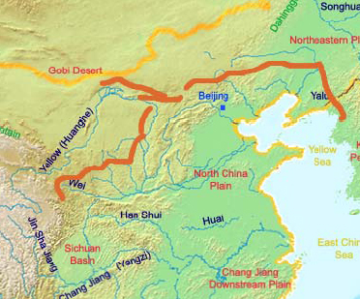

Slide 25
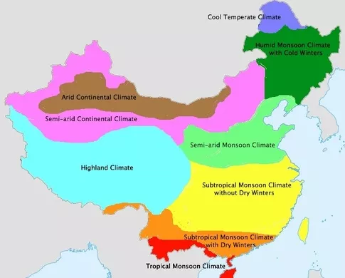
Climate of China

Slide 26
The Tibet-Qinghai Plateau
Two of China’s major rivers begin in this area the Huang He (Yellow River) and the Chang Jiang (Yangtze River)
The plateau is rather dry

Slide 27
The Taklimakan Desert
105,000 square miles
A dangerous desert
“Once you go in, you will not come out”
Sand dunes and sandstorms

Slide 28
The Northeastern Plain
Located in present-day Mongolia.
Land of low hills and plains.
Natural vegetation is mostly prairie grass.

Slide 29
The Northeastern Plain
The plain is too cold and dry to be a good place for growing crops.
This plain was the route several groups of invaders took into Inner China.

Slide 30
The North China Plain
Flat region of grassland in Inner China.
Temperatures range from very cold to quite warm.
Called the “Land of the Yellow Earth”
Covered by a yellow limestone silt

Slide 31
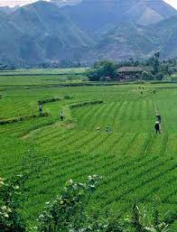
The North China Plain
Silt are fine particles of rock
The silt gives the river its name, Huang He or Yellow River.

Slide 32
Early Settlement in Ancient China
First inhabitants lived in caves 500,000 years ago.
Peking Man found in the 1920’s.
Lived by hunting, gathering, and fishing.

Slide 33
Early Settlement in Ancient China
While people began farming they settled mostly in the North China Plain in Inner China.
They lived near the Huang He.

