Slide 1
THE ACHIEVEMENTS OF THE GUPTA EMPIRE
History Alive Chapter 18

Slide 2
Warm Up
The Gupta Empire set up a central government with a counsel to help the king make decisions. Under this, the empire was divided into provinces. Each province was ruled by a royal governor who could make many decisions for that province.
In what ways is this set up similar to the government of the United States?

Slide 3
What happened after the Mauryan Empire fell?
India broke apart into small kingdoms that fought for power and land
This lasted for 500 years
The Gupta empire then took over ruled by CHandragupta I (some say he took the name in honor of the great Mauryan ruler)

Slide 4
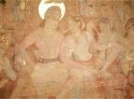
Golden Age
A time of great prosperity and achievement.
Peaceful times allow people to spend time thinking and being creative.
Hinduism returns as the dominate religion

Slide 5
Chandragupta I
The Guptas united the northern kingdoms by conquering them through war.
Formed alliances through marriage.

Slide 6
Guptas
Gave local areas or provinces a lot of independence.
The Guptas stayed in power for nearly 230 years.

Slide 7
Great Achievement in the Gupta Empire
Universities
Literature
Painting
Sculpture
Metalwork
Mathematics
Roads

Slide 8
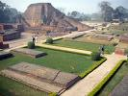
Universities
Time of great learning
Hindu and Buddhist universities
No women were allowed to attend, except for the daughter’s of teachers
Hindu universities were designed for the upper classes.

Slide 9
Nalanda
Famous Buddhist school.
Eight colleges
Three libraries
Hospital
Monastery
Students instructed in both Buddhist and Hindu philosophy

Slide 10
Literature
Gupta writers created many types of literary works.
They wrote poetry, fables, and folktales, and plays.
Hindu law and religion

Slide 11
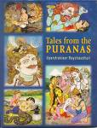
The Puranas (“Ancient Lore”)
Described many Hindu legends
The stories were passed down through the oral tradition

Slide 12
The Mahabharata (“Great Work”)
All the stories from the Puranas were finally written down.
The stories were hundreds of years old.
Themes relate to Hindu values of good versus evil.

Slide 13
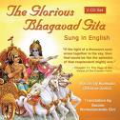
Bhagavad Gita (“Song of the Lord”)
Part of the Mahabharata
Beautiful poem and beloved work
Prince Arjuna is taught basic truths of Hinduism by Krishna, an earthly form of the deity Vishnu.

Slide 14
Gupta Literature Spread
Beyond India to Greece and Persia.
The famous Arabian tale about Aladdin and his magic lamp was inspired by a Gupta folktale.

Slide 15
Painting
Gupta empire famous for its beautiful paintings
Subjects included deities and other religious topics
Paintings were created on long scrolls

Slide 16
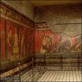
Anjanta Cave Murals
Murals cover the walls of thirty caves
Ancient Buddhist monastery
Paintings are done in bright colors like red, purple, and green.
Artists made paints from minerals and clay.

Slide 17
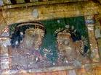
Ajanta Cave Murals

Slide 18
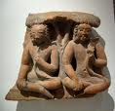
Sculpture
Sculptors created statues made out of stone, wood, bronze, and terra-cotta clay.
Many portrayed Buddhist or Hindu deities.

Slide 19
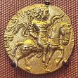
Metalwork
Gupta kings controlled huge mines of gold, copper, and iron.
Gold and copper coins honoring Gupta rulers

Slide 20
Ironworks
Part of metalworks
Iron pillar at a place called Meharauli is an impressive and mysterious examples of their skill.
Pillar made of solid iron, stands 25 feet tall, weights 13,000 pounds.

Slide 21
Mathematics
Write whole numbers 1-9.
Used decimals system to write numbers.
Hindu mathematicians were the first to use the zero as a number.
Arabic numerals began wish the Indian system of numbers.

Slide 22
Aryanhata
Combined math and astronomy.
He figured out that a year was exactly 365.258 days long.
Calculated the approximate size of the earth.
Proposed planets were like balls or spheres.
Suggested the earth spins on an axis.

Slide 23
Mathematics Practical Uses
Gupta builders used mathematics to design more complex structures.

Slide 24
Roads
Gupta rulers encouraged trade by creating a huge system of well built roads.
Roads built with care and precision.
Signs told travelers where they were.
Empire greatly benefitted from trade.

Slide 25
Roads
Connected India to China and the lands east of the Mediterranean Sea.

Slide 26
A few extensions
Crash Course
fall of the empire 1.28

Slide 27
THE END

