Slide 1
Unlocking the Secrets of Mohenjodaro
History Alive Chapter 14

Slide 2
Introduction
Mohenjo Daro is located near the Sarasvati River.
Settlements are known as the Indus-Sarasvati civilization or Harappan civilization.

Slide 3
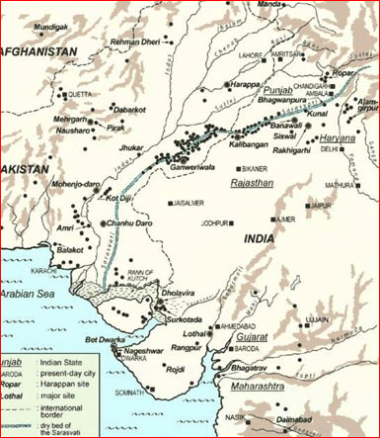
But it’s not on my map!!
Saraswati River

Slide 4
Harappan civilization
intro 2 mins
intro 4.34
tour
Flourished for 800 years from about 2700 B.C.E. to 1900 B.C.E.
No one knows how these cities were destroyed.

Slide 5
The Mystery of Mohenjodaro
Carefully planned city.
Citadel rose up with nine streets below.
Streets lined with houses made of mud and brick.

Slide 6
After 1900 B.C.E.
The Great civilization disappeared.

Slide 7
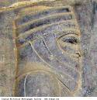
Invaders
Some scientist believe hostile invaders were to blame.

Slide 8
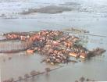
Natural Disasters
Other scientist think natural events like floods and earthquakes struck the region around 1900 B.C.E.

Slide 9
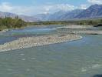
Indus River Changed Course
Some think the Indus River changed course and people mover to the Ganges River valley in search of a steady water supply.

Slide 10
Weights and Scale
Inside Mohenjodaro several weights and a scale were found.
Weights and a scale were found near a granary.
Maybe grain was traded for various goods.
They are also credited with discovering the concept of zero

Slide 11
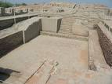
The Great Bath
The Great Bath was a pool built 39 feet long and 8 feet deep.
A well supplied the bath with water.
Dirty water was removed from the water through a drain that ran along the side of the bath.

Slide 12
The Great Bath
Was used for the people to bathe on hot days.
It could have been used for religious rituals.

Slide 13
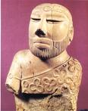
Statue
This shows how men may have looked and dressed.

Slide 14
Beads
Women probably wore beads in necklaces, bracelets, earrings, and rings.
Some Indian bead makers made beads out of clay and baked them in hot ovens called kilns.

Slide 15
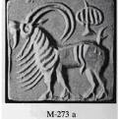
Seals
Small stone seals are the most mysterious of Mohenjodaro artifacts.
Found in large numbers throughout the ruins.
More than 400 pictographs have been discovered.

Slide 16
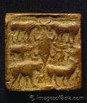
Seals
Many seals show animals such as buffalo, bulls, tigers, elephants, rhinoceroses, fish, and crocodiles.
People may have worn them as charms.
Merchants might have used them.

Slide 17
Sewer System
The Mohenjodaro sewer system carries waste away from the houses.
There were pipes, drains, wells, and bathrooms.
Main sewer system.
Sewage then emptied into the Indus River.

Slide 18
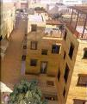
Homes
People lived in the lower part of the city.
Houses were made out of mud bricks.
They had flat roofs and were two stories.

Slide 19
Homes
Some houses had windows made of alabaster.
Poor people lived in smaller homes and the richer people lived in larger homes.

Slide 20
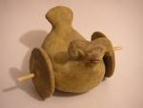
Games
Enjoyed playing games.
Crafter many objects for toys and parts of a game set.
Game of chess was probably invented in India.
Children rolled balls along clay mazes.

Slide 21
Clay Models
Clay models have been found all around Mohenjodaro.
Model maybe a toy, but also shows how farmers transported their goods.

Slide 22
Crash Course
Indus valley 9.34

Slide 23
The End

