Slide 1
The Kingdom of Kush
History Alive
Chapter 10

Slide 2
Kush
Egypt’s neighbor to the south.
African Kingdom
Thrived between
2000 B.C.E. and 350 C.E.

Slide 5
So who are these people
Why does Nubia and Kush appear to be the same place?
Nubia - forgotten Kingdom 4.55
Kush Empire - 2.24

Slide 6
Gold Mines
Kush was known for it’s gold mines.
Another word for Kush is Nubia .
Nub is the Egyptian word for Gold.

Slide 7
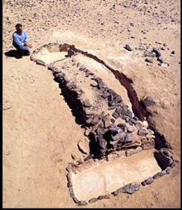
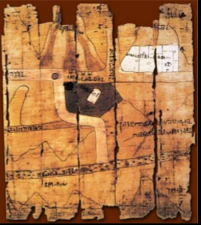
Here are some primary sources
An ancient panning basin
Papyrus map showing roads to gold mines
courtesty of A. Castiglioni
courtesy of Egyptian Museum Turin, Italy

Slide 9
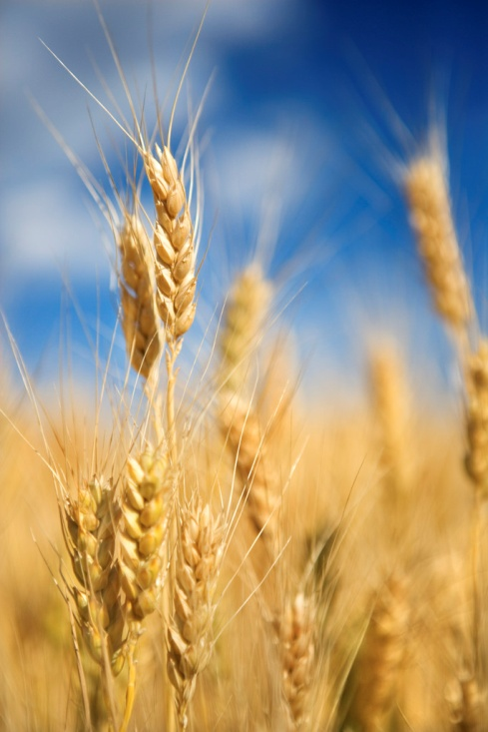
Important Trading Hub
Egyptians traded:
Grain
Beer
linens

Slide 10
For Kush’s
Gold
Ivory
Leather
timber

Slide 11
New Kingdom
Egypt controlled Kush
1600 – 1100 B.C.E.
Appointed a governor.

Slide 12
Kush paid tribute to Egypt
Tribute-wealth sent from one country or ruler to another as a sign that the other is superior.

Slide 13
Kush became Egyptianized
Kushites spoke and wrote in Egyptian.
Worshipped Egyptian Gods.
Wore Egyptian Clothing.

Slide 15
Kush’s Archers
Were hired to fight in Egypt’s army.
Princes from Kush’s royal families were sent to Egypt to be educated.
Archer - a person who shoots with a bow and arrow

Slide 16
Egypt’s New Kingdom collapses
Around 1100 B.C.E.
Kush gains its independence.’
Egyptian culture persisted
about 900 BCE a new line of Kush kings was established - these kings continued to follow Egyptian traditions

Slide 17
Kush Conquers Egypt
10 Egyptian Kingdoms fought for power.
In the mid 700s B.C.E. Kush took advantage of Egypt’s weakness and invaded Egypt.
King Piye became the new pharaoh from Kush

Slide 18
Kush ruled Egypt for 100 years
Called the Black Pharaohs
Did not want to tear Egypt down
Revive Egypt to its past Glory
Build magnificent Temples and Pyramids

Slide 21
In 671 B.C.E.
Egypt invaded by the Assyrians.
Kushites tried to fight off the Assyrians.
Assyrians used advanced iron weaponry.
By 650 B.C.E. The last of the Kushite pharaohs returned to Kush.

Slide 23
Meroe
The new capital and center of trade.
Produced iron for better weaponry.

Slide 26
African Roots
Kush returns to its African roots.
Female leadership called kandakes or queen mothers.
Queen Amanierenas defended Kush against Rome.
Amanishakheto - another powerful queen

Slide 27
Warrior Queen - Amanishakheto
4.18

Slide 29
The End

