Slide 1
Geography of India
and Indus River Introduction

Slide 2
Warm up
1, Copy your homework
2. Title your ISN table of contents Geography Day 2
3. Title the next available page Geography day 2 and copy the objective from the board
3. Go to the page marked interactive notebook from last class. Describe and rate each place for its suitability for settlement - 1 for very unsuitable to 5 for very suitable.

Slide 3
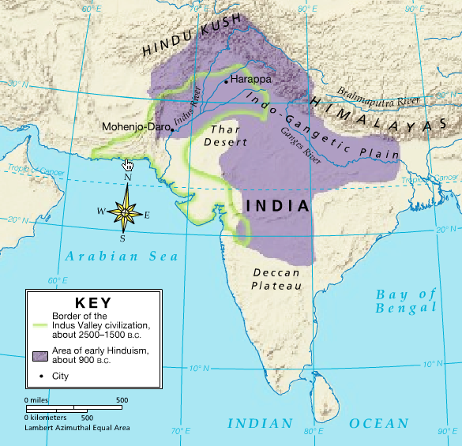
Geography - Brahmaputra River
Starts high in the Himalayas
Water from monsoons adds water
Joins with the Ganges river and makes fertile farmland

Slide 4
Geography - Deccan Plateau
Elevated flat area of land between two mountain ranges.
It is fairly dry but watered by monsoons.
Some land is fertile - rich soil used to grow cotton

Slide 5
Geography - Eastern and Western Ghats
Long mountain ranges near India’s coast.
The Deccan plateau stretches in between them.
Western Ghats are high and very wet
Eastern Ghats are lower and not as wet

Slide 6
Geography - Ganges River
Begins in the Himalayas
River floods during rainy season
Leaves sediment that makes the land fertile
water comes from melting ice
Ends in Bay of Bengel - which is fertile due to mountain water

Slide 7
Geography - Himalayan Mountains
Highest mountain range in the world
Mt. Everest reaches 5 ½ miles high
They form a natural boundary between the India sub-continent and the rest of Asia
Most of the rivers’ water starts here

Slide 8
Geography - Hindu - Kush Mountains
Barrier between India and modern day Pakistan
One of the highest mountain ranges in the world
Khyber gap is a 28 mile gap between the mountains - used to trade with Indus valley civilizations and connecting India to Asia (Mesopotamia)

Slide 9
Geography - Indus River
Begins in the Himalayas
Contains some of the most fertile farmland in the world
Melting snow and ice from both mountain ranges keeps water levels high
Sediment is carried from the mountains to the plains
Monsoons bring 5 - 20 inches of rain per year

Slide 10
Geography - Thar Desert
Stretches for hundreds of miles
Very little plant life and high temperatures
More than 45 species of lizards and snakes live there

Slide 11
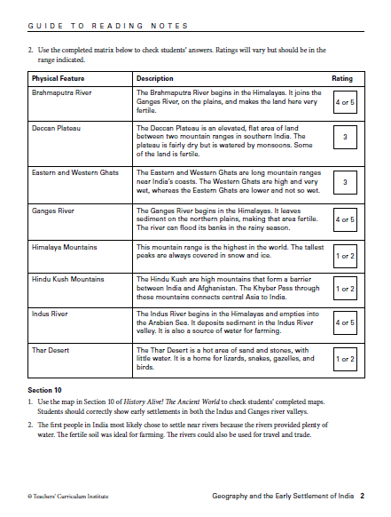

Slide 12
Introduction to Ancient Indus River Valley Civilizations
People first started settling in the Indus valley region about 6500 BCE.
By 2500 BCE walled city establishments started forming near the rivers

Slide 13
Crash Course
crash course Indus Valley

Slide 14
Kahoot
Play 1 - 10

Slide 15
An overview of Mohendojaro and Harappa
2.00 a quick look

Slide 16
A tour of a city
a recreated tour 4 mins

