Slide 1
Geography of India

Slide 2
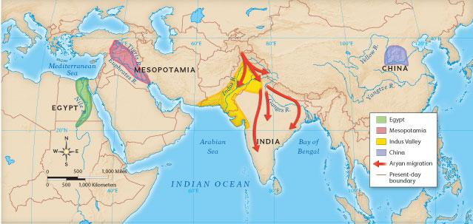
Topic: Geography of Ancient India Session: 40
Date
Warm Up: Examine the map below to explain what the ancient civilizations of Mesopotamia, Egypt and India have in common? Why was this commonality so vital to their development and success?
Ancient Mesopotamia, Egypt and India all _____________________ which was important to their development and success because

Slide 3
Review:
1. Name the three environmental factors that affect where a civilization settles.
Topography
Water
Vegetation
2. Secret Ballot: In your composition book
vote for the environmental factor that you feel most impacts a society and justify your reasoning.
3. Move to the corner of the room that you voted for and share your response with your corner team - add to/edit your justification.

Slide 4
A few videos to get an overview
2.48 discovery
2.41

Slide 5
In our study of Ancient India, SWBAT evaluate the major geographical features of South Asia and determine how they influenced the development of the society and culture by participating in a map study, analyzing visuals and completing an evaluation matrix.
NCSCOS 6G, 6C

Slide 6
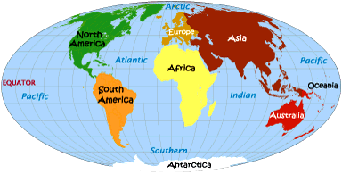
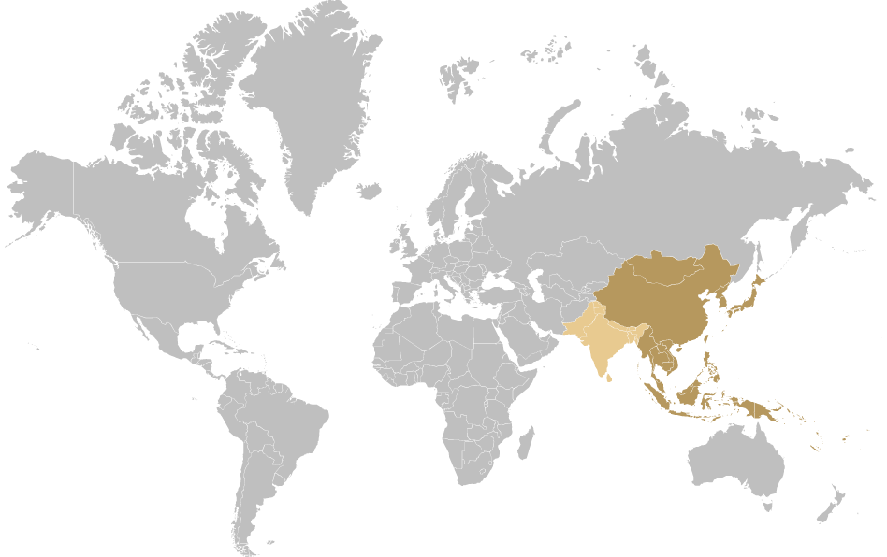
Why do you think India is described as a subcontinent?
subcontinent
Vocab:
Subcontinent
A subcontinent is a large, relatively self-contained landmass forming a subdivision of a continent.

Slide 7
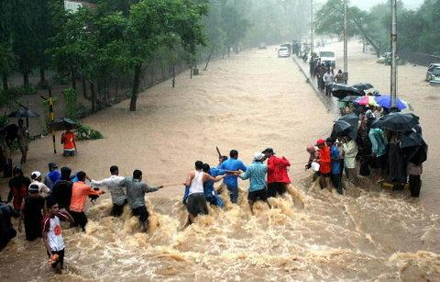
Define the italicized word using context clues and details from the photograph.
Every summer this part of the river receives added water from heavy monsoon rains.
Monsoon: A strong wind that often brings huge amounts of rain.

Slide 8
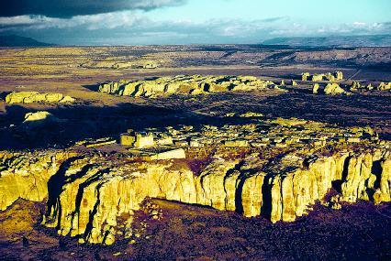
Define the following word using context clues
plateau
The Deccan Plateau is a flat and raised triangle shaped area that lies between two mountain ranges in southern India.
Plateau: An elevated, or raised area of land that is flatter than a mountain.

Slide 9
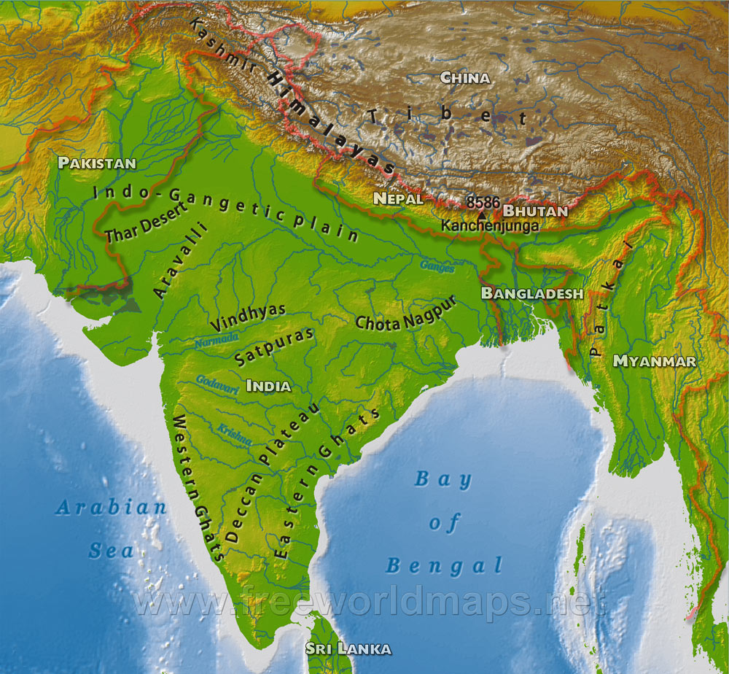
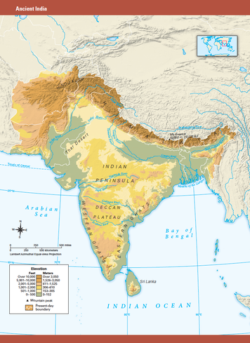
6.1 explore pages 1 - 3 as you complete #1-5, 8, 9-11 the geography challenge. Be sure to click the link to techbook atlas and use the zoom feature to help you!

Slide 10
Another map to help you
Click here for classzone

Slide 11
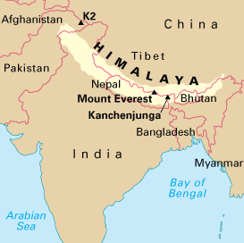
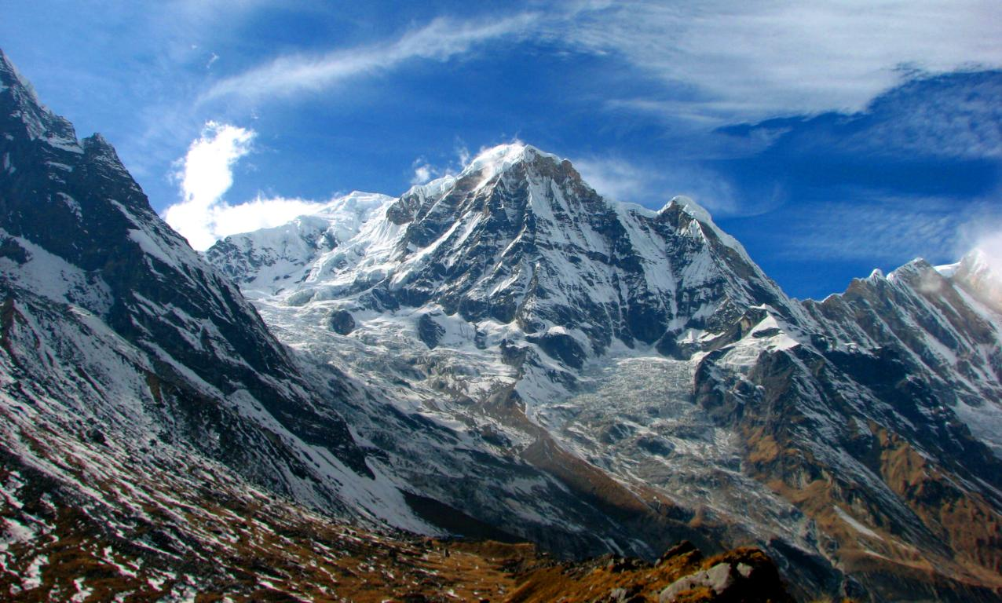
WB: Make a prediction
India's geography isolated it from the rest of the world.
How did this impact its culture and its development as a civilization?

Slide 12
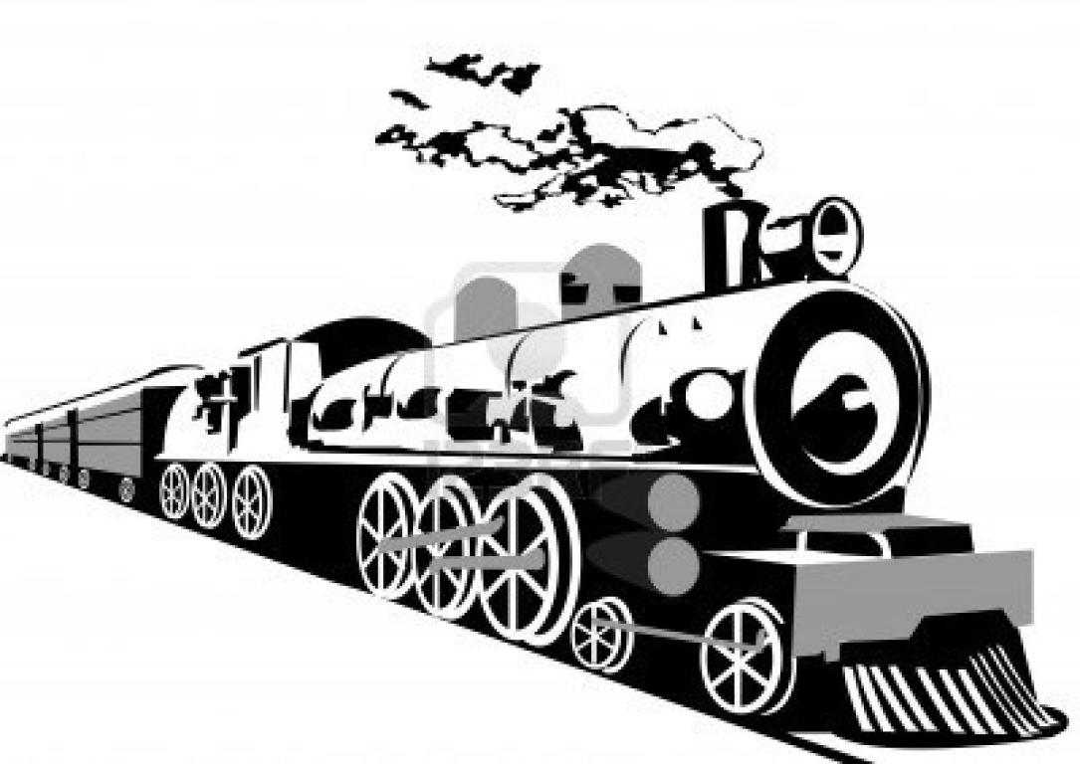
Explore India's geography!
1. Write a brief description of the feature you visit.
2. Evaluate each feature in regards to how suitable it would be for a settlement.
Rank it from 1-5 with 1= least unsuitable for settlement and 5= most suitable for settlement.

Slide 13
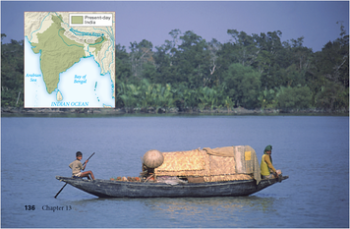
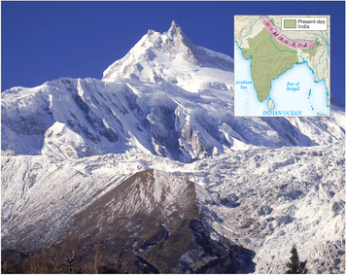
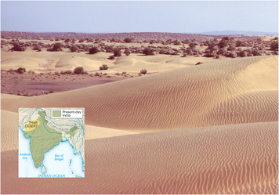

Slide 14
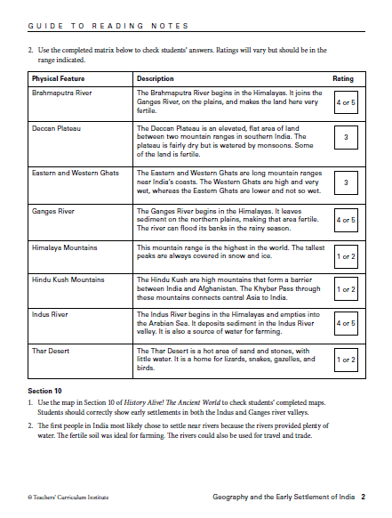
How was your trip?

Slide 15
Crash Course Indus Valley
crash course 8 mins

Slide 16
