Slide 1
Exploring the Earth

Slide 2
Objective
I can understand the composition of the different layers of the earth as well as the components that make up the earth’s structure.

Slide 3
Closed system
Energy can flow in and out of the system but matter cannot enter or leave
The Earth is like a bubble: Closed from space. The only thing that can enter or leave is energy or heat no matter.
(Rockets??)

Slide 4
Open System:
A system where matter can move in and out of the system.
Both energy and heat can also move in and out of the system.
Examples:
Animal is part of the (biosphere) and it relies on oxygen from the (atmosphere) to live.
Plants (Biosphere) rely on the soil (geosphere..)

Slide 5
Four parts that make up the Earth’s system.
Hydrosphere - water
Biosphere - living things
Geosphere - earth’s interior and rocks and soils
Atmosphere - Air
All four parts shape the planet’s surface

Slide 6
Atmosphere
Mixture of gases that surrounds and protects earth,
It is mostly made of Nitrogen and Oxygen
78% Nitrogen
21% Oxygen

Slide 7
Hydrosphere
All of the water on earth in the oceans, lakes, glaciers, rivers, streams, and underground.

Slide 8
Biosphere
All life on Earth in the air, on the land, and in the water.
Examples:

Slide 9
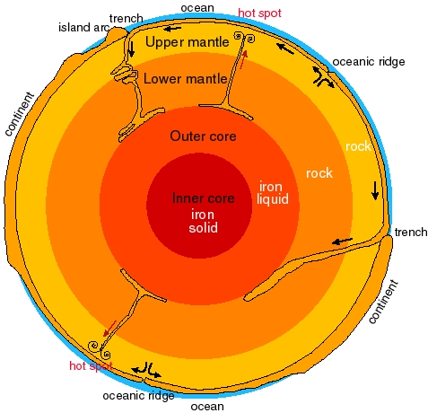
Geosphere
All the features on Earth’s surface:
Examples:
The continents, islands, seafloor,
and everything below the surface.
(Refer to the picture)

Slide 10
Additional Resources
Everything you wanted to know about earth 7 mins
Tim and Moby 2.46
7 mins - Step by step layers

Slide 11
Songs!
Layers of earth song
Mr Lee rap

Slide 12
Kahoot
Kahoot - formative

Slide 13
Homework:
Create a colorful and neat diagram of the four layers of the earth.
You must label each layer and describe what each is made of.
If you feel creative you can create a model, but you must include description of each layer.

