Slide 1
Introduction to Continents and Plates

Slide 2
Warm up - Who is Alfred Wegener?
Take a minute and look him up? Try to figure out based on your findings what we will be discussing today

Slide 3
Homework
Take out your drawing of the layers of the earth or get a zero credit slip

Slide 4
Check it out
I am not sure what to say about this one!

Slide 5
Introduction
I can
Understand the different properties of earth’s layers
Discuss the plates that make up the outermost layer of the earth and how they change position over time.

Slide 6
Earth’s Creation
(4.6 billion years ago)
Bits of material collided in space and stuck together.
Planet grew larger as more material was added.
The young planet became a growing ball of intense heated material.
In time, the denser materials, (iron, nickel) sank toward the center of the Earth
Slowly over time, the layers of the Earth formed. (Core, mantle, crust.)

Slide 7
What does Earth look like inside?
Inner Core- is a ball of hot, solid Metal.
Outer Core- is a layer of liquid metals that surrounds the inner core
Mantle (see next slide)
Crust-is a thin layer of cool rock.
2 basic types:
Continental Crust: all continents and major islands
Oceanic Crust: all of the ocean seafloors

Slide 8
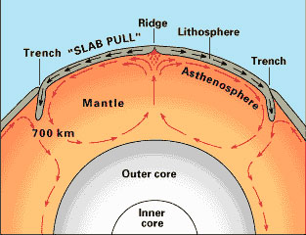
Mantle
Earth’s thickest layer (1700 miles
Made of hot rock, and is less dense than the metallic core
Top part is cool and rigid
Just below that the rock is soft and moves like toothpaste.

Slide 9
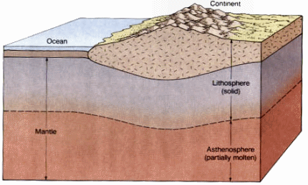
Asthenosphere: The tough liquid part of the inner mantle.
Lithosphere: The stiffer part of the outer mantle and the crust. The lithosphere 'floats' on the asthenosphere, like ice on water.

Slide 10
Plate Tectonics
Discoveries
Lithosphere
does not form a continuous shell
It is broken into many large and small slabs of rock)
Scientists
do not know exactly when in history these plates formed.

Slide 11
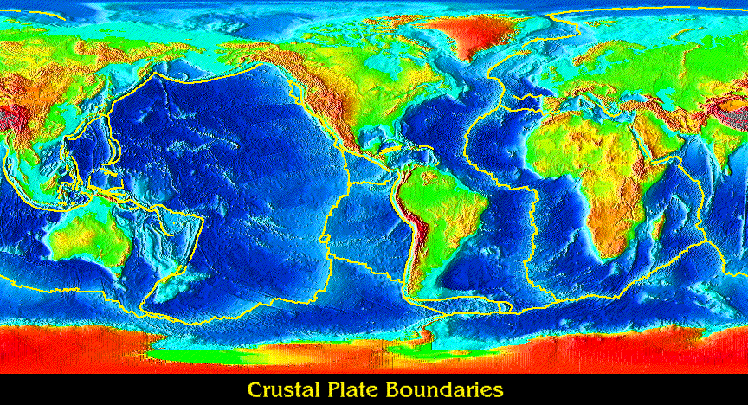
Most Tectonic Plates include both continental and oceanic crust.

Slide 12
More sources: Earth Structure:
Earth’s layers (good website)
http://library.thinkquest.org/28327/html/universe/solar_system/planets/earth/interior/layers_of_earth.html

Slide 13
3.2 Continents Change positions over time.
Learn about:
How the continental drift hypothesis was developed.
About evidence for plate movement from the sea floor.
How Scientists developed the theory of plate tectonics.

Slide 14
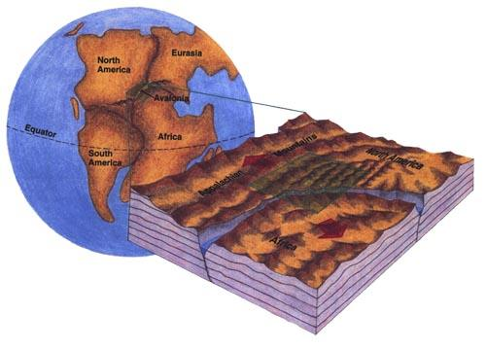
History behind it all!
When North and South America were included on the map. It made lots of people curious.
The eastern side of North and South America seem like a they fit the Western side of Africa and Europe like a “Jigsaw puzzle”

Slide 15
Alfred Wegener
German Scientist
Proposed 1912, his hypothesis called,
Continental drift.
Continental drift:
Earth’s continents were once joined in a single landmass and slowly drifted apart.
Not until mid 1900’s did Scientists find new evidence that made them consider continental drift more seriously.

Slide 16
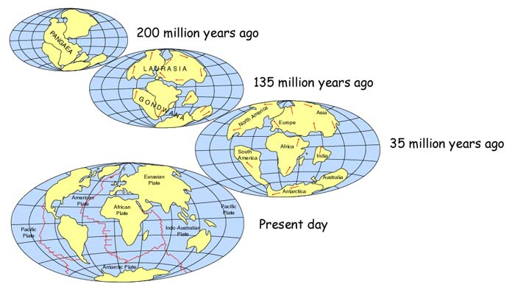
Pangaea
“Pangaea”- comes from the Greek word meaning “all lands.”
This Giant continent reaches from Pole to pole and was centered where Africa lies today.

Slide 17
Pangea
3.18 from the beginning to today

Slide 18
Evidence #1 for Continental Drift
Fossils-
Ancient Reptile “Mesosaurus” has been discovered in South America and Western Africa.
This reptile is very rare not found in any other place in the world.
It also only lived 260 million years ago.
(Pg. 75B in textbook)

Slide 19
Evidence # 2 of Continental Drift
Climate change:
Green land today lies near the Arctic Circle and mostly covered in ice.
Fossils of a tropical plants can be found one it’s shores.
Which means “The land must have once been located in a tropical place.”
(near the Equator.)

Slide 20
Evidence # 3 of Continental Drift
Geology-
Wegener’s best evidence came from the kinds of rocks that make up the continents.
Rocks from Brazil matched up with those found on the shore of Western Africa.
Also Appalachian Mountains in North America were exactly like the limestone in Scotland’s Highlands.

Slide 21
Evidence from the Sea-floor
Ocean Sea-floor:
1950’s Scientists began mapping the sea-floor in detail.
Many thought that the seafloor would be smooth and level (they were wrong.)
They found huge underwater mountain ranges (called Mid-ocean ridges)
These ridges were in every ocean and would prove to be very good evidence.

Slide 22
About the Sea floor
Sea-floor spreading:
also known as (spreading centers)
Molten rock rises through these cracks, cools, and forms new oceanic crust.
Age of the sea-floor:
Rocks samples revealed that the youngest rock is closest to the ridge, the oldest rock is farthest away.
Oceanic crust is much younger
Continental crust is older.

Slide 24
Sea floor (continued.)
If the ocean sea floor is spreading, why isn’t the Earth’s surface getting bigger?
Because of Ocean trenches:
These are sights where dense oceanic curst is sinking into the asthensphere.
Old crust is destroyed at the same rate that new crust is made.
This keeps the Earth at the same size.

Slide 25
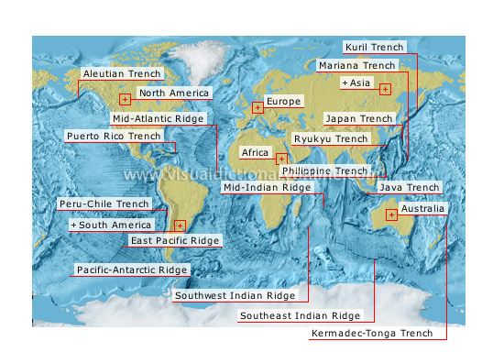

Slide 26
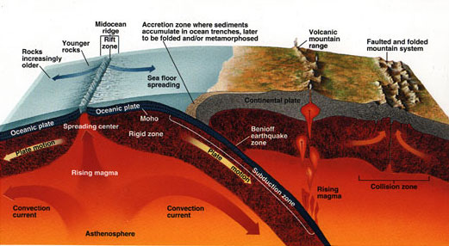

Slide 27
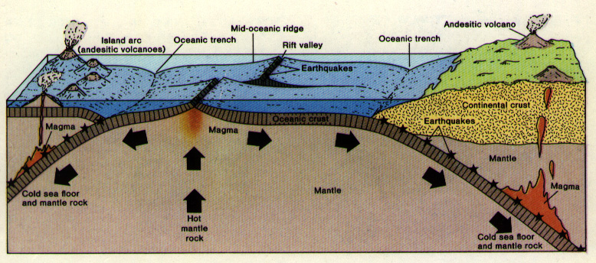

Slide 28
Convection Currents
Convection -is the transfer by the movement of material.
The rock in the Asthenosphere acts like a boiling pot of water.
The hot soft rock rises, cools, and sinks, then is heated rises again.
This motion continues creating a
convection current (see next slide to help)

Slide 29
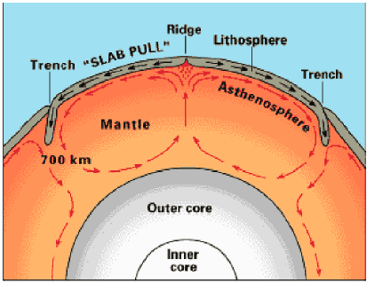

Slide 30
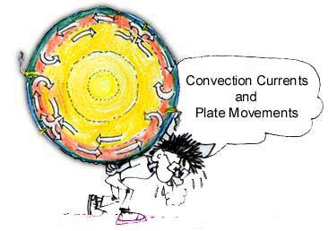

Slide 31
Theory of Plate Tectonics
The Theory:
“Earth’s lithosphere is made of huge plates that move over the surface of the Earth”
By combining our knowledge of Earth’s plates (as discussed in this presentation)
The seafloor and the asthenosphere help us support and understand our Earth

Slide 32
Homework
In section B read 3.1 and 3.2 (pages 69 - 79) answer the questions on page 73 (1 - 5) and on page 79 (1 - 5)

Slide 33
rap by middle schoolers
Continental drift dance
Make me Genius - an introduction to next class

Slide 34
The End

