Slide 1
The Stone Ages and
Early Cultures

Slide 2
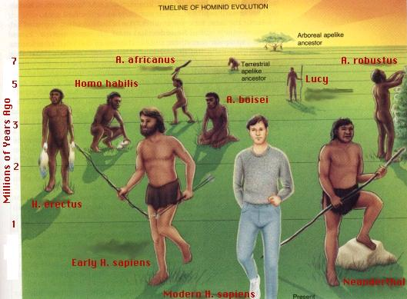
Prehistory is the time before written records were kept.
Because these people didn’t write down their history we have to do our best to figure out what happened.

Slide 3
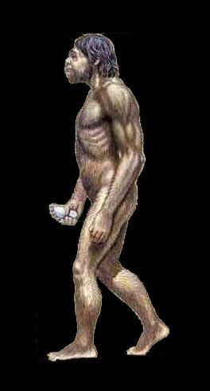
3 Million Years Ago…Early Humans
It was during this time that the higher primates, including apes and early man, first appeared.
There was a difference between apes and man. Early human-like hominids could stand upright. Apes could not.
Hominids are humans and other creatures that walk upright on two feet.

Slide 4
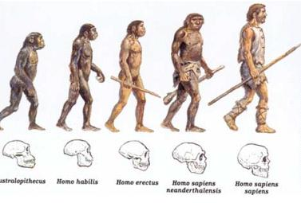
EARLY HUMANS

Slide 5
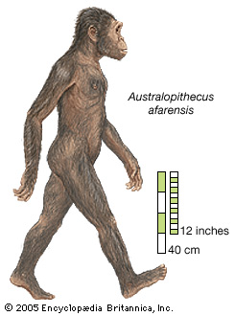
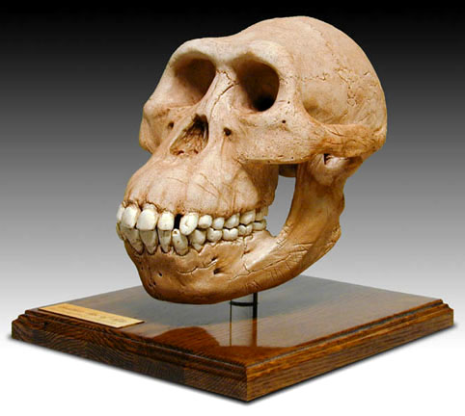
The first Hominids, they are thought to have emerged in East Africa in the Great Rift Valley between 3-4 million years ago.
Name means “southern ape”
Stood upright and walked on two legs
Brain was about one-third the size of modern humans

Slide 6
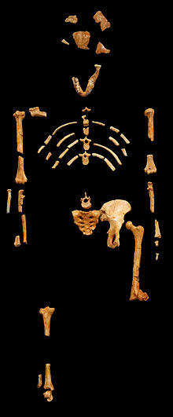
LUCY
In 1974, a skeleton was found in Africa.
The bones were those of a female, about 20 years old or so when she died.
Scientists named her Lucy (after a Beatles song).
Tests showed that she lived more than 3 million years.
Anthropologists could also tell from her bones that she was small and had walked on two legs…a key step in human development.

Slide 7
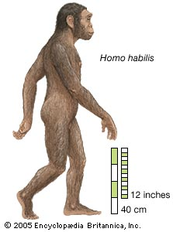
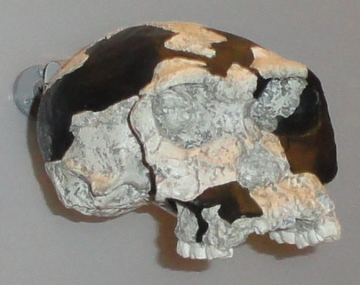
HOMO HABILIS
Name means “handy man”
Appeared in Africa about 2.4 million years ago
Used early stone tools for chopping and scraping
Brain was about half the size of modern humans

Slide 8
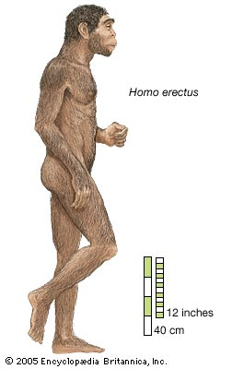
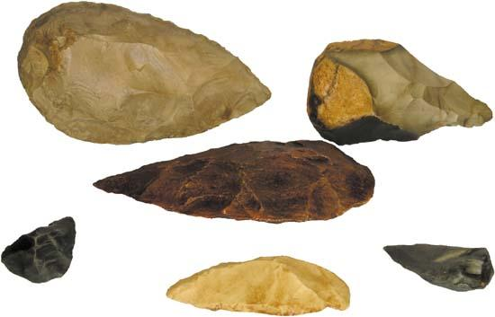
Name means “upright man”
Appeared in Africa 2-1.5 millionyears ago.
They also used more complex tools (a handheld object that has been modified to help a person accomplish a task)
Learned to control fire
Migrated out of Africa to Asia and Europe

Slide 9
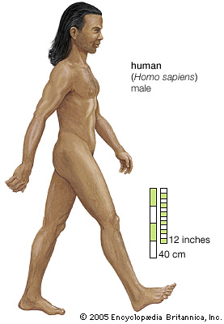
Name means “Wise Man.”
Appeared in Africa about 200,000 years ago
Migrated around the world
Same species as modern human beings
Learned to create fire and use a wide variety of tools
Developed language
This group split into two distinct groups:
Neanderthals and Homo Sapiens Sapiens

Slide 10
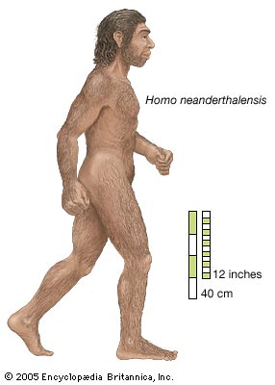
Found in the Neander Valley in Germany.
Thought to have lived between 100,000 and 30,000 years ago.
Used stone tools, and buried their dead. It is thought they had some primitive religious beliefs.
Were killed off by Homo Sapiens Sapiens

Slide 11
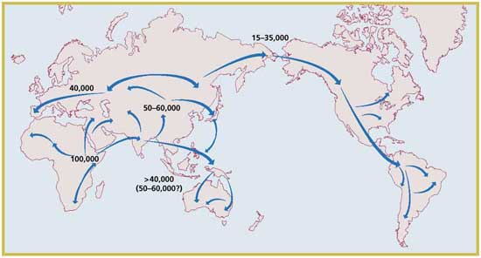
Modern Human Beings
Appeared in Africa between 150,000-200,000 years ago
Began to migrate outside of Africa 100,000 years ago.
Replaced the Neanderthals by 30,000 B.C..
By 10,000 B.C. Homo Sapiens Sapiens could be found throughout the world due to migration.
During the last ice age between 100,000 B.C. and 8000 B.C. the water level in the oceans dropped revealing a land bridge connecting Asia and North America

Slide 12
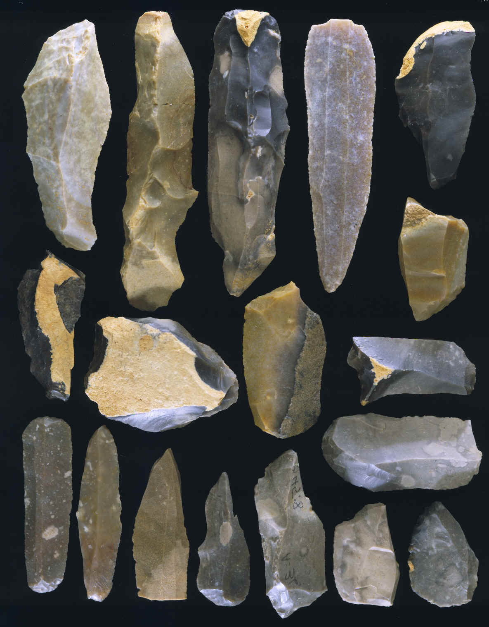
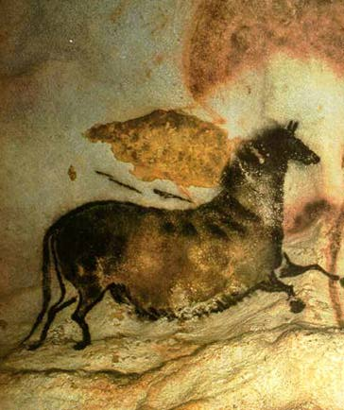
Paleolithic= Old Stone Age. This era was called the stone age because early man used stone to make his tools and weapons.
These clans got their food by Hunting and Gathering
Once the food supply ran out they would move to a different area.
Essential Knowledge
Were Nomadic: Wandered from place to place in search of food and shelter
Invented the first tools and weapons including simple stone tools.
Lived in clans of about 20-30 people, used caves for shelter.
Learned to make and control fire to keep warm and cook their food.
Developed oral, or spoken language
Made cave art and statues.
The role of men was to do the hunting
The role of women was gathering and caring for children

Slide 13
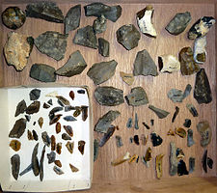
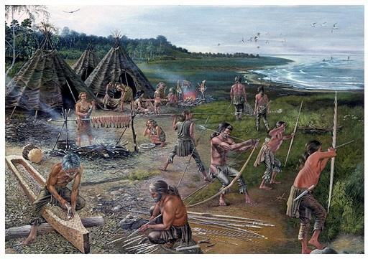
MESOLITHIC
“Meso” means middle
“Lithic” means stone
Mesolithic means middle stone age.
Means middle stone age.
It began with the end of the last glacial period over 10,000 years ago and evolved into the Neolithic period
“Meso” means middle
“Lithic” means stone
Domesticated plants and animals
Settled in communities
Tools became smaller
Pottery and the use of the bow developed

Slide 14
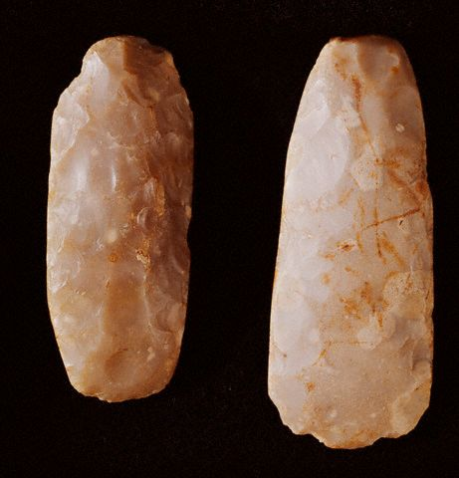
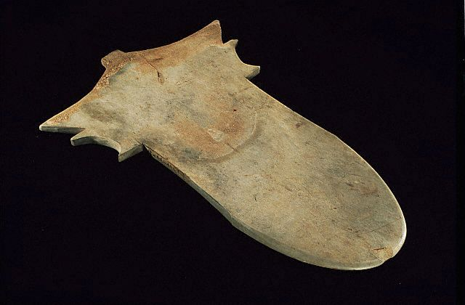
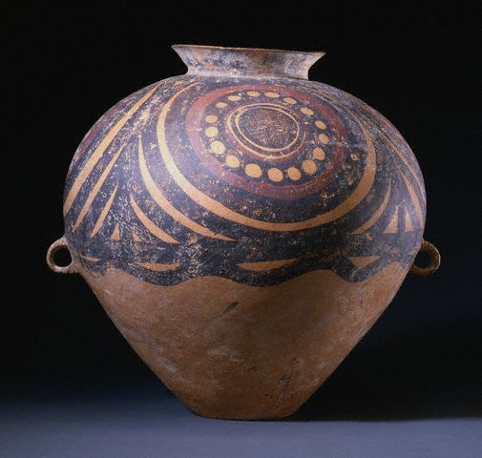
Neolithic
Neolithic means new stone age. Also known as the Agricultural Revolution.
“Neo” means new
“Lithic” means stone
Developed Agriculture and weaving (better clothing)
Domesticated Animals
Used Advanced Stone Tools
Made Pottery (for food storage)

Slide 15
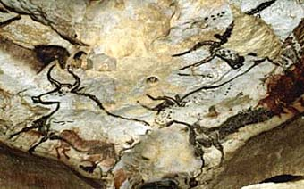
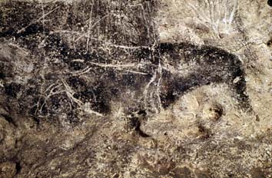
Adaptation
Use of Fire
Early man learned to use fire to adapt to his environment.
It was probably discovered from friction, lightning, or accidental hitting two rocks together.
Ice Ages
Fire was very important during the ice ages. Without fire man would not have been able to survive.
Cave Art
Man has created art for a very long time. There is some argument as to what this art was for. Was it art as art, or art as a form of religion?

Slide 16
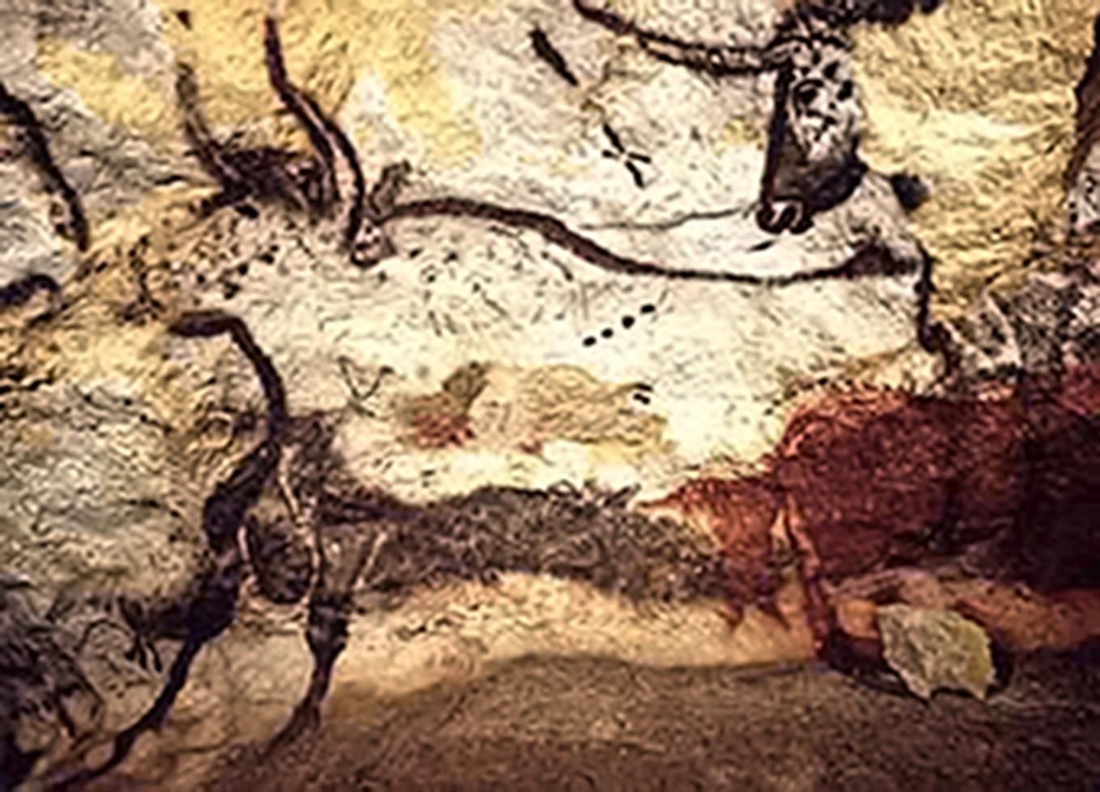
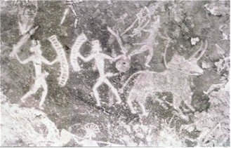
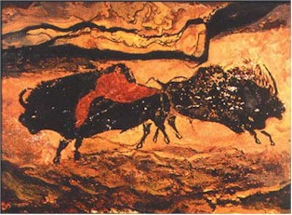
Gathering was a more reliable source of food and so in Paleolithic society it is thought that it may have been Matriarchal, or female dominated.
Women were often seen at the time as symbols of life and fertility. Many ancient religions were centered around the worship of the earth and the woman was often representative of the earth and life because of the fact that women gave birth.
It is thought that early man often drew, or made representations of what he/she wanted to happen. Fertility statues for having many children, paintings of successful hunts etc.

