Slide 1
Scientific method steps
Experiment and variables

Slide 2
Review
Paul - Problem
Revere - Research and observation
Hates - Hypothesis

Slide 3
Tim and Moby (watch for the rest)
Brainpop scientific method

Slide 4
Experiment
The next step is to experiment which will test the hypothesis to determine how well it works or how accurate your inference was.
This helps you see if your hypothesis was accurate.

Slide 5
Designing an experiment can be tricky
In your ISN, write down the steps to making a bologna and cheese sandwich with mustard on bread.
This is called the procedure. These are the steps you will follow during your experiment.
(explain detailed steps)

Slide 6
Results
As you witnessed. It is very important to be careful as you layout the steps (or procedure) in your experiment and the process you follow.

Slide 7
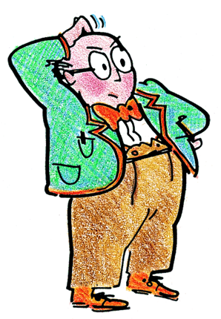
Variables
Variables are things that vary and change in the experiment

Slide 8
Variables
Variable - anything in an experiment that can change.
In any experiment there are 3 variables
Independent (input) things you pick
Dependent (outcome)
Control

Slide 9
Independent Variable
This is the thing you manipulate and cause to change in an experiment. This is the thing that you decide.
Less water
Different color light
eating less chocolate
Detentions for not turning in homework

Slide 10
Independent Variable
Think about your hypothesis:
If I _______, then _______
The beginning portion is the independent variable.

Slide 11
Independent Variable
There should only be one thing that you test at a time SO there should only be one thing you change.
If you are testing the amount of water a plant has you should NOT also test the amount of sunlight it gets.

Slide 12
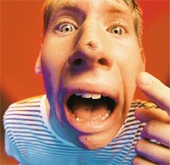
The story of Brad
}Let’s say that Brad has a pimple. He wonders what will get rid of it. He’s heard that putting toothpaste on the zit will get rid of it. He’s also heard that lemon juice will get rid of it. He decides to rub his face with lemon juice and toothpaste. The next morning his pimple is gone. But which thing cured him? The toothpaste or the lemon juice?

Slide 13
The answer
There is no way to know because there was more than one independent variable or thing that changed.
Lemon juice
Toothpaste

Slide 14
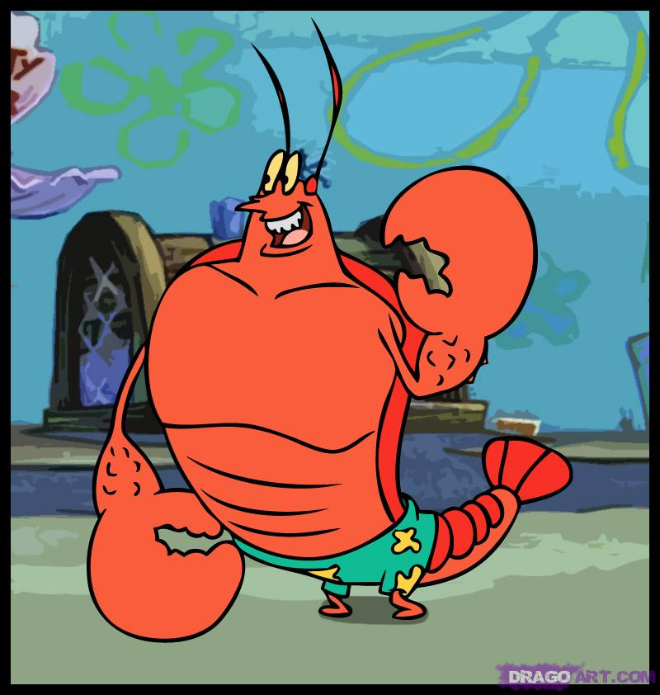
Another example
}Larry is wondering how different lotions will affect how much Spongebob and Patrick can lift.
}He changes (manipulates) the type of lotion that each person gets.
}Therefore, the independent variable in this example is the TYPE OF LOTION he puts on each.

Slide 15
Definitions
Variable - anything in an experiment that can change
Independent Variable - What you manipulate (change on purpose) in an experiment
Dependent Variable - what happens in an experiment because of the independent variable (measure?)

Slide 16
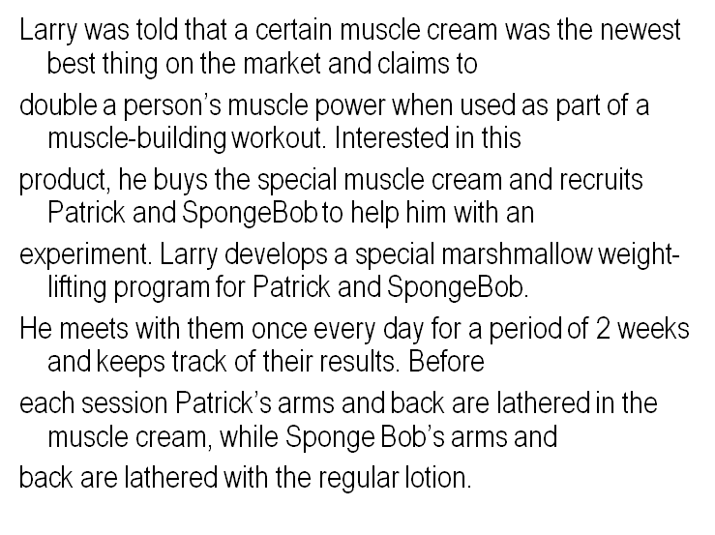
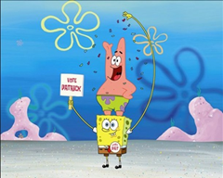
Another example

Slide 17
Remember
The dependent variable is the possible outcome of the experiment; the effect. It depends on what happens to other variables in the experiment. The dependent variable is basically the part that you are changing.

Slide 18
What is the dependent variable
Since Larry is looking to see if the cream has an effect on how much someone can lift, the dependent variable is the number of marshmallows that can be lifted by Spongebob and Patrick
The number of marshmallows each can lift depends on the type of lotion which is the independent variable

Slide 19
So...
Dependent Variable
“Depend on”
Independent variables

Slide 20
Movie to sum things up
independent and dependent variables

Slide 21
Another video about the whole process
Study Jams
(Scientific Method)

