Slide 1
Scientific Method (day 3)
First three steps

Slide 2
Warm up
Write one observation and inference. Explain how you know the difference
Label page 4 and 5 in your ISN Scientific Method and title the top of those two page
Write down your homework

Slide 3
Objective
What are six steps to the Scientific Method?
How can students utilize the process to organize scientific questions, and investigations?
Science as inquiry

Slide 4
Observation or inference
Get out your homework.
Let’s discuss; was the bag activity an observation or an inference?

Slide 5
Overview with Tim and Moby
Brainpop
(4 Minute Video Clip)

Slide 6
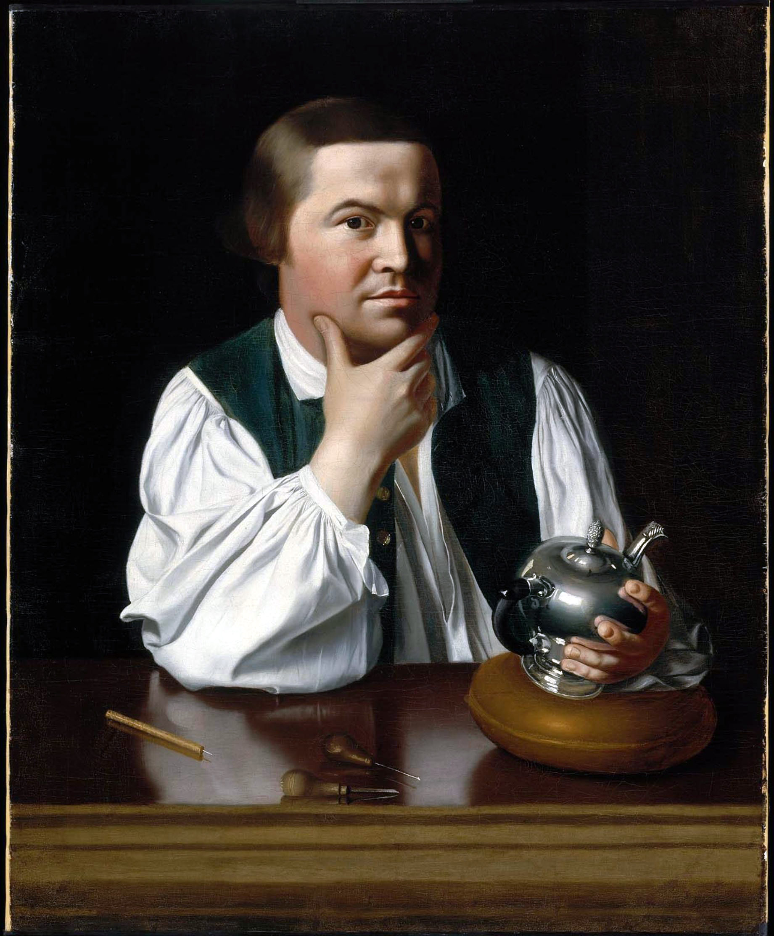
Once upon a time...
This handsome
guy is Paul Revere

Slide 7
Knowing Paul Revere will help us
Paul………..Problem
Revere…...Research
Hates……...Hypothesis
Eggs………..Experiment
And………...Analysis
Cheese…...Conclusion

Slide 8
What’s “yo” Problem Man?
Choose a Problem
This is the purpose or reason for doing any experiment
Examples
My sister takes my stuff
My dog jumps on me
My locker jams

Slide 9
Use real life problems
Think about siblings, pets etc.
Share out (phrase as a question)
Always phrase your problem as
a question to solve

Slide 10
Research and Observations
Step two has to do with researching what is going on, you can use
Books
Internet
videos
interview with experts on the topic
Good Scientist alway take time to make observations on what is currently going on!

Slide 11
Let’s Try one out - step 1 problem
Everytime I try to open my locker, it won’t work
Remember problems should be phrased as questions...so
I wonder what is happening that is causing me to not be able to open my locker

Slide 12
Step 2 Research and Observation
You could...
Watch a video on how to open a locker
Get help from a friend and watch them do it
Check your locker combination to make sure it is correct

Slide 13
Observations after research
I am doing the turns correctly (I watched a teacher)
My teacher and my friend had some trouble after putting in the right combination
I can use the combination correctly with the door open

Slide 14
Remember Observations and Inferences?
After you make observations and do some research on the problem.
You are ready to make an inference on what is going on.
This inference will be the basis for the next step...hypothesis

Slide 15
You’ve made your observations
What is your inference (which will be the basis for your hypothesis
Talk to your table partner - we will share together

Slide 16
Hypothesis
Make a prediction (inference)
If I _______, then___________will happen
It must be worded so it can be tested in an experiment

Slide 17
Hypothesis Writing 101
The format is always:
If I ________, then _____________.
If I (then describe what you will do in the experiment), then (predict the outcome of the experiment.)

Slide 18
Examples
If I take my sister’s stuff, then she will stop taking mine.
If I ignore my dog when he jumps, then he will stop jumping
If I do my combination slower, then my locker will open more frequently

Slide 19
For each example given write a hypothesis

Slide 20
#1 Chocolate may cause pimples.
(40 seconds)
If I ________________, then _____________.

Slide 21
Plant Growth may be affected by the color of the light.
If I ______________, then _____________.

Slide 22
Which lunch will give me more energy, chicken sandwich or pizza?
If I _______________, then __________.

Slide 23
Do birds with longer or shorter wings fly faster?
If I ______________, then ______________.

Slide 24
Do caterpillar feces weigh the same as the leaf they ate?
If I ______________, then _______________.

Slide 25
Mr. Tubb predicted that giving detentions for missing homework would lower the amount of homework missed at South Charlotte Middle School. He recorded the number of missing homework for 30 days. Mr. Tubb then assigned detentions for each missing homework assignments. He then compared the numbers to see if the policy had any effect.

Slide 26
What what the hypothesis for the detention scenario?
If Mr. Tubb__________, then _______________.

Slide 27
Does T.V. time affect the reading scores on fourth graders?
If I ____________, then __________.

Slide 28
Mrs. Bauer wants to see if different smells travel at the same speed. She sprays a can of hairspray, peppermint air freshener, and insect repellant at the same time. Five feet from where Mrs. Bauer stood, six friends stand around her in a large circle.

Slide 29
Write a hypothesis that Mrs. Bauer could use in her experiment.
If Mrs. Bauer ___________, then__________.

Slide 30
Review
Paul - Problem - What is doing wrong or what do you want to test, explain
Revere - Research and observe. What can you learn and what do you notice related to your problem
Hates - Write your Hypothesis - This is always an “If_____then____statement” and will be tested during the experiment

Slide 31
Problem: How can I stop my dog, Gilligan, from waking me up at 3 O’clock am to go outside?
Research: When Gilligan wakes me up, I will follow him outside to see what he does.
Hypothesis: If I let Gilligan go outside just before bedtime, then he will stop waking me up at 3 O’clock in the morning.

Slide 32
Practice..Practice…(Homework)
Use the first three steps of the Scientific Method to outline one problem:
Problem:
Research:
Hypothesis:
(Make it a real problem that you can experiment at home.)

