Slide 1
Day 2 Sound
Sound Pitch and Production

Slide 2
Warm up
Take 5 minutes to review your notes and answer the questions on side one of the partner sheet.

Slide 3
Objectives and essential questions
I can differentiate between different types of waves and how they travel. 6.P.1.1

Slide 4
Investigating Sound
Each partnership takes two dixie cups and one piece of string
Poke a SMALL hole in the end of each cup and make a knot inside of each cup.
Start to move apart and alternate who speaks and who listens

Slide 5
Findings
When did the “telephone” work best?
What kind of wave was being used during this telephone experiment?

Slide 6
Compression or Longitudinal wave
Sound wave in action

Slide 7
Types of waves
(1) Based on the type of material they move through
Material type
Material t type
Mechanical
Electromagnetic
Mechanical
Electromagnetic
These need a medium to travel
through such as water
Air, ground
These travel through
empty spaces
These need a medium to travel through such as water
Air, ground
These travel through empty spaces

Slide 8
Two types of mechanical waves
Direction of waves
Longitudinal
Transverse

Slide 9
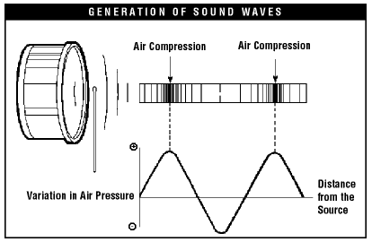

Slide 10
Speed and Mediums
Medium - Something that sound travels through. Sound travels through matter.
Sound waves are repeating patterns of compressions as particles vibrate. Sound waves are produced by vibrations
Sound moves in longitudinal waves
Hertz - The unit to measure frequency - waves per second

Slide 11
The speed of Sound
Sound travels fastest through Solids followed by liquids and then gasses.
Turn and talk why do you think that might be true?
Sound travels faster in warmer temperatures
Why do you think this might be?
(How sound travels on Symbaloo for a good illustration)

Slide 12
Waves and Medium
From the symbaloo

Slide 13
Pitch
Frequency determines pitch
High frequency = High Pitch

Slide 14
Volume
Amplitude determines Loudness
High Amplitude = High Energy = Louder sound

Slide 15
Waves in Action
Simulation

Slide 16
Let’s sum up when you have learned so far
Brain pop sound

Slide 17
Instrument Demonstration
cgp 5023

Slide 18
How do you produce sound?
Your vocal cords in your voice box (larynx) tense up and draw close together when you are about to speak.
Air is pushed against the cords causing them to vibrate
This vibration causes sound waves
How vocal chords work 5.40
Singing quartet 3.14

Slide 19
Song
Do you recognize these ladies???
Sound song

Slide 20
Homework
Read in your textbook C37 - C43 and answer the 5 questions on the bottom of page 43 in your ISN

