Slide 1
Inference and Observation

Slide 2
Warm up
Share your picture with the people at your table group.
Make sure you have your Science notebook, agenda and a sharpened pencil
use tape to put it in front of your table of contents

Slide 3
Objective
Describe the difference between observations and inferences
Be able to give specific examples of each

Slide 4
Bag Activity
In science, you need to be very curious and observant to your surroundings. Please label page two Inferences and observations
Turn to page two and label in Bag activity and number the page 1 - 9 skipping a few lines

Slide 5
The activity
Starting with the table you are at. You will feel the bag (carefully) and write your guess in your ISN (interactive science notebook). I will tell you when it is time to switch to the next station

Slide 6
6 minute movie
inferences and observations

Slide 13
To Infer
When you infer, you make a mental judgment based on observations. Inferences cannot be directly observed. They require thought. For example, if you get up in the morning, look up at the sky and observe dark clouds, observe the air is cool and humid, and observe puddles on the ground, you might infer that it has recently rained. Note: you did not see rain; you decided that it rained based on your observations. An inference is a statement based on your interpretation of the facts.

Slide 14
Often an observation leads to an inference
You see steam rising off of a cup of coffee. (Observation)
The coffee is hot. (Inference)

Slide 15
Ovservations - to - inference
The piece of metal is red, so it must be hot.
The plant is green, so it must be healthy.
The room is dark, so the light bulb must not be on.
Andrea is studying, so she probably does well in school.
The street is wet, so it must have rained.

Slide 16
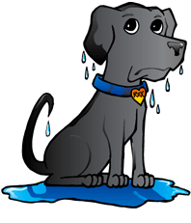
Example
I observe that I see a swimming pool
I observe that my dog feels wet
I infer that my dog jumped in the water

Slide 17
There can be more than one inference to any given observation

Slide 21
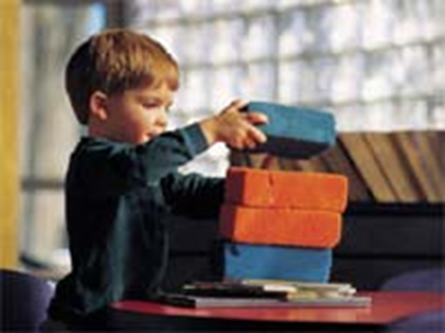
Observation or inference?
The child has a blue block

Slide 22
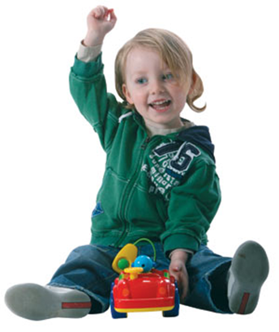
Observation or inference?
The child playing with the car is smiling

Slide 23
Observation or inference?
The child is happy because she is playing with the car

Slide 24
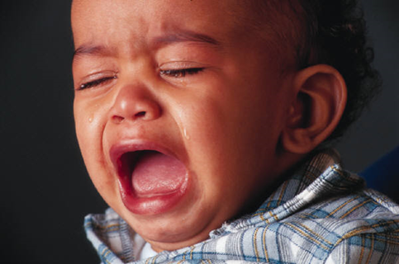
What do you observe?

Slide 25
What do you infer?

Slide 26
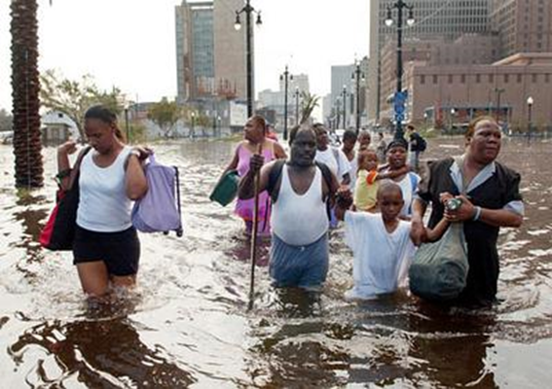
Exit ticket - Make 3 observation and two inferences about this picture

Slide 27
Homework
IN your science journal think back to the bag activity - were you making observations or inferences?

