Slide 1
Cornell Notes
Note-taking strategy that will
improve your study skills and
your grades!!

Slide 2
Problems with taking notes
I can’t write everything down the teacher says because he/she talks TOO fast!
I can’t read my notes.
The notes I take when I read don’t help.
I don’t know which parts of my notes are most important.
I don’t see how the notes from lecture match the readings from the book.

Slide 3
Don’t be like this guy…

Slide 4
….or her

Slide 5
What’s the advantage of Cornell notes?
Helps me take organized notes.
Helps me identify key words and concepts from lecture or reading.
Helps me scan my notes to locate important information.
Improved study skills.
Improved grades.

Slide 6
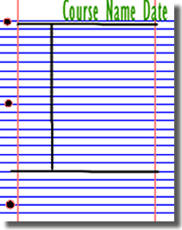
Set up your paper
Address your paper like you normally would any other paper.
-Include name, date, and class period.
Now use a ruler and your pencil and draw lines on your paper to make it look like the picture on the right.
-It doesn’t need to be perfect, just as close as you can get.

Slide 7
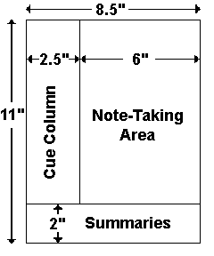
This is for all the perfectionists out there!

Slide 8
Helpful hint!
Make sure that you have several pages already set up before your instructor begins their lecture to prevent you missing notes that might help you succeed on your tests.

Slide 9
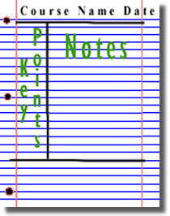
Now what?
-Take notes like you normally would on the right side of the vertical line.
-Continue to take notes on as many pages as you need until the lecture is complete.
Always take notes here.
After the lecture, go back and give headings to your notes to make it easier to find when you study.
Summarize each section of your notes into only a few words

Slide 10
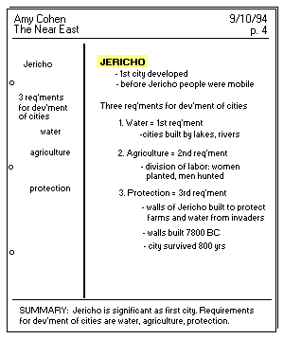
History example

Slide 11
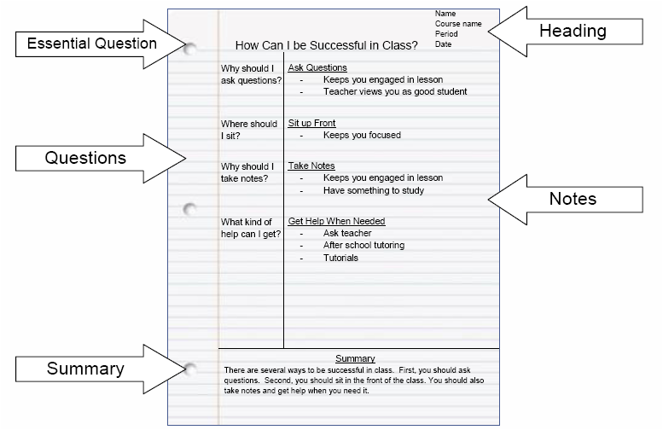

Slide 12
Remember
You can take notes in any format you choose, just keep those notes in the large section on the RIGHT side of the vertical line!
Some styles of notes
Outline
Narrative
Symbols
Short hand
Draw pictures

Slide 13
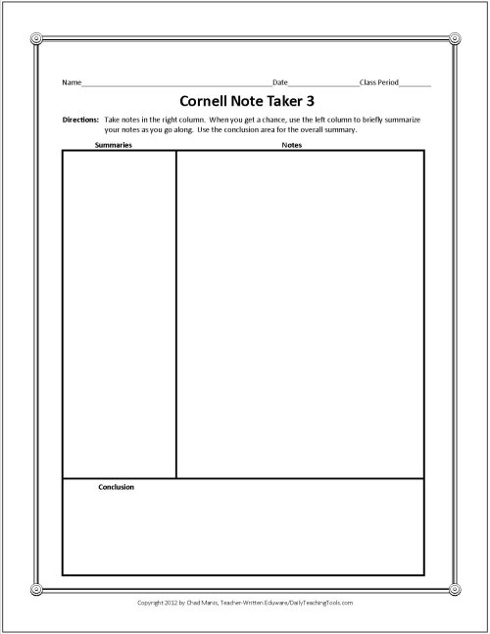

Slide 14
Tips for recording notes
Use abbreviations
Paraphrase to capture content but simplify writing
Use symbols
Arrows, circles, underlining, and highlighting
Include graphics when necessary
Skip lines between ideas

Slide 15
More recording tips
Identify words that are unclear.
Think about what is being said.
Ask questions.
Pay attention to class objectives.
Make sure your notes are aligned.
Become familiar with the speaker’s style
Look for voice inflections, gestures, etc.

Slide 16
What we’ve learned so far
Step 1: Record
Take notes on the right side of the page.
Step 2: Revise
Using your notes, label your notes in short, easy to find words or phrases on the left side of the page. This helps you to find key points within the notes easily when you study.
Write questions about your notes that you think the instructor might use on the test.

Slide 17
Tips when revising
Develop study questions and identify main ideas.
Fill in details for clarity.
Look up definitions of words you don’t know.
Delete irrelevant information.
Add symbols to highlight important points or key words.
Write a summary of the significant ideas.

Slide 18
Step 3: Recite
Cover the note taking column (right side) with a sheet of paper. Then, looking at the key points or questions of the left of the paper, say aloud, in your own words, the answers to the questions, facts, or ideas indicated by those key points or questions.
NOW YOU’RE STUDYING!

Slide 19
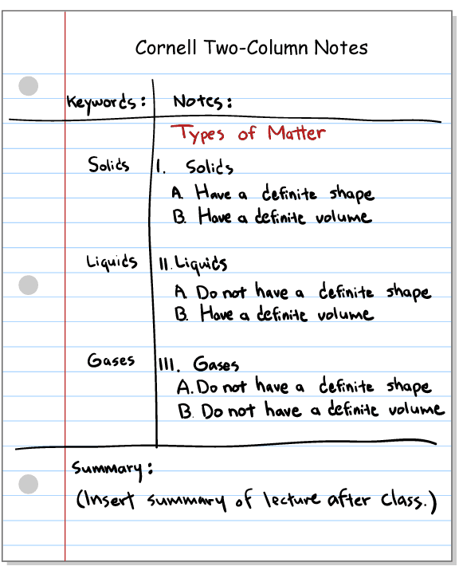

Slide 20
Step 4: Reflect
Reflect on the material by asking yourself questions, for example:
-What’s the significance of these facts?
-What principles are these based on?
-How can I apply them?
-How do they fit in with what I already know?
-What’s beyond them?

Slide 21
Step 5: Review
Spend at least 10 minutes every week reviewing all your previous notes. If you do, you’ll retain a great deal for current use, as well as, for the exam.

Slide 22
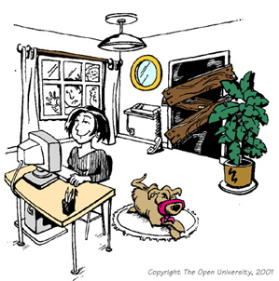
Remember: only 10 minutes a week (minimum) for each subject.
With 6 subjects, that’s only an hour a week.

