Slide 2
Let’s Review
study jam
Reflection
absorption
refraction

Slide 3
Two equally true statements:
The only thing we can hear is sound.
The only thing we can see is light.

Slide 4
How do we see color?
The color of an object is not actually within the object itself. Rather, the color is in the light that shines upon it and is ultimately reflected to our eyes.

Slide 5
Study Jam
4 mins

Slide 6
Make sure you know that...
Black - absorbs every color
White - reflects all colors

Slide 7
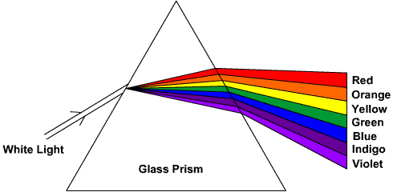
Let look at Prisms
This causes light of different colors to be refracted differently and to leave the prism at different angles, creating an effect similar to a rainbow. This can be used to separate a beam of white light into its constituent spectrum of colors.

Slide 8
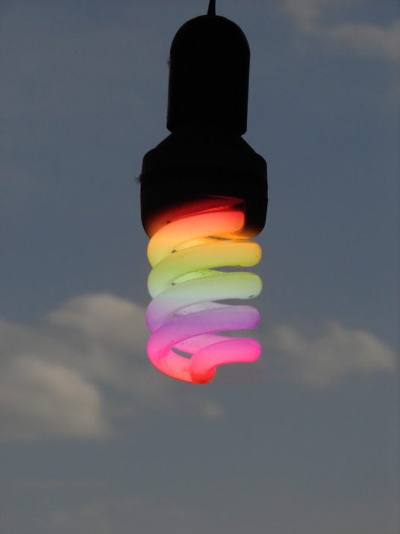
How do we see color?
When visible light strikes an object
and a specific frequency becomes
absorbed, that frequency of light will
never make it to our eyes.
Any visible light that strikes the object and becomes reflected to our eyes will contribute to the color appearance of that object. So the color is not in the object itself, but in the light that strikes the object and ultimately reaches our eye.

Slide 9
How do we see color?
The only role that the object
plays is that it might contain
atoms capable of selectively absorbing one or more frequencies of the visible light that shine upon it. So (for example), if an object absorbs all of the frequencies of visible light except for the frequency associated with green light, then the object will appear green.

Slide 10
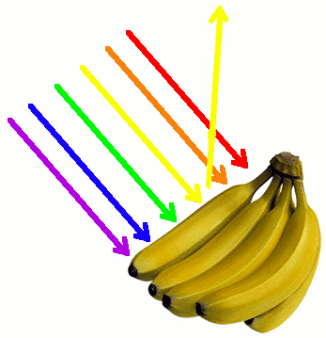
Can you see what is wrong with this diagram?

Slide 11
Check your understanding:
White light shines on both papers. What color will each paper appear to be?

Slide 12
How does the eye work?
5.09

Slide 13
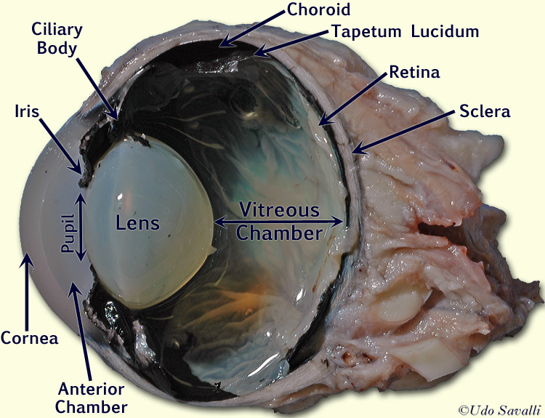
Cow eye dissection
8.05
13 min version

Slide 14
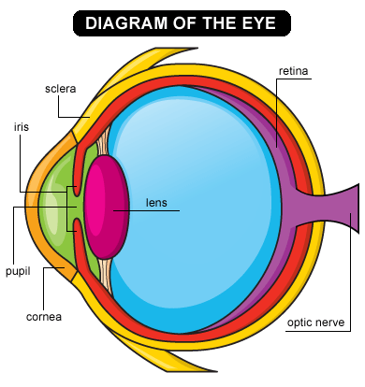
The eye

Slide 15
Discovery Education
https://app.discoveryeducation.com/player/view/assetGuid/799A1DB0-668D-4F76-B616-5D48B365E630# Label the parts of the eye. This has been assigned to you on Discovery Education.

Slide 16
Homework
Make sure you go over the terms at the top of the sheet. For homework, answer the questions below the definitions

Slide 17
Extensions

Slide 18
The Human Eye
The human eye has cone cells for detecting red, blue, and green light. These cells are used for daylight vision.
Rod cells are used in night vision since they detect only light and dark.

Slide 19
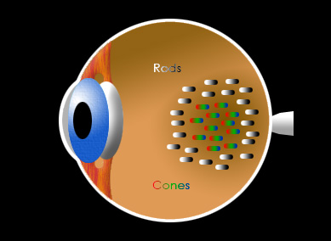
Rods and Cones in the Retina: Remember, the cones are red, green, and blue.

Slide 20
Stare at the center of the circle in the next slide.

Slide 23
Cyan is composed of blue and green. After staring at cyan for a long time, you have exhausted the blue and green cone cells in your eye. Therefore, when you look at white, you see red after staring at cyan.

Slide 24
When have you ever experienced this phenomenon?

Slide 25
When someone takes your picture using a flashbulb, you see black spots. The flashbulb exhausted all of the cone cells in your eye so none of them were working for a few moments, and you don’t see any light.

Slide 26
Stare at the center of the circle in the next slide.

Slide 29
Yellow is composed of red and green. After staring at yellow for a long time, you have exhausted the red and green cone cells in your eyes. Therefore, you see blue after staring at yellow.

Slide 30
Stare at the center of the circle in the next slide.

Slide 33
Magenta is composed of red and blue. After staring at magenta for a long time, you have exhausted the red and blue cone cells. Therefore, you see green after staring at magenta.

Slide 34
Your eyes are capable of more complicated shapes than circles. Stare at the center of the heart on the next slide.

Slide 37
You should have seen a red heart after staring at the cyan heart since you have exhausted the green and blue cone cells from staring at cyan.

Slide 38
Stare at the center of the next slide.

Slide 41
You should have seen a green smiley face since your blue and red cone cells were exhausted from staring at the magenta smiley face.

Slide 42
Your eyes are capable of resolving an even more complicated picture. Stare at the center of the next slide.

Slide 45
Your eyes are capable of resolving an even more complicated picture. Stare at the center of the next slide.

Slide 48
The U.S. flag was originally cyan, yellow and black.
After it was removed it appeared red, white, and blue.

Slide 49
If NO color reaches your eyes, you see BLACK. If ALL color reflects and reaches your eyes you see WHITE .

Slide 50
Stare at the center of the even more complicated picture.

Slide 53
Test yourself for colorblindness!

Slide 54
What Controls Color Blindness ?

Slide 55
Color blindness usually involves the colors of red and green.
Color blindness is found in 4% of the male population and 0.25% of the female population.

Slide 56
Color blindness is a sex linked recessive genetic trait that appears on the X chromosome.
Since men have only one X chromosome, if the gene for color blindness appears on it, they will be color blind.
Women have two X chromosomes and it would have to appear on both X chromosomes before the woman would exhibit the trait.

Slide 57
Color Blind Test

Slide 58
What do you see in the next slide?

Slide 59
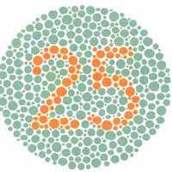

Slide 60
Color Blind Results
Everyone should have seen the number 25.

Slide 61
What do you see in the next slide?

Slide 62
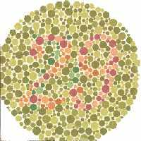

Slide 63
Color Blind Results
If you have normal vision you should see the number 29.
If you are red-green color blind you will probably only see spots.

Slide 64
What do you see in the next slide?

Slide 65
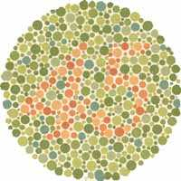

Slide 66
Color Blind Results
If you have normal vision you should see the number 45.
If you are red-green color blind you will probably only see spots.

Slide 67
What do you see in the next slide?

Slide 68
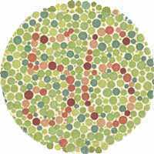

Slide 69
Color Blind Results
Everyone should see the number 56.

Slide 70
What do you see in the next slide?

Slide 71
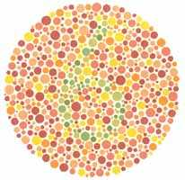

Slide 72
Color Blind Results
If you have normal vision you should see the number 6.
If you are red - green color blind you will probably only see spots.

Slide 73
What do you see in the next slide?

Slide 74
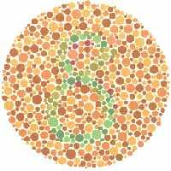

Slide 75
Color Blind Results
If you have normal vision you should see the number 8.
If you are red - green color blind you will probably only see spots.

Slide 76
What NUMBER do you see in the next slide?

Slide 77
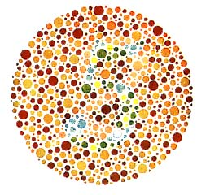

Slide 78
Color Blind Results
The individual with normal color vision will see a 5 revealed in the dot pattern.
An individual with red - green (the most common) color blindness will see a 2 revealed in the dots.

