Slide 1
Visible Light

Slide 2
Today’s Essential Question
What are the sources and types of light and how do they interact with mediums?
6.p.1.2

Slide 3
Let’s Review - Electromagnetic spectrum
Brainpop

Slide 4
Notes
Electromagnetic spectrum - Types of radiation organized by amount of the energy they carry
Radiation - Any movement of energy through space - a wave of moving electric and magnetic fields

Slide 5
The spectrum in order
Song 2.35

Slide 6
Visible Light
Three sources of visible light
Incandescence
Luminescence
bioluminescence

Slide 7
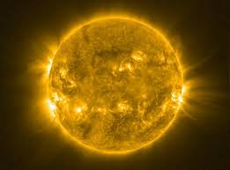
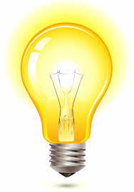
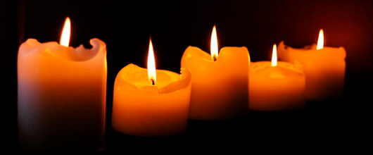
Visible Light
Incandescent - Production of light at high temperatures. When a material gets hot enough it gives off light by glowing or bursting into flames

Slide 8
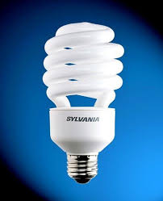
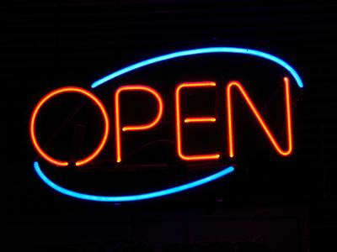
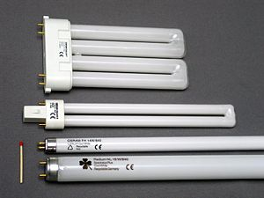
Visible Light
Luminescence - Production of light without high temperatures - neon and fluorescent lamps are examples

Slide 9
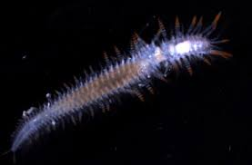
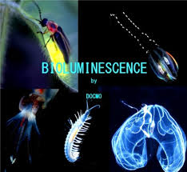
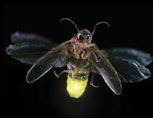
Visible Light
Bioluminescence - Production of light by living organisms

Slide 10
Light - How is it transmitted
Reflection - Bouncing back of a wave as it strikes a barrier
Absorption - Light disappears or is absorbed into a medium
Refraction - The bending of light when it crosses a boundary between two mediums

Slide 11
Reflection
•When light bounces off a surface, it is called reflection.
•When light is reflected it travels in a straight line away from the reflecting surface.
•When light bounces off a surface, it is called reflection.
•When light is reflected it travels in a straight line away from the reflecting surface.

Slide 12
Reflection
Light experiment

Slide 13
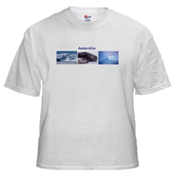
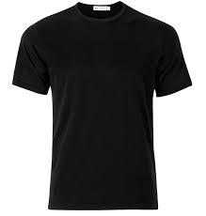
Absorption
•Any time light hits a surface, some of it is absorbed, or taken in.
•When light is absorbed into a surface it is transformed from light energy, into heat energy.
•That is why on a sunny day it is cooler to wear a white t-shirt, than a black t-shirt; dark surfaces absorb more light than lighter surfaces.

Slide 14
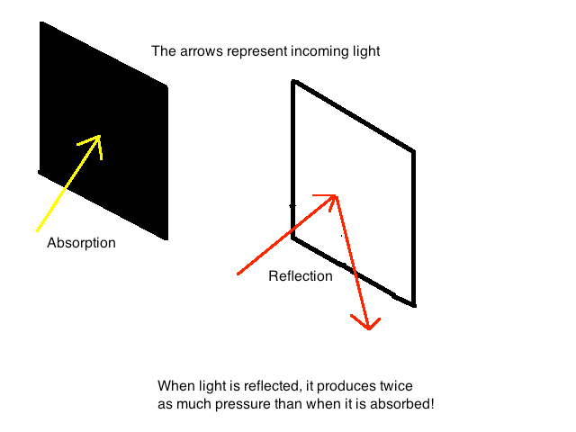

Slide 15
Refraction
Try this...
Ruler
Oil
water

Slide 16
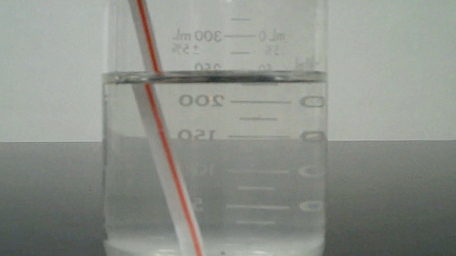
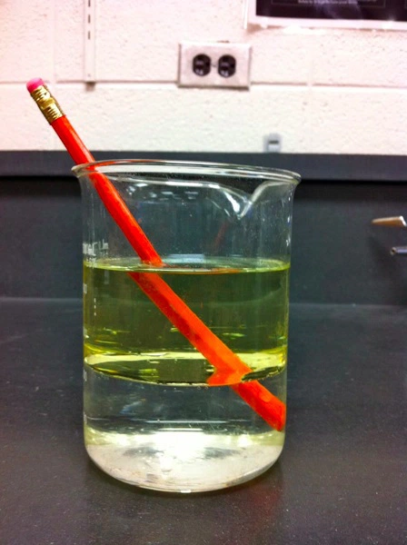
Refraction

Slide 17
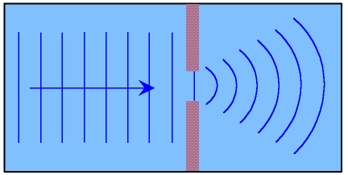
Diffraction
Diffraction - the spreading out of waves as they pass through an opening or around
the edges of an
obstacle.
Bozman 4.19
Holograms are an example

Slide 18
Brainpop - Light
light

Slide 19
credits
https://www.google.com/search?q=image+of+the+sun&espv=2&biw=1242&bih=566&tbm=isch&tbo=u&source=univ&sa=X&ved=0CDMQ7AlqFQoTCJjAiqrikskCFYbgJgodIi8BSg - image of the sun
https://www.google.com/search?q=image+of+a+light+bulb&espv=2&biw=1242&bih=566&tbm=isch&imgil=mWvzej1LXx0JRM%253A%253BvzHjw89RmuUIRM%253Bhttp%25253A%25252F%25252Fwww.crafthubs.com%25252Fbrowse%25253Ftip%2525253Dlight-bulb&source=iu&pf=m&fir=mWvzej1LXx0JRM%253A%252CvzHjw89RmuUIRM%252C_&usg=___5MjF8PCPAQdR2P5MwTZF7YOLKE%3D&ved=0CD4QyjdqFQoTCIvC6cfikskCFYntJgodH0UNCg&ei=OqhIVou9LYnbmwGfirVQ#imgrc=mWvzej1LXx0JRM%3A&usg=___5MjF8PCPAQdR2P5MwTZF7YOLKE%3D - image of a light bulb
https://www.google.com/search?q=image+of+a+candle&espv=2&biw=1242&bih=566&tbm=isch&tbo=u&source=univ&sa=X&ved=0CDcQ7AlqFQoTCOyyhpHjkskCFcZJJgodBasGHA#imgrc=xPjdMQPf_qzluM%3A - candle
https://www.google.com/search?q=picture+of+a+neon+sign&espv=2&biw=1242&bih=566&tbm=isch&imgil=suCiKSGrVsNmoM%253A%253BponDSnEiKG09jM%253Bhttp%25253A%25252F%25252Fsmallbusiness.chron.com%25252Fneon-signs-businesses-5081.html&source=iu&pf=m&fir=suCiKSGrVsNmoM%253A%252CponDSnEiKG09jM%252C_&usg=__lHBNZ4HdDc6c8zwXEyviNNsc1r8%3D&ved=0CFEQyjdqFQoTCIj7-rrnkskCFQXCJgod-a4C9w&ei=Xa1IVsjYOYWEmwH53Yq4Dw#imgrc=suCiKSGrVsNmoM%3A&usg=__lHBNZ4HdDc6c8zwXEyviNNsc1r8%3D - neon
https://docs.google.com/presentation/d/1ddXh4b7qBgXrSEQM2amYUo88KGMCl1MJji7HplDmZjM/edit#slide=id.gd8815565a_0_148 - florescent
https://www.google.com/search?q=images+of+bioluminescent+organisms&espv=2&biw=1242&bih=566&tbm=isch&tbo=u&source=univ&sa=X&ved=0CCIQsARqFQoTCI2s1a_okskCFcruJgodzxwN3w - bioluminescience

