Slide 1
5 Solubility

Slide 2
Warm up
Go to the symbaloo on the matter tab on the website. Pull up Sci Fri and explore the site. Be ready to share an article that you are interested in exploring further.

Slide 3
Objective
How do solubility and melting points work?
How can I use a lab to explore my ideas?
How does temperature and size affect solubility?
6.p.2.3

Slide 4
Vocabulary Words for Cornell Notes
Physical Property
Melting Point
Boiling Point
Solubility
Sovent
Solute

Slide 10
Solute and Solvent
A substance dissolved into another substance is called a solute
The substance used to dissolve is called the solvent
With alka seltzer and water; the alka seltzer is the solute and the water is the solvent.

Slide 11
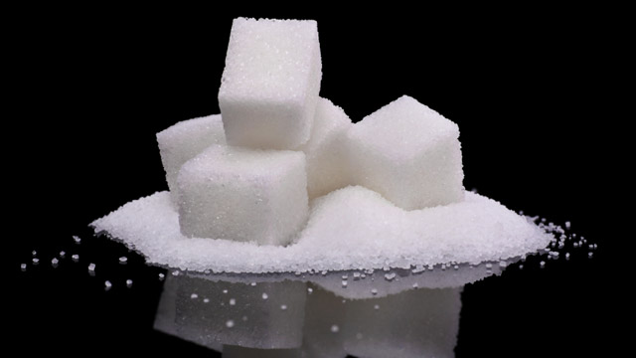
Another way to look at it
A solvent is known as the substance that dissolves the solute, a solute on the other hand is the substance being dissolved. For example when you miss water and sugar. The water will be the solvent and the solute will be the sugar.

Slide 12
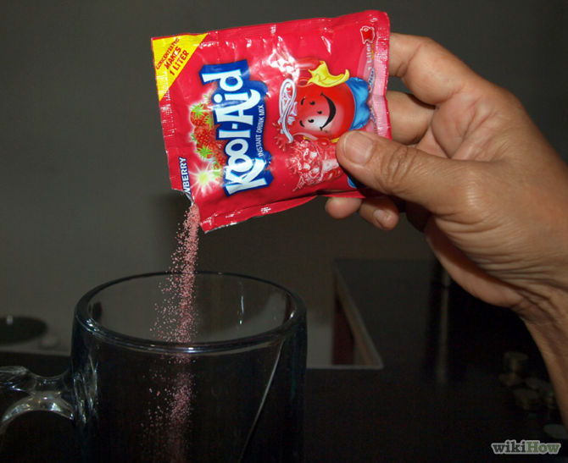
Which is Which
Solvent - ????
Solute - ????

Slide 15
Lab safety
In this lab you will be using a hot burner and tin foil as well as glass beakers. It is important that you exercise caution and good judgement at all time.

Slide 16
Lab Procedure
Your group need to investigate both solubility and melting points
Follow the instructions on your lab sheet.
Make sure to curl the edges of the tin foil up to make a “bowl” so that the items do not spill over
Share the work and the opportunities between your team members
BE CAREFUL of the heat element!!!!!

Slide 17
Homework
Study your new terms and prepare for your formal assessment on Thursday!!!!

Slide 18
Credits
https://www.google.com/search?q=picture+of+sugar&espv=2&biw=1093&bih=534&tbm=isch&imgil=KEExcQg3bRx9GM%253A%253BagOZz2JoDGiczM%253Bhttp%25253A%25252F%25252Fwww.cbc.ca%25252Ffifth%25252Fblog%25252Fcredits-for-the-secrets-of-sugar&source=iu&pf=m&fir=KEExcQg3bRx9GM%253A%252CagOZz2JoDGiczM%252C_&usg=__Z8v4ydNdBNJtBx1Z-KO7kTgDYnY%3D&ved=0CDAQyjdqFQoTCI7ajeq2vsgCFQFpPgodBu4A-Q&ei=FXAcVs77G4HS-QGG3IPIDw#imgrc=KEExcQg3bRx9GM%3A&usg=__Z8v4ydNdBNJtBx1Z-KO7kTgDYnY%3D
https://www.google.com/search?q=picture+of+water&espv=2&biw=1093&bih=534&tbm=isch&imgil=IvC9-tEAYVYuXM%253A%253BXrMru_vYfjbx5M%253Bhttp%25253A%25252F%25252Fwww.wnd.com%25252F2015%25252F02%25252Fmontanans-fight-to-last-drop-over-precious-water-rights%25252F&source=iu&pf=m&fir=IvC9-tEAYVYuXM%253A%252CXrMru_vYfjbx5M%252C_&usg=__Qs3-RSQ1hvjFYuUkL6hnXMAUH_w%3D&ved=0CDAQyjdqFQoTCIyq67i3vsgCFQaPDQodEMgGCA&ei=unAcVozlIoaeNpCQm0A#imgrc=IvC9-tEAYVYuXM%3A&usg=__Qs3-RSQ1hvjFYuUkL6hnXMAUH_w%3D

