Slide 1
Hearing and Sound

Slide 2
Objective
How do your ears receive sound?
What is the relationship between sound production and reception?
6.P.1.3
Let’s review our homework

Slide 3
Terminology for you (notes!!!)
Hertz - one complete wave (cycle per second)
Hertz determines pitch and is measured by frequency
High frequency = High Pitch - amount of waves
Amplitude - volume Height of waves
Decibels - The unit we use to determine the intensity or loudness of a sound

Slide 4
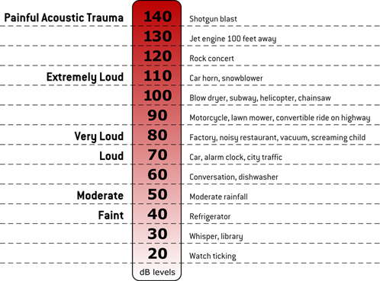

Slide 5
Instruments
cgp 5023

Slide 6
How do you produce sound
Your vocal cords in your voice box (larynx) tense up and draw close together when you are about to speak.
Air is pushed against the cords causing them to vibrate
This vibration causes sound waves
How vocal chords work 5.40
Singing quartet 3.14

Slide 7
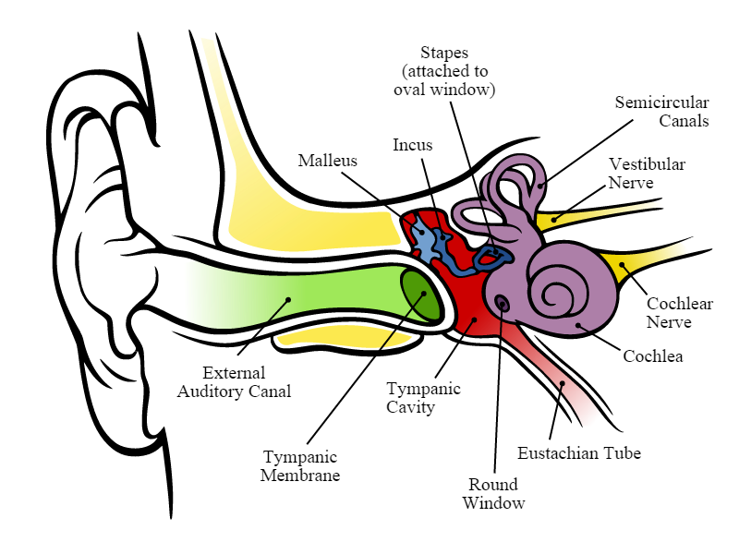
Now that you know how sounds are produced, how do we hear them?
3.26 video
6.44 more complete
5.04 NASA

Slide 8
What can we hear

Slide 9
How old are your ears?
1.37

Slide 10
Hearing test
with frequency waves

Slide 11
Homework
Read C52 - C63
Answer questions 11 - 19 on page C67

Slide 12
extensions
Mr Parr 3.19
Can you trust your ears 3.29
animusic 3.28
Bill Nye 31 mins

Slide 13
Credits
https://www.google.com/search?q=diagram+of+the+ear&espv=2&biw=1920&bih=919&tbm=isch&imgil=gGTArUnMZEdsQM%253A%253BtshBcG5miu8SMM%253Bhttps%25253A%25252F%25252Fcommons.wikimedia.org%25252Fwiki%25252FFile%25253AAnatomy_of_the_Human_Ear_en.svg&source=iu&pf=m&fir=gGTArUnMZEdsQM%253A%252CtshBcG5miu8SMM%252C_&dpr=1&usg=__iQIKM840FAEGNSPuB6SvrYjSiow%3D&ved=0CDAQyjdqFQoTCMmQmLqL_8gCFUpJJgodHKULgQ&ei=wVY-VomsDsqSmQGcyq6ICA#imgrc=gGTArUnMZEdsQM%3A&usg=__iQIKM840FAEGNSPuB6SvrYjSiow%3D - ear diagram
https://www.google.com/search?q=image+of+decibels&espv=2&biw=1920&bih=919&tbm=isch&imgil=0wsYk5KUACNYLM%253A%253B89C8EZ0Fb0e8gM%253Bhttp%25253A%25252F%25252Fwww.noisemonitoringservices.com%25252Fdecibels-explained%25252F&source=iu&pf=m&fir=0wsYk5KUACNYLM%253A%252C89C8EZ0Fb0e8gM%252C_&usg=__OIVGHsHwxL8JO8dhDs0p_VsooMo%3D&ved=0CDkQyjdqFQoTCMrc-cOS_8gCFUvrJgodyaQDtA&ei=LF4-VsqWLsvWmwHJyY6gCw#imgrc=0wsYk5KUACNYLM%3A&usg=__OIVGHsHwxL8JO8dhDs0p_VsooMo%3D - decibles

