Slide 1
EXPLORING FOUR EMPIRES OF MESOPOTAMIA
History Alive Chapter 6

Slide 2
6.1 Introduction
Sumerian city-states were like independent countries.
They fought over land and water rights.

Slide 3
Crescent Moon

Slide 4
The Fertile Crescent

Slide 5
What is an empire?
An empire is a large territory where several groups or people are ruled by a single powerful leader or government

Slide 7
Who controlled Mesopotamia?
Akkadian Empire
Babylonian Empire
Assyrian Empire
Neo Babylonian Empire
Between 2300 and 539 B.C.E.

Slide 8
Who controlled Mesopotamia?
There were other groups that controlled Mesopotamia.
In the 6th grade, we focus on only four empires that controlled Mesopotamia.

Slide 9
The Land Between Two Rivers
Mesopotamia is Greek for “the land between two rivers.”
The names of the two rivers are the Tigris River and the Euphrates River.
Tigris River
Euphrates River

Slide 10
6.2 The Akkadian Empire
In 2300 B.C.E. the Akkadians conquered the land.
Sargon was a strong king and skilled ruler.

Slide 11
Sargon the Great Military Leader
Assembled large armies.
Soldiers would fight in tight formations.
Soldiers would carry shields.
Another group would carry spears.

Slide 12
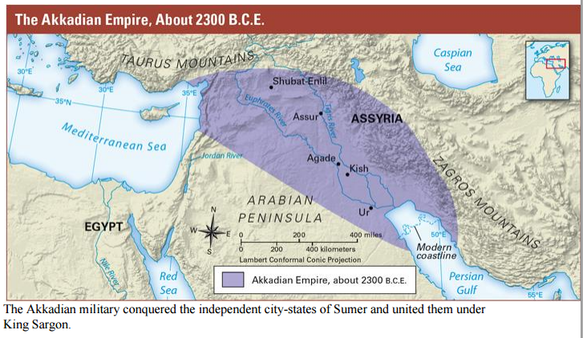

Slide 13
Sargon
He destroyed the walls of cities so people would not rebel.
He created the world’s first empire.

Slide 14
6.3 Life Under Akkadian Rule
Sargon used tributes to build his empire.
Tribute is wealth sent from one country or ruler to another as a sign that the other is superior.

Slide 15
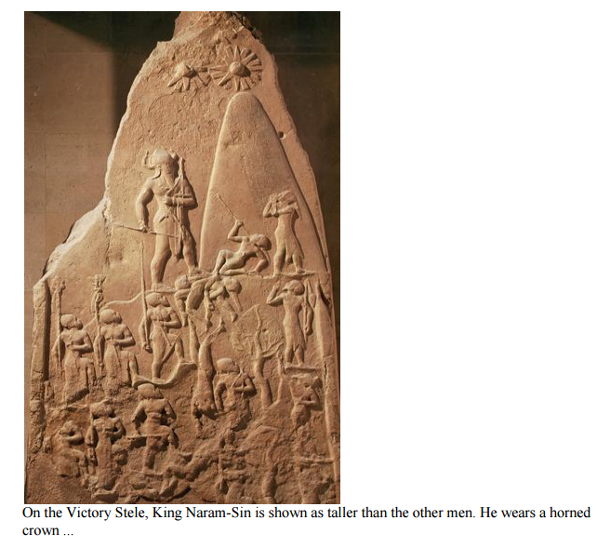

Slide 16
Akkadian Empire
Rise and fall 3.33

Slide 17
6.4 Hammurabi and the Babylonian Empire
Hammurabi became the next ruler.
He was the king of Babylon.

Slide 18
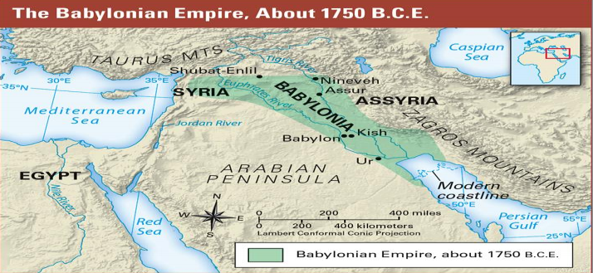

Slide 19
Hammurabi’s Code of Laws
Hammurabi’s Code of Laws unified his empire and preserved order.
He believed the Gods had asked him to create laws.
The code of law was written on a stele.

Slide 20
Hammurabi’s Code of Laws
The laws were very detailed they covered, trade, payment, marriage, divorce, and other matters of daily life.
This was a great achievement.

Slide 21
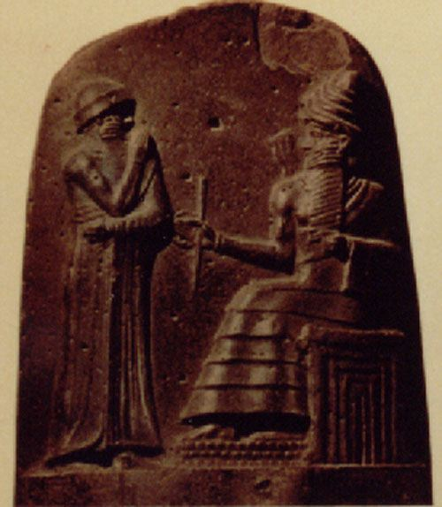
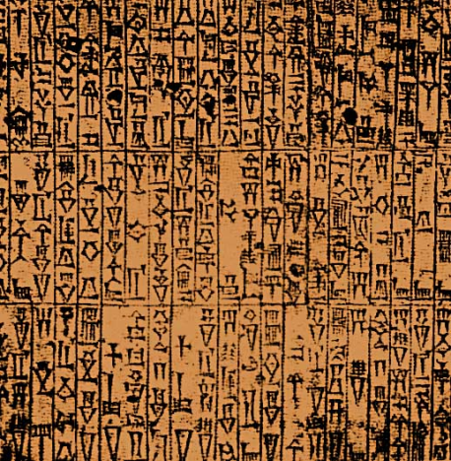
Hammurabi’s Code
Picture of King Hammurabi
Rights and responsibilities of Babylonian s

Slide 22
6.5 Life in the Babylonian Empire
Babylonia thrived under Hammurabi.
The Babylonian fod Marduk became the supreme god.

Slide 23
Babylonia
Became an important trade center.
They traded grain, cloth, wood, gold, silver, precious gems, and livestock.
Trade helped the economy.
Arts and writing flourished.

Slide 24
6.6 The Assyrian Empire
The Assyrians were a warlike people.
After taking over the Assyrians began to expand their army.
King Tiglath-Pileser was one of the best known leaders

Slide 25
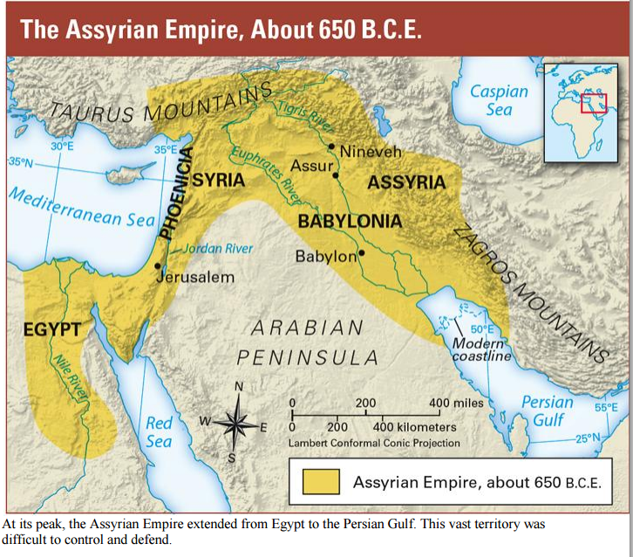

Slide 26
Assyrian Empire
They were feared for their military might.
They created new weapons and new military strategies.

Slide 27
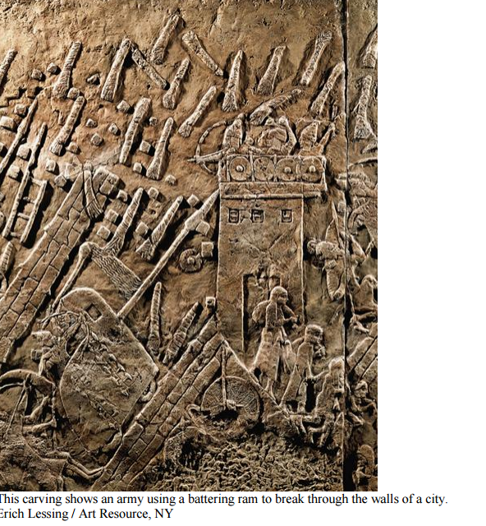

Slide 28
Assyrian Empire
Used siege warfare.
Created battering rams.
Long poles on wheels for punching holes in walls.
Built moveable towers to help soldiers climb over walls.
Created fear among their enemies.

Slide 29
6.7 Life Under the Assyrians
The Assyrians believed that their kings were special beings selected by the gods.
Huge sculptures of winged and human headed bulls or lions stood at entrances.

Slide 30
Life Under the Assyrians
Kings ruled and there were farmers.
There was an irrigation system and aqueducts.
A canal brought water to Nineveh that was 30 miles away.

Slide 31
Life Under the Assyrians
Craftspeople created two dimensional sculpture called bas-reliefs on palace walls.
The Assyrian Empire lasted 300 years.
Nineveh was plundered.

Slide 32
6.8 The Neo-Babylonian Empire
After the fall of Nineveh, the Babylonians regained control over Mesopotamia.
They established a new empire, the word neo means new.

Slide 33
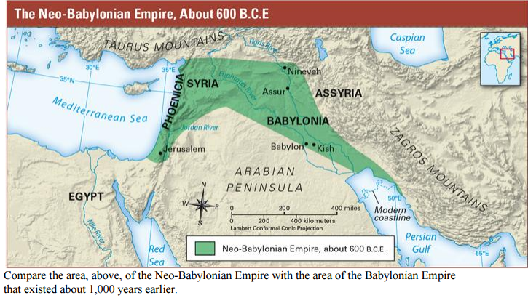

Slide 34
Nebuchadrezzar
Expanded the empire.
Drove the Egyptians out of Syria.
He controlled Canaan or present day Israel.
He made the Hebrews slaves in Babylonia.

Slide 35
Nebuchadrezzar
As a military leader he wanted to keep his capital safe.
He built an inner and outer wall around the city.
Towers were also built and archers would stand on top of them.
A moat was also built.

Slide 37
View of Babylonia

Slide 38
6.9 Life in the Neo-Babylonian Empire
Ziggurats were rebuilt.
Nebuchadrezzar created the Hanging Gardens of Babylon.
First sundial was created.
60 minute hours and 7 days in a week were created.

Slide 39
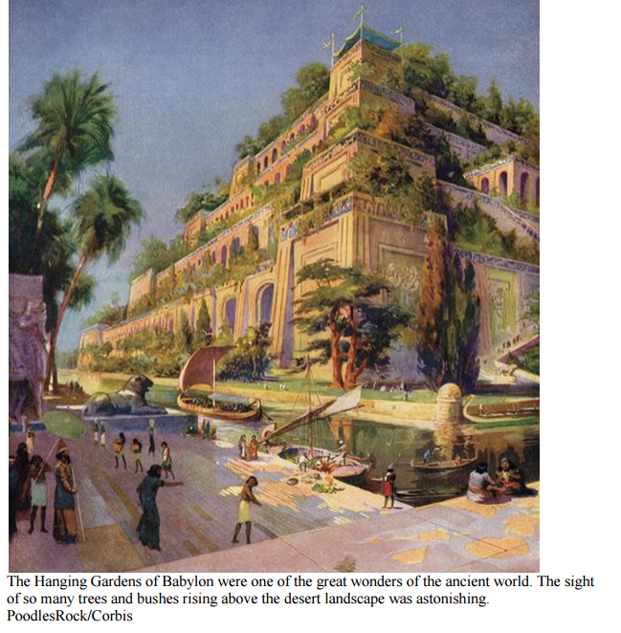

Slide 40
The End
Credits - Frost middle school
https://d3jc3ahdjad7x7.cloudfront.net/4QRHdAkZ25bZZ5zs2LbsB9OUXrGISNtqBuwDdkIRjn1Ce8Ac.pdf

