Slide 1
4 Meet the Elements

Slide 2
Objective
What are the difference between the elements and how are they used in the world?

Slide 3
Lab Reports returned block 2 and 3
Most issues were due to groups not following the rubric
If your group scored under a 79% you may redo as a group or individually

Slide 4
A Definition
An element is a substance consisting of atoms which all have the same number of protons - i.e. the same atomic number. Elements are chemically the simplest substances and hence cannot be broken down using chemical methods.

Slide 5
Meet the Elements
Meet the elements 3.14

Slide 6
Elements Song
song

Slide 7
Today’s Project
The card you picked as you came in the door is now your adopted element. Your job is to learn about your element and share with your classmates. You can use the interactive periodic table on the symbaloo located on my website.

Slide 8
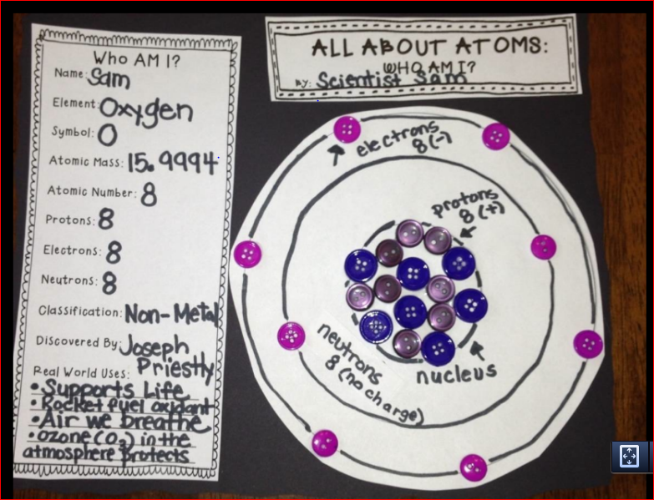

Slide 9
Homework
Finish the work you received on Monday. Due Friday.

