Slide 1
Sumerian Civilization

Slide 2
What are the elements of Sumerian City States?

Slide 3
SWAGR

Slide 4
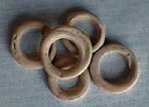
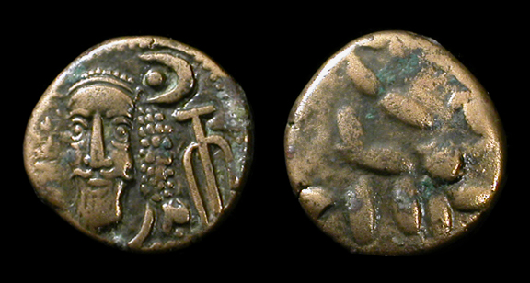
Sumarian Currency

Slide 5
Overview
3.21 overview

Slide 6
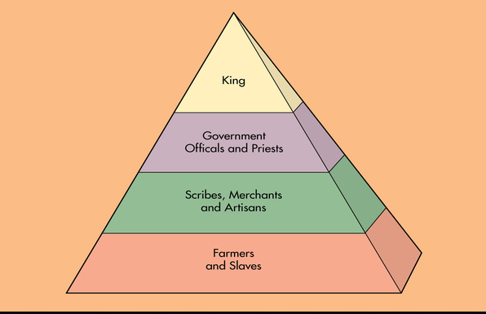
((S)) Social Structure - discovery education

Slide 7
How did they live?
Priests, Landowners and Government officials - Had large luxurious 2 story homes near the center of the city
Merchants, craftspeople, farmers, fishermen and metalworkers had small mud-brick houses along the edges of the city
Slaves - owned no property and lived in the homes of their owners

Slide 8
((W)) Writing - Cuneiform
Direction of writing: variable - early texts were written vertically from top to bottom, but by about 3,000 BC the direction had changed to left to right in horizontal rows. At the same time the signs were rotated 90° anticlockwise and started to be made up mainly of wedges.
Number of symbols: between about 1,000 in older texts to 400 in later texts.
Many of the symbols had multiple pronunciations

Slide 9
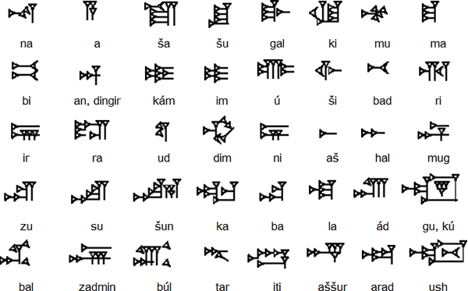
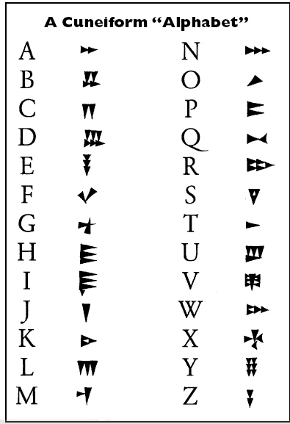
Cuneiform Example

Slide 10
Try this for yourself
Keep in mind that there is no perfect way to make Cuneiform fit into our English alphabet, but it is fun to try!

Slide 11
((A)) Art and Architecture
This pertains to music, art, stories, buildings, jewelry and technological advances

Slide 18
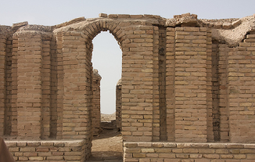
Inventions of early Sumarians - Technology
Plow (6000 BCE)
Cuneiform (2400 BCE) - through several modifications
Arches - For beauty and strength
Wheel (3500 BCE)
Math ( First for trade)
Time (60 minutes)
Bronze (copper and tin)

Slide 19
((G)) Government

Slide 22
((R)) Religion

Slide 23
Think Swagr

Slide 24
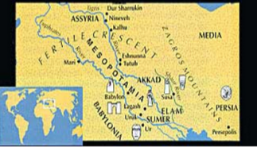
Soon….Empires begin!!!!

Slide 25
Group work
Look at paragraph 1 and 2 of your rubric.
Work with your group to answer those questions and begin to structure your government

Slide 26
Homework
Read 5.3 - 5.7 Look for and define any words you find.
Answer questions in your study guide 11 -16

Slide 27
Extension
13.58 - all about Sumer

