Slide 1
Changing States of Matter

Slide 2
Warm up
You are having an argument with your friend about what happens to the mass when matter changes from one form to another. To prove your idea, you put three ice cubes in a sealed plastic baggie and record the mass. You let the ice cubes melt completely then record the mass of the water. Which is the result?
The mass of the water will be less than the mass of the ice cubes
The mass of the water will be the same as the mass of the ice cubes
The mass of the water will be more than the mass of the ice cubes

Slide 3
Answer!!!!!
Mass is the measure of the amount of matter in a substance
When the water changes from one state to another the molecular structure does not change, so the amount of matter or mass doesn’t either.

Slide 4
Answer
When the water changes states, the motion of the molecules changes and the arrangement of molecules changes; but not the NUMBER of molecules. Remember atoms have the same mass no matter what state or form they are in.

Slide 5
Essential Question
What are the properties of the three states of matter and how can I describe how they change states from one to another?
6.p.2.2

Slide 6
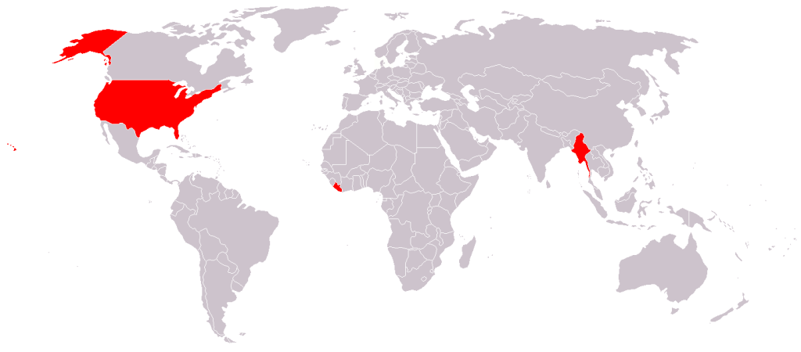
What do you think this projection map represents?

Slide 7
Farenheit vs Celsius
Liberia, Myanmar and the United states are the only countries to use farenheit

Slide 8
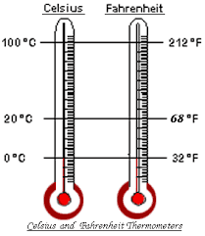
Fahrenheit vs celsius thermometers
Boiling Point
Room Temperature
Freezing Point

Slide 9
Review Three states of matter - 3 volunteers (this should be in your notes)
Solid - Structure - molecule close - definite shape and volume - shape stays the same no matter what container
Liquid - molecules fairly close but in not set structure - Fixed volume, but no fixed shape ( in a glass)
Gas - molecules move faster and move farther away from each other. No fixed volume or shape ( filling a balloon)
The key is energy applied (heat)

Slide 10
Homework from Thursday
Take out your homework and discuss your answers with your table partner
If you did not complete it, please complete a 0 credit slip

Slide 11
Tim and Moby
Look for theses terms a jot a definition during the movie (set up as Cornell notes)
Melting
Melting point
Boiling point
Sublimation
Find a partner and compare
3.12 - changing states of matter

Slide 12
How did you do?
Melting
Melting Point
Boiling Point
Sublimation
Solid becoming a liquid as heat energy is applied
The unique temperature in which a solid melts into a liquid
The point in which liquid turns into a gas
Turning directly from a solid state to a gas state

Slide 13
New learning
Heat always moves from hotter to cooler, never the other way “getting cold means losing heat to the surrounding cooler air
There is no such thing as cold, only less heat
Increasing temperature = increases energy - more heat quicker state change

Slide 14
Phase changes of matter
Solid
Liquid
Gas
Notes:
See drawing in notes

Slide 15
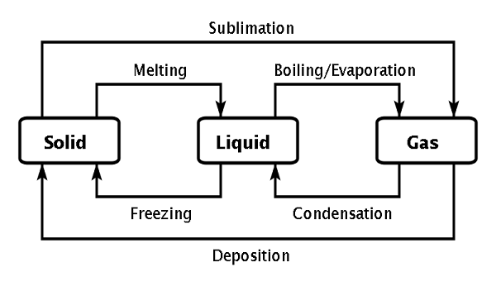

Slide 16
Notes for you
Heat can change matter
Heat can make matter change its state (from solid to liquid) OR
Heat can Change shape (melted chocolate)
The change can be reversed by removing heat so it is reversable.
Changes occur by adding or removing heat from the object.

Slide 17
Homework
Answer the short answer questions on what we have learned to date. This will be due on Friday….you get a break because Wednesday is a short day!!!!!

Slide 18
Kahoot
14 questions

Slide 19
Exit ticket
Answer the three questions on the exit ticket and hand it to me as you leave.

Slide 20
Group work based on formative

Slide 21
Extensions
Additional slides

Slide 22
Glass and Matter
4 minutes 38 seconds

Slide 23
Three states of matter video
What do these people know about matter?
Use water as an example 4.52
Use this for molecules and compounds

Slide 24
Rap - three states
Rap

Slide 25
Heat transfer song
song 3.15

Slide 26
