Slide 1
2 - Potential and Kinetic energy
December 7 and 8

Slide 2
Objective
I can understand the concept of potential and kinetic energy and give examples to demonstrate my understanding.

Slide 3
Energy
Energy has many forms, but is always conserved
Energy can be transformed but cannot be created or destroyed
Energy is measured in Joules - named after James Prescott Joule who came up with the idea that mechanical energy (motion) and heat energy were basically the same
Turn and talk about what you think that means and share some concepts you think you will be learning about in this unit
Answer this with your partner...true or false, only objects that are moving have energy??

Slide 4
Answer - False
molecules are always moving - therefore there is energy!
Today we will learn about two types
Potential
Kinetic

Slide 5
Potential Energy
Energy that is stored because of an object’s position, condition and chemical make up
Objects have the potential to move because of their location
Which object has more potential energy and why?

Slide 6
Did you pick the one on the left?

Slide 8
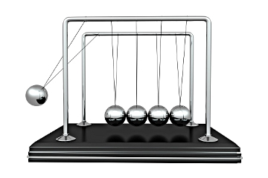
Potential energy
When an object has the potential to move; it has potential energy
2.05 - Brain pop
Let’s look at this

Slide 9
Types of potential energy
Elastic - tension - things like springs, rubber bands, bows and catapults are good examples
Gravitational - an apple can fall from a tree or a roller coaster
Chemical - Usually using heat or light - batteries and light bulbs

Slide 10
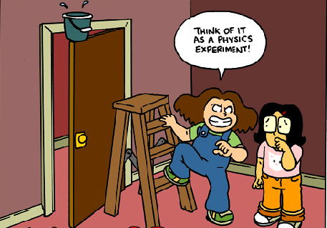

Slide 12
Kinetic energy
Potential - Stored energy which increases or decreases depending on an objects’s position and condition
Kinetic - The energy an object has because of its motion - If it isn’t moving it doesn’t have kinetic energy. It can be transferred when objects collide and can be transformed

Slide 14
Brain pop
2.28 - brain pop

Slide 15
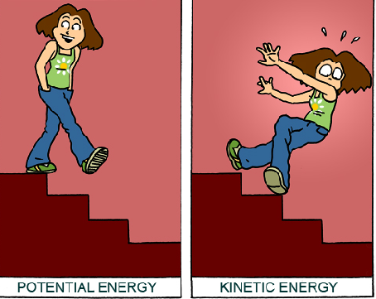

Slide 17
Answers
An apple on a table has more potential energy than the apple on the ground
A kid running has more kinetic energy than a parked car (motion)
A boy riding a bike has more kinetic energy than a boy walking (speed)
a tiger running has more kinetic energy than a rabbit running ( mass)

Slide 18
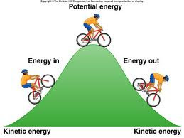

Slide 22
What would a presentation be without a song?!
Kinetic and potential energy 1.54
Bill Nye 2.01

Slide 23
Homework
Glue the top half of the sorting activity into your ISN and cut the individual pieces out and glue them onto the correct side of the organizer.
read pages 9 - 14 in section B

Slide 24
Extension
3.55 The story of
Mr Parr - Conversation 3.00
Bill Nye 2.00

Slide 25
Credits
Cartoons courtesy of Brainpop
https://www.google.com/search?q=example+of+electric+potential+energy&espv=2&biw=942&bih=889&tbm=isch&tbo=u&source=univ&sa=X&ved=0ahUKEwjqqKn_ra7JAhUGHh4KHeltDvcQ7AkILg#tbm=isch&tbs=rimg%3ACZ9SjDDBhyIVIjgMp7vEodjElPiiH6rsGUJxfD0RwdqxgUeK9XWgPniezNOhsvrTO4V-7P0XvqJYyUdfNUex3EiGHyoSCQynu8Sh2MSUEeKadEsnTVFbKhIJ-KIfquwZQnERuH2ilkJ2HHYqEgl8PRHB2rGBRxFyN8io5cD4WCoSCYr1daA-eJ7MEVGT6L6h0r7WKhIJ06Gy-tM7hX4Rta36s744dSwqEgns_1Re-oljJRxEK-YRDW72dZCoSCV81R7HcSIYfEeCISjQDcaYc&q=example%20of%20electric%20potential%20energy&imgrc=NmeKxOKBKVh2eM%3A - Bike picture
https://www.google.com/search?q=image+of+newton%27s+cradle&espv=2&biw=942&bih=889&tbm=isch&imgil=1SO8tlNH6ajSeM%253A%253BzUqoFDghYJM87M%253Bhttp%25253A%25252F%25252Fscience.howstuffworks.com%25252Fnewtons-cradle.htm&source=iu&pf=m&fir=1SO8tlNH6ajSeM%253A%252CzUqoFDghYJM87M%252C_&usg=__4nvcqz5PJ0Fcp14YfkezZuCv-FI%3D&ved=0ahUKEwj__cPxqq7JAhWKeT4KHbmWCwUQyjcIMw&ei=8htXVv-8Horz-QG5ra4o#imgrc=1SO8tlNH6ajSeM%3A&usg=__4nvcqz5PJ0Fcp14YfkezZuCv-FI%3D Newton’s cradle

