Slide 1
All About Matter

Slide 2
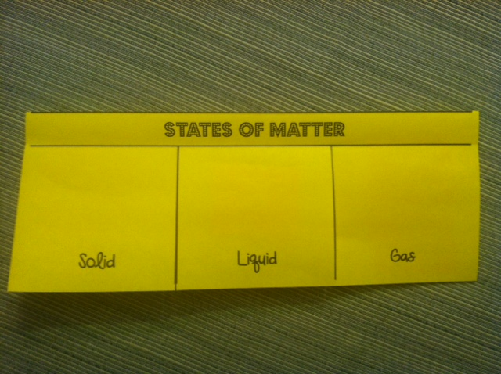
Make a foldable - Get out flashcards
Take a blank sheet of paper off the front table. Fold it hot dog style and make three cuts as seen in this picture. Label each section as seen below

Slide 3
Essential Questions
What are the three states of matter and how exactly are they different?
6.P.2.2

Slide 4
All about Matter
Matter is all around us.
It is everything we see and touch
Matter has three forms, solid, liquid and gas.(there is also plasma)
Matter is made up of molecules
Matter can change form with heat.

Slide 5
Three Questions
Turn and Talk
Why does an ice cube melt when it sits on a table?
Why does water freeze when placed in a freezer?
What happens when a glass of water sits out for a few days?

Slide 6
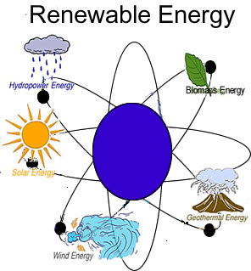
The Answer
It is the energy of the molecules!!!
Heat is a great source of energy

Slide 7
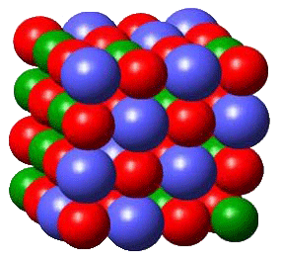
Eureka - Solids
4.49
Students demonstrate

Slide 8
Solid - put this information inside the flap labeled solid and add an illustration
Definition - An object with a definite volume and shape
Characteristics
Keeps its shape
Molecules vibrate - Although you can’t notice it
tightly packed
Can’t be compressed
Examples - Penny, Candle, chocolate bar, ice cube
Notes:
GASES COME UP IN ANOTHER LESSON

Slide 9
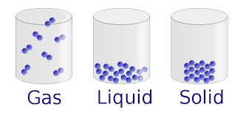
Foldable
Above you picture of solid - show tightly packed molecules.

Slide 10
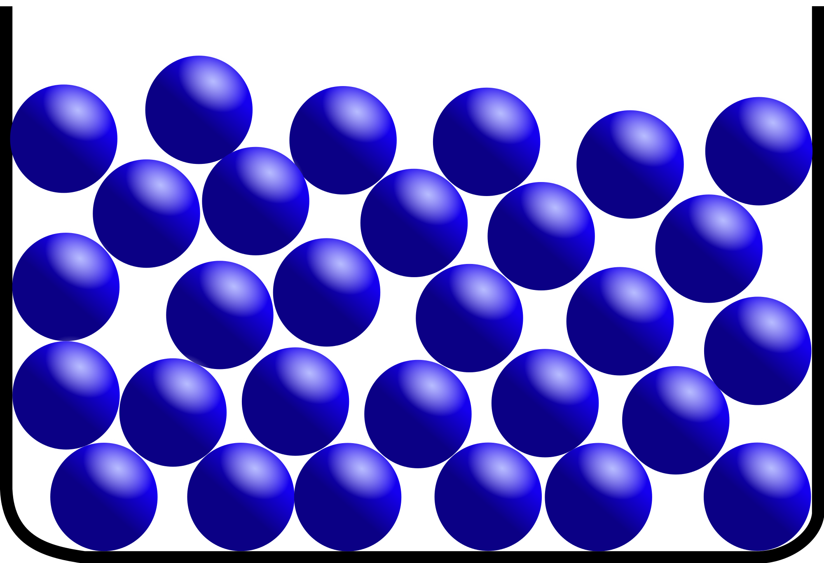
Eureka - Liquids
Students
demonstrate

Slide 11
Liquid - Made when heat (energy) is added to a solid - add your illustration
Definition - Something that moves or flows and that takes the shape of its container
Characteristics - Does not have its own shape, can move or flow, has definite volume
Examples - water, soda, juice, glue

Slide 12
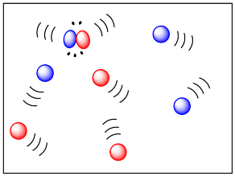
Eureka gas condensation and evaporation
4.49
Students
demonstrate

Slide 13
Gas - back to our foldable
Gases have no definite shape or volume.
If unconstrained, gases will spread out indefinitely.
If confined, they take the shape of their container (like a balloon)
Gas particles have enough energy to overcome attractive forces

Slide 14
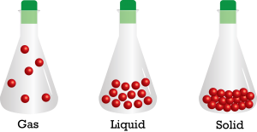
All three states in action
54 seconds

Slide 15
Additional things you should know
Energy appears in different forms
Heat energy is the disorderly motion of molecules
Atoms and molecules are always in motion
The greater the temperature the greater the energy
Most substances can exist as a solid, liquid or gas depending on temperature

Slide 16
mocomi kids - three states no words
2.28
Weird but informative

Slide 17
Three states rap
Rap 3.39

Slide 18
Homework and exit
Worksheet
First three parts
Fill out exit slip

Slide 19
Overview of all three states
3.38

