Slide 1
Rise of City States

Slide 2
Objective
I can identify and understand for the challenges faced by the citizens of the early sumerian city states

Slide 3
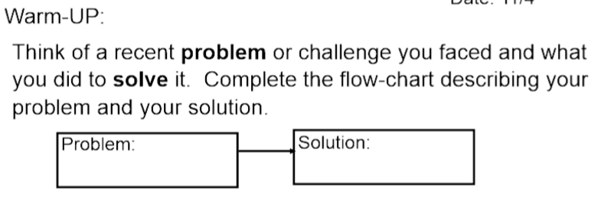

Slide 4
Vocabulary words
How many did you find in 4.1 and 4.2?
Mesopotamia
Irrigation canal (system)
City-State
Tigris River
Euphrates River

Slide 6
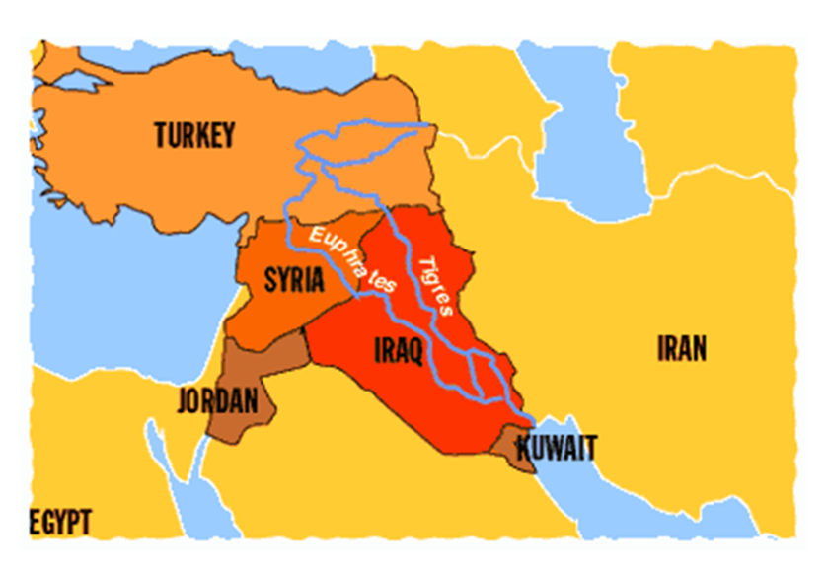

Slide 7
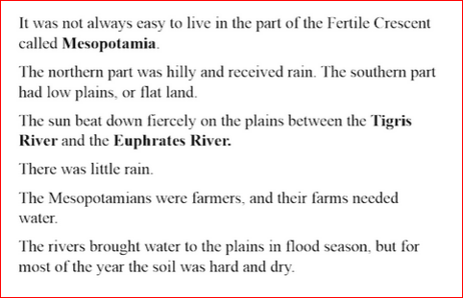
Is it perfect???......NO!

Slide 8
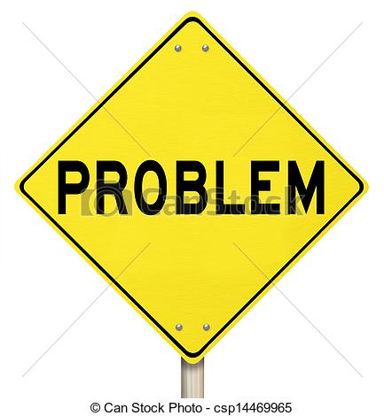
Problems to solve
There were four major challenges for the people of Sumer region of Mesopotamia.

Slide 9
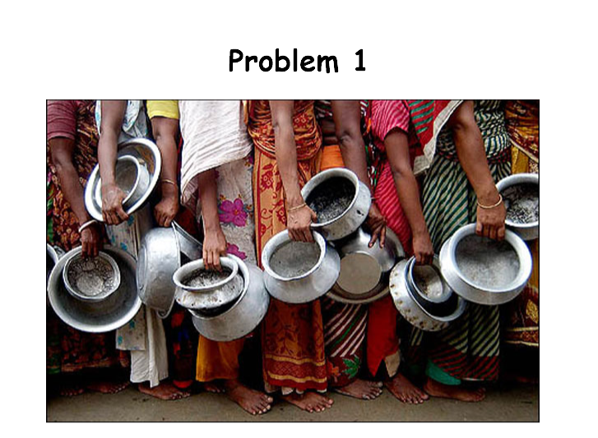

Slide 10
Food Shortages in the mountains
Farmers did not have enough land to grow food for the increasing population
Populations moved down to the plains for more land to farm to provide food. This made the city states in Sumar larger and larger

Slide 12
Uncontrolled Water supply in the plains
Flooding and drought - two HUGE issues
Solution - a series of canal, dams and levees to control and move the water where needed.
Levee - Earth walls to prevent flooding

Slide 13
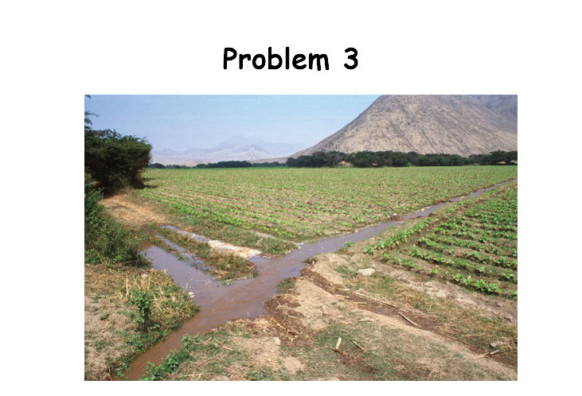

Slide 14
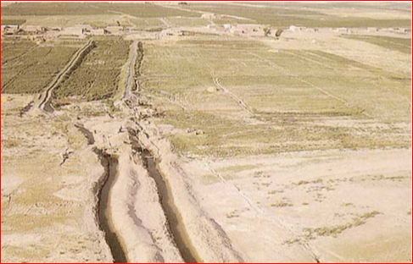
Trying to maintain the system
Trying to keep silt from clogging the system
Trying to keep the system running between city states
Solution - neighboring city states worked
together to keep canals free and clear...at least
for a while!

Slide 15
Mesopotamia Irrigation
1.37 Irrigation explained

Slide 16
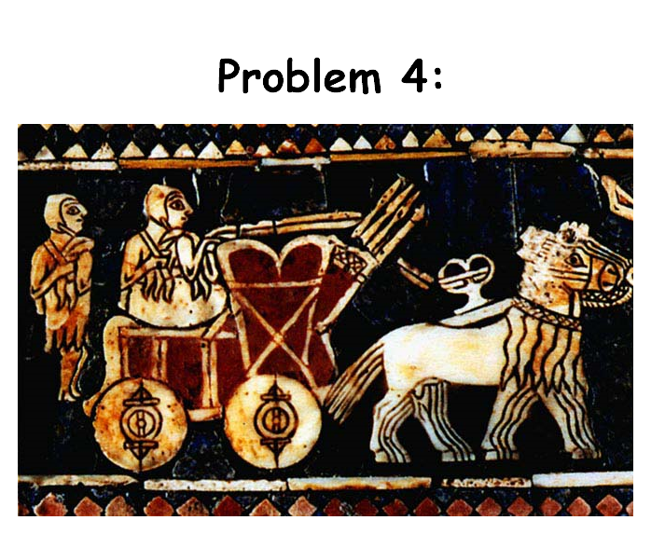

Slide 17
Attacks and Fighting over water
City states continued to fight over water and control of canals. Increasing population mading fighting fierce! Neighboring communities drew blood against each other.
City states began to learn to protect themselves with walls, moats and armies

Slide 19
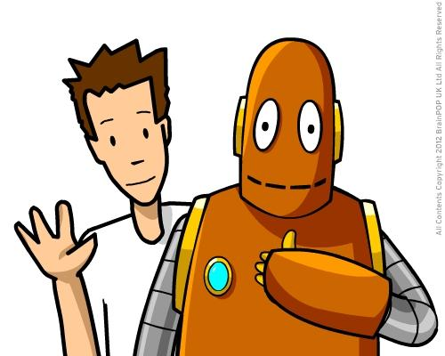
More about the Sumerians
Tim and Moby
City-state definition….

Slide 21
More information
9.34 - Sumerian city-states - to about 6 minutes

Slide 23
Homework
Study Guide questions 1 - 10
Read 4.3 - 4.7 This will help with the study guide - fill out any new vocabulary word definitions

Slide 24
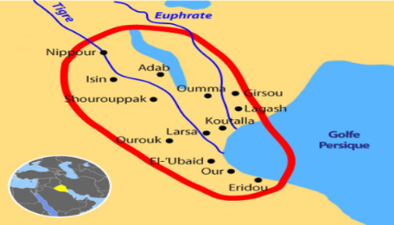

Slide 25
Group time
You are creating a new city state in Sumar. Name your state and look over the rubric with your team.

