Slide 1
Waves

Slide 2
Lesson objectives
Define the terms force medium, media, waves measurable properties
Outline how a wave transfers energy

Slide 3
Brain pop
Waves

Slide 4
Introduction Let’s learn some key terms
Force- a push or a pull that can change the direction or motion of an object .It creates a disturbance
Medium – matter in which waves can travel (media plural form)

Slide 5
Waves – a disturbance cause by a force that transfers energy

Slide 6
What really is a wave and how can it transfer energy?
Waves – a disturbance cause by a force that transfers energy
Wave move energy along over a certain distance without moving matter for great distances
e.g. Seismic waves move kinetic energy along by moving the earth “slightly”. (The ground return to its position)

Slide 7
Study Jams
http://studyjams.scholastic.com/studyjams/jams/science/energy-light-sound/sound.htm

Slide 8
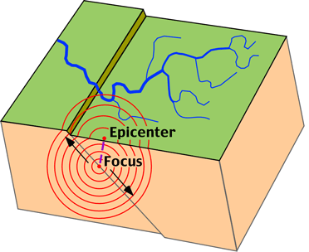
Seismic waves

Slide 9
There are so many waves! How do we classify them?
Two ways
(1) Based on the type of material they move through
(2) Based on:
Direction the disturbance moves related to how its’ energy moves

Slide 10
Classification 1
(1) Based on the type of material they move through
Material t type
Material t type
Mechanical
Electromagnetic
Mechanical
Electromagnetic
These need a medium to travel
through such as water
Air, ground
These travel through
empty spaces
These need a medium to travel through such as water
Air, ground
These travel through empty spaces

Slide 11
(2) Based on direction of the wave’s disturbance and particle movement
Direction of waves
Longitudinal
Transverse

Slide 12
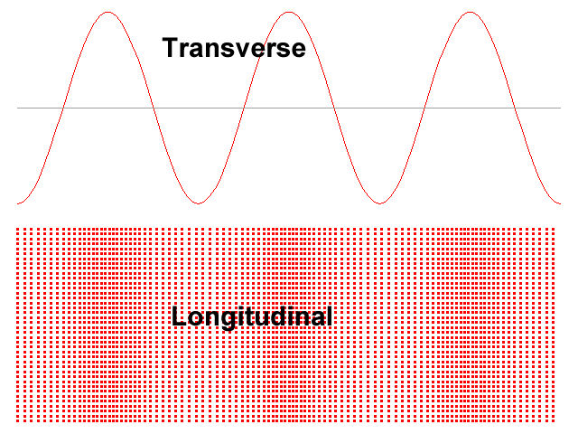
Direction of
particles/disturbance
Direction of wave

Slide 13
Transverse Wave
When the direction of disturbance meets the wave direction at a 90 Degree angle
(Math people = Perpendicular..get it?)
Example: Rope wave, Water wave..etc

Slide 14
Particles move in same
direction
Wave move in same direction as
Particles/disturbance

Slide 15
Longitudinal Wave
When the direction of disturbance travels in the same direction as the wave direction.
Example: Sound- vibration of the disturbance travels in the same direction as the air particles transferring the sound.

Slide 16
Stop and review
review here

Slide 17
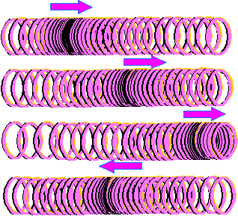
Additional notes
Longitudinal waves- are sometimes called compression waves because a section of it bunch up or compressed
here

Slide 18
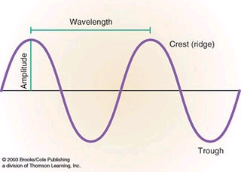
Waves are predictable and have measurable properties
Five ways in which you can measure wave properties are:
Crest
Trough
Amplitude
Wavelength
Frequency

Slide 19
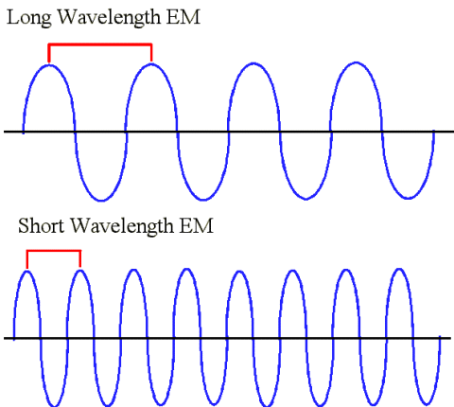
Waves are predictable and have measurable properties
Frequency and wavelength are related, as frequency increases wavelength decreases.
Therefore as wavelength decreases frequency increases.

Slide 20
Review
Song

