Slide 1
Atoms, Molecules and Elements

Slide 2
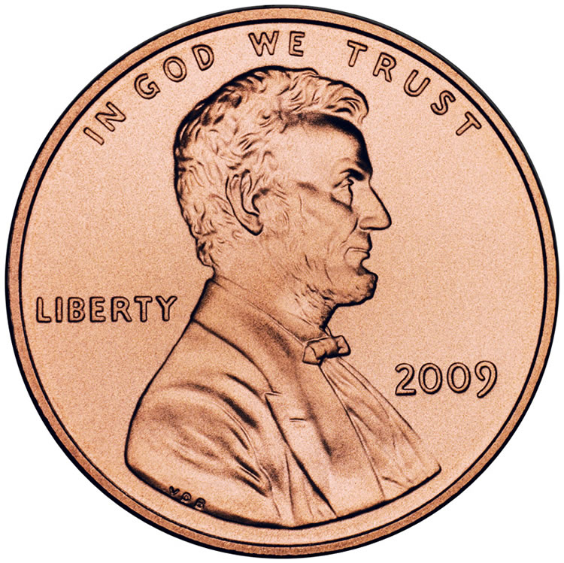
Warm Up - PENNIES
A shiny new penny is made up of atoms. Put an X next to all the
things on the list that describe the atoms that make up the shiny new penny.
___ hard ___ soft ___ always moving ___ do not move
___ solid ___ copper-colored ___ cold ___ warm ___ shiny ___ dull
___ very small ___ has mass ___ made of smaller particles
___ contains mostly empty space

Slide 3
Answer
Five items on the list make up the best response:
Very small
Has mass
Always moving
Made of smaller particles
Contains mostly empty space

Slide 4
Explanation
.Atoms are the smallest particles of matter that make up the substances zinc and copper (elements) in the penny. Most pennies circulating today are made up of 97.5%zinc and 2.5% copper. If a penny were made of pure copper, it would contain about 2.4 × 1024 copper atoms. This indicates that the size of an individual atom is very small. A penny weighs only about 2 g. With over 1024 atoms in a penny, this shows that the mass of an individual atom is extremely small, yet it still has mass. Atoms and molecules are always in motion and reach a minimum of motion in very extreme, cold conditions. Since the penny is a solid, the atoms that make up the penny are in a fixed position and can only move by vibrating. An atom is mostly empty space. Even though the zinc and copper atoms make up the solid substance of the penny, the atoms themselves are mostly empty space.

Slide 5
Learning Target
What are the differences between atoms, molecules, elements and compounds and how do they interact with the physical world?
6.p.2.1
Questions
How are an atom and a molecule different?
How do the terms atom and molecule differ from matter?
What is an element and a compound?

Slide 6
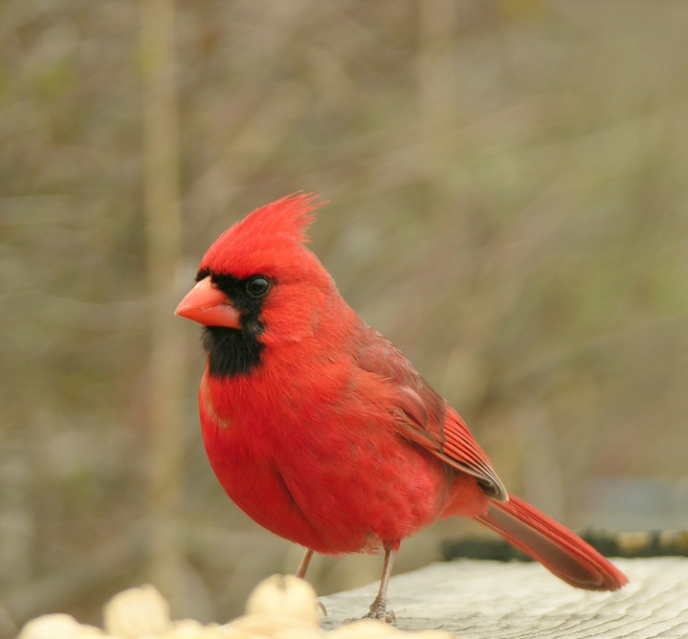
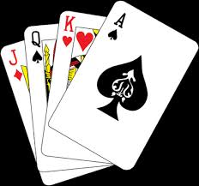
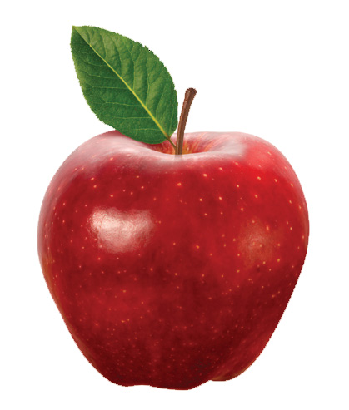
What is Matter?
Matter is anything that takes up space and has mass.

Slide 7
What is not matter?
Matter is virtually everything...
The only thing isn’t made is energy (sunlight, heat, electricity).
It has no mass or volume so it can’t be matter!

Slide 8
Let’s be more specific
If matter is a general word that means anything that takes up space and has mass...Then what are atoms and molecules?
These words are more scientific and specific. You could say that you have a dog; but I would know more if you told me his breed and his characteristics.

Slide 9
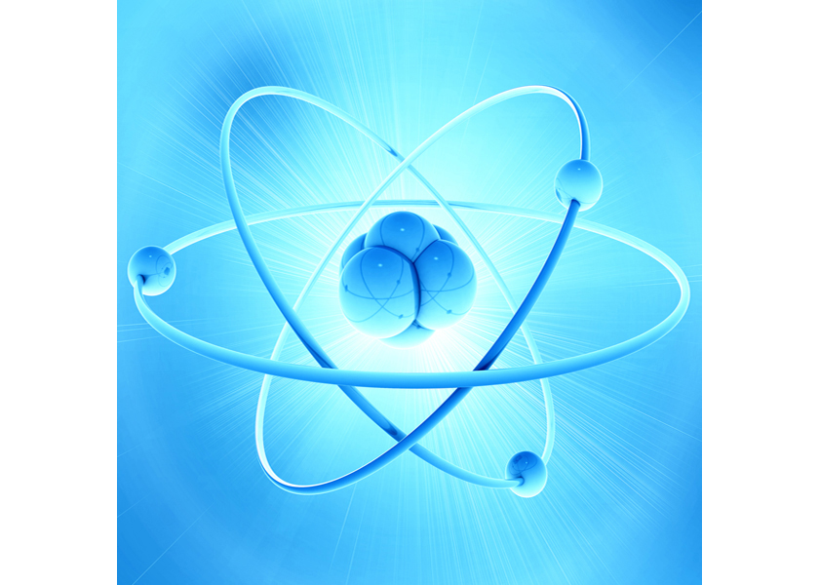
Atoms
Atoms are the basic units of matter.
Atoms have all the properties of matter
They occupy space
They are incredibly small
They can only be seen with a special microscope
They have mass

Slide 10
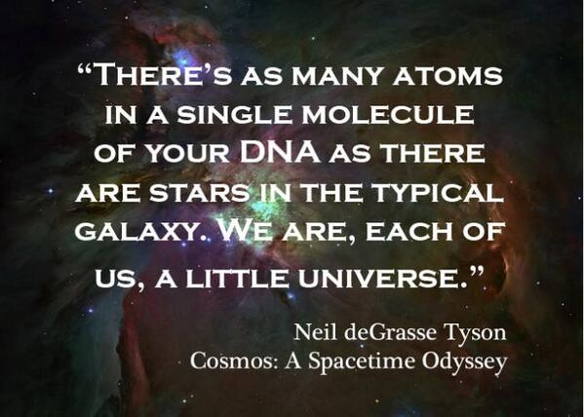

Slide 11
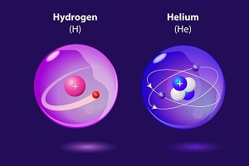
Not all atoms look alike!
What do you do you notice between these two atoms?

Slide 12
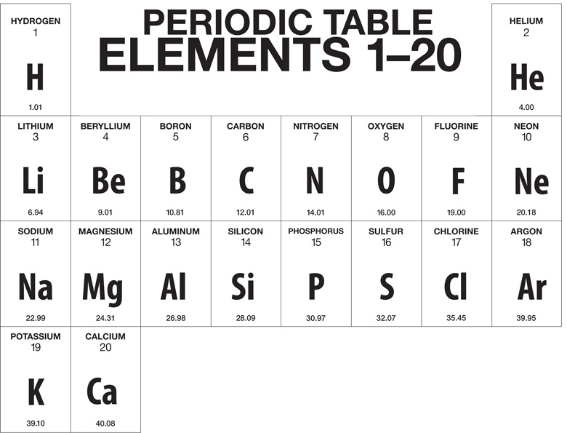
Elements are identified by letter and number
The number of protons (+ in the nucleus) and electrons circling, which is the same number, give the element its spot on the periodic table. This is its atomic number

Slide 13
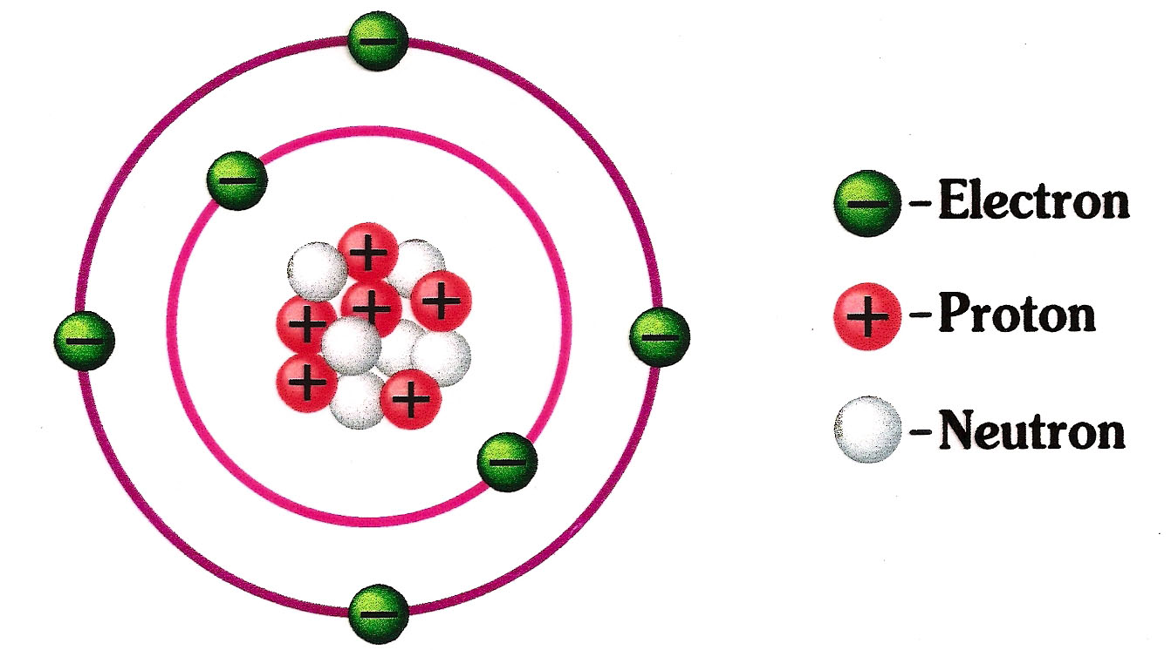
What kind of atom is this?

Slide 14
Elements
Elements are pure substances made up of only one kind of atom

Slide 15
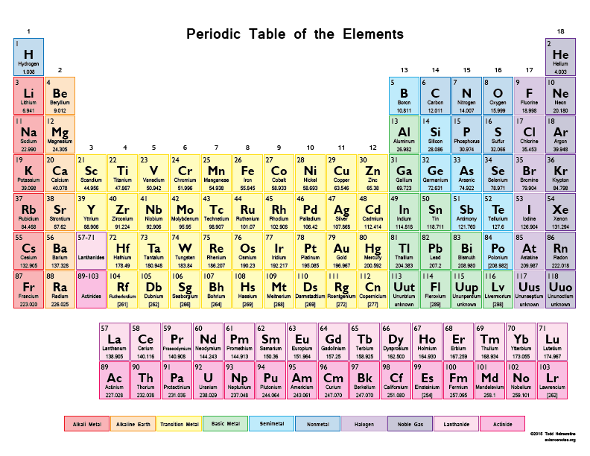
Wow - there are 118 elements and more are being discovered!

Slide 16
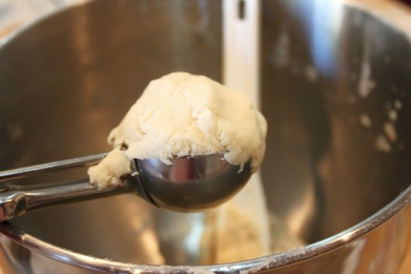
Elemental Ice Cream Store
You have just entered the Elemental Ice Cream Store. It boasts 118 flavors.
The smallest size the store can sell you is a scoop. A scoop is like an atom.

Slide 17
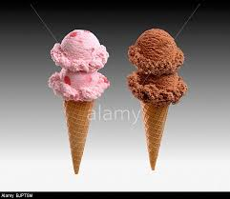
What if I want more than one type of elemental ice cream?
Two or more atoms (scoops) that are chemically joined is called a molecule

Slide 18
Element
If all the scoops (molecules) are the same type then this is an element like gold or oxygen or any of the other elements on the periodic table.

Slide 19
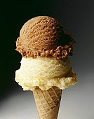
What if I don’t want one type of ice cream?
Molecules with more than one type of atom are called Compounds. Compounds are made up of more than one element. Water or H2O is a great example. This compound is made up of two molecules of hydrogen and one of oxygen.

Slide 20
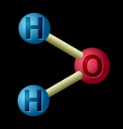
Water

Slide 21
Molecules can have the same type of atom or different types
Compounds have different types of atoms
Elements have one type of atom

Slide 22
Summary
element - a basic substance that can't be simplified (hydrogen, oxygen, gold, etc...)
atom - the smallest amount of an element
molecule - two or more atoms that are chemically joined together (This can be the same type of atom or different types of atoms)
Element - contains only one type of atom
Compound - a molecule that contains more than one element (H₂O, C₆H₁₂O₆, etc...)
Three scoops of Vanilla would be an element. One scoop of vanilla and two scoops of chocolate would be a compound

Slide 23
another way to look at it
Atoms - are like letters
Molecules - are like words

Slide 24
Putting together to this point
Study Jams (approx 3 minutes)

Slide 25
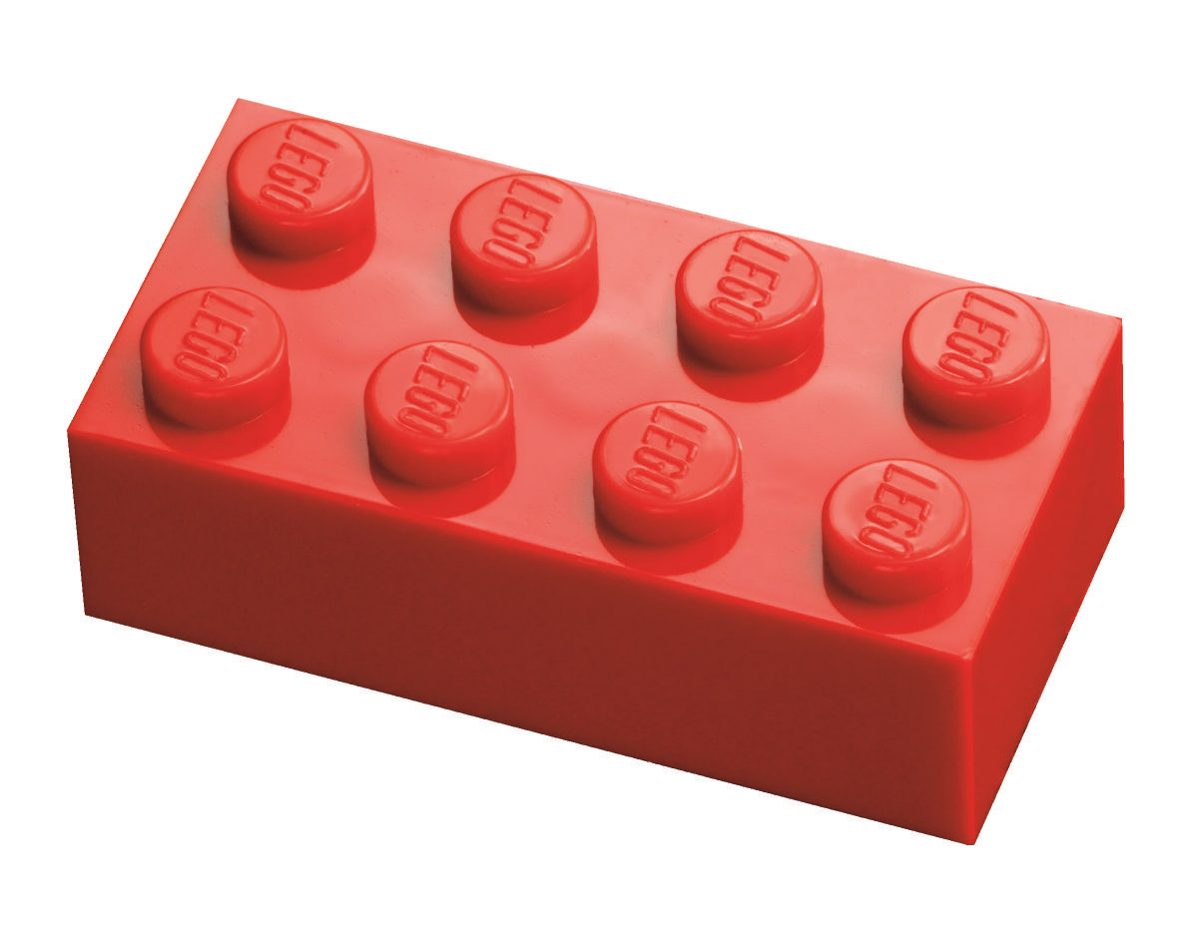
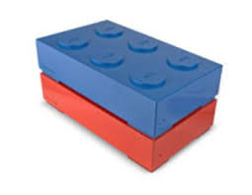
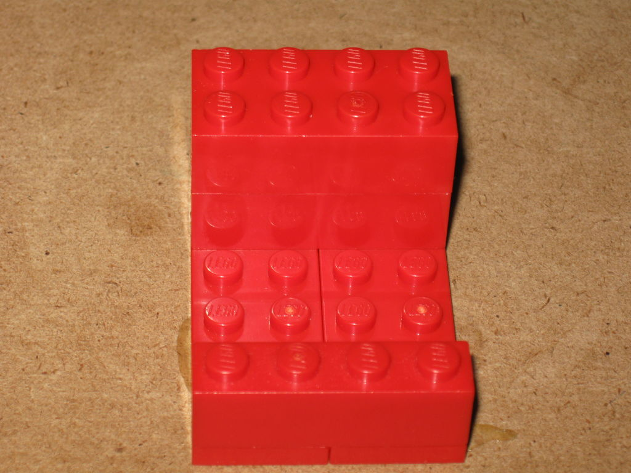
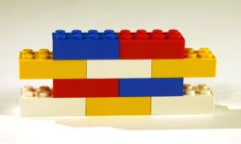
It legos were atoms - then describe these
1.
3.
2.
4.

Slide 26
Atom
Molecule
compound
Molecule/
Element
molecule
different type of compound

Slide 27
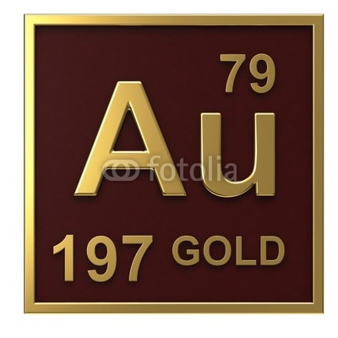
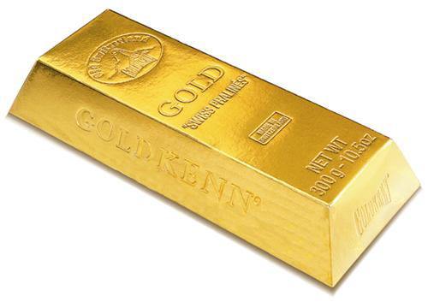
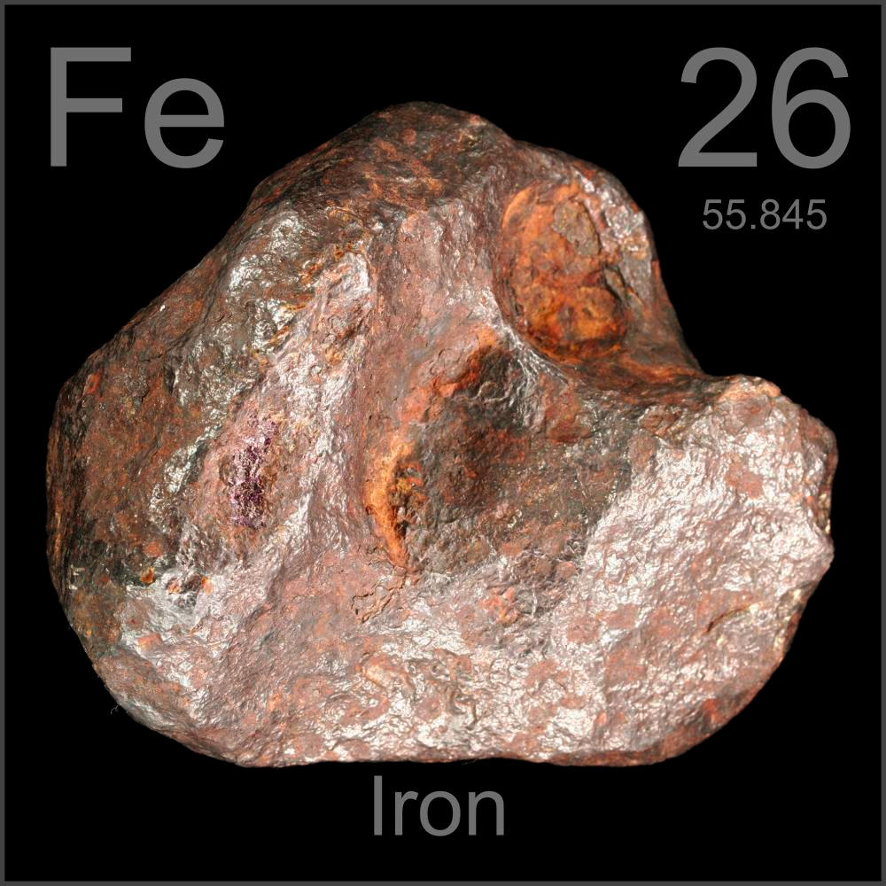
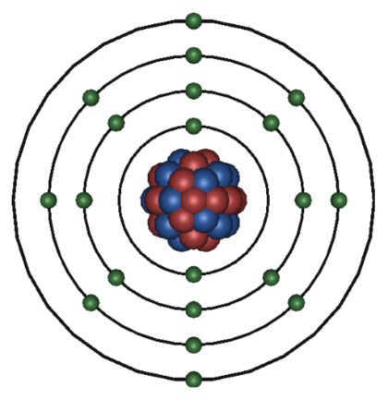
Real World examples of Elements
Gold - AU is an element
Iron - Fe is an element

Slide 28
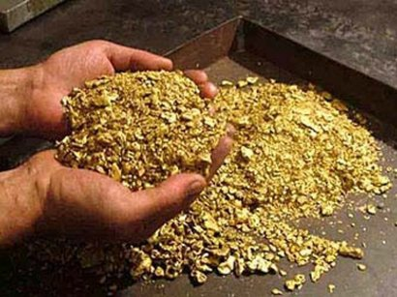
So...
All gold atoms have the same mass and occupy the same amount of space there for all matter made up of gold has the same properties because of the gold atoms.

Slide 29
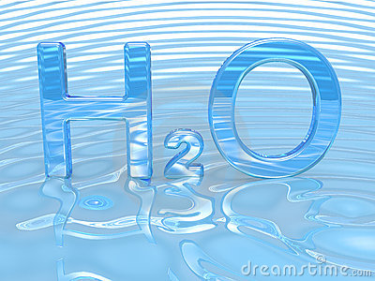
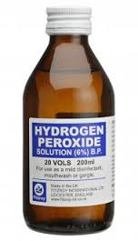
Real world examples
Water - H2O - compound molecule with two hydrogen atoms and one one Oxygen atom chemically bonded together
Hydrogen Peroxide - H2O2 - Compound molecule with two
Hydrogen atoms and two oxygen atoms
A few changes to a molecule’s structure makes a big difference!

Slide 31
Time Permits
good video - stop at 4.40

Slide 32
Homework
Make flashcards for the five key terms we learned today
Atom
Molecule
Matter
Element
Compound
Flashcards should have the term on one side and the definition and a picture on the other. These are due the next time we meet on October 1st
**Lab reports printed out are due then as well!!!

Slide 33
credits page
https://docs.google.com/presentation/d/1vUAJIQiefAOIg1KK6exv1mSN4uiMraB93LGzeWAnGJE/edit#slide=id.gc9b3647b8_1_13 - cactus
https://docs.google.com/presentation/d/1vUAJIQiefAOIg1KK6exv1mSN4uiMraB93LGzeWAnGJE/edit#slide=id.gc9b3647b8_1_3 - apple
https://docs.google.com/presentation/d/1vUAJIQiefAOIg1KK6exv1mSN4uiMraB93LGzeWAnGJE/edit#slide=id.gc9b3647b8_1_3 - cardinal
https://www.google.com/search?q=image+of+playing+card&espv=2&biw=1920&bih=971&tbm=isch&imgil=Fjm8eRrhH8euZM%253A%253Bd2Jn3AxivcagGM%253Bhttp%25253A%25252F%25252Fwww.eventhubs.com%25252Fnews%25252F2014%25252Ffeb%25252F26%25252Fkiller-instincts-combo-system-creation-began-standard-deck-playing-cards%25252F&source=iu&pf=m&fir=Fjm8eRrhH8euZM%253A%252Cd2Jn3AxivcagGM%252C_&usg=__5DNnYBNttt861IpOGzpqVWI1e2U%3D&ved=0CDYQyjdqFQoTCMft8IzYlcgCFYXMgAodId8KvQ&ei=CxQHVoe8HYWZgwShvqvoCw#imgrc=Fjm8eRrhH8euZM%3A&usg=__5DNnYBNttt861IpOGzpqVWI1e2U%3D - playing card
https://docs.google.com/presentation/d/1vUAJIQiefAOIg1KK6exv1mSN4uiMraB93LGzeWAnGJE/edit#slide=id.gc9e0b8d84_0_19 - dog
https://www.google.com/search?q=image+of+an+atom&espv=2&biw=1920&bih=971&tbm=isch&tbo=u&source=univ&sa=X&ved=0CDUQ7AlqFQoTCOeo1tfblcgCFQOUDQod7mcEVw#imgrc=FIt0HVXERl1yDM%3A - atom
https://www.google.com/search?q=image+of+the+first+10+elements+of+the+periodic+table&espv=2&biw=1920&bih=971&tbm=isch&imgil=n4sU-oU4djl5cM%253A%253BaX3WSYw1xq_0rM%253Bhttp%25253A%25252F%25252Fwww.middleschoolchemistry.com%25252Fmultimedia%25252Fchapter4%25252Flesson2&source=iu&pf=m&fir=n4sU-oU4djl5cM%253A%252CaX3WSYw1xq_0rM%252C_&usg=__3WwslgeKk9Q_hkWPA9HBVi7QJq0%3D&ved=0CDAQyjdqFQoTCLLyiKHelcgCFUyGDQodn94G-w&ei=gBoHVrKyGsyMNp-9m9gP#imgrc=n4sU-oU4djl5cM%3A&usg=__3WwslgeKk9Q_hkWPA9HBVi7QJq0%3D - periodic table 1 - 20
https://docs.google.com/presentation/d/1vUAJIQiefAOIg1KK6exv1mSN4uiMraB93LGzeWAnGJE/edit#slide=id.gc9ea91010_0_11 water

