Slide 1
5 Themes of Geography
Part One

Slide 2
Warm Up
Good Morning
Label Page 7 of your ISN - Place
Label Page 8 - Location
On the top of page 7 write what you think the most typical person in the world looks like

Slide 3
Essential Question
What will I learn today
How do the themes of place and location help us to understand the world and the people in it as well as how if influenced the history of the world?
6.E.1

Slide 4
The World’s most Typical
National Geographic

Slide 5
What is Geography
ge·og·ra·phy
1 : a science that deals with the description, distribution, and interaction of the diverse physical, biological, and cultural features of the earth's surface
Source-Merriam Webster Collegiate Dictionary

Slide 6
IN PLAIN ENGLISH
Geography is the study of the earth and everything on it.

Slide 7
Why study geography?
Here are some reasons (2.06)
Another great video (4.31)

Slide 8
Five Themes
Geography is a vast and complicated subject. To make it easier to organize and explain, Geologist categorize this subject into 5 major themes or ideas.

Slide 9
They are...
Location
Place
Interaction ( humans with the environment)
Movement
Region
Here is a good way to remember them

Slide 10
Let’s Location
Play Place
In Interaction
Mario’s Movement
Room Region

Slide 11
Location
®Location -- Where are things located? A location can be specific (for example, it can be stated as coordinates of longitude and latitude or as a distance from another place) or general (it's in the Northeast).

Slide 12
Absolute Location
Absolute location is described in terms of Longitude and Latitude
Charlotte North Carolina’s exact location is
longitude - 80.823 W
latitude 35.479 N

Slide 13
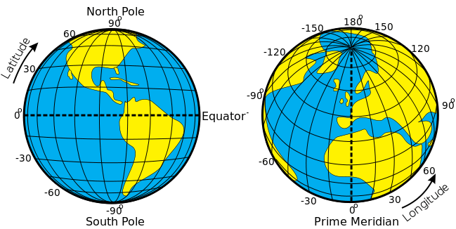
Example of exact location

Slide 14
Relative Location
Relative location refers to the position of a place or entity based on its positive with respect to other locations. For example, the location of the US Capitol is located about 38 miles southwest of Baltimore. Relative location can be expressed in terms of distance, travel time, or cost. (near, above, west, beside, across from)

Slide 15
Relative Location
Relative location is more general and can be used relative to the surroundings of the object. You could say something like, "The post office is South of the diner on main street".

Slide 16
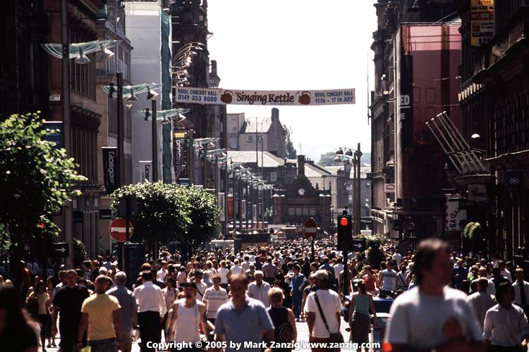
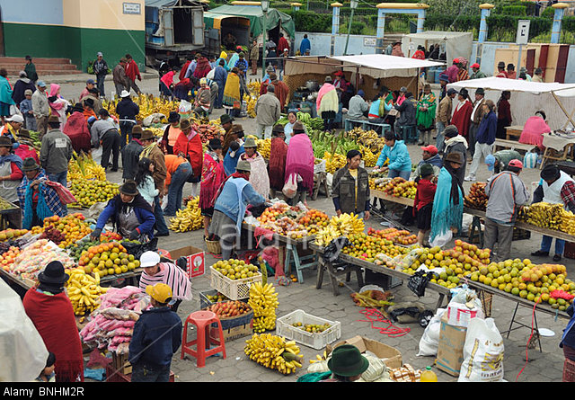
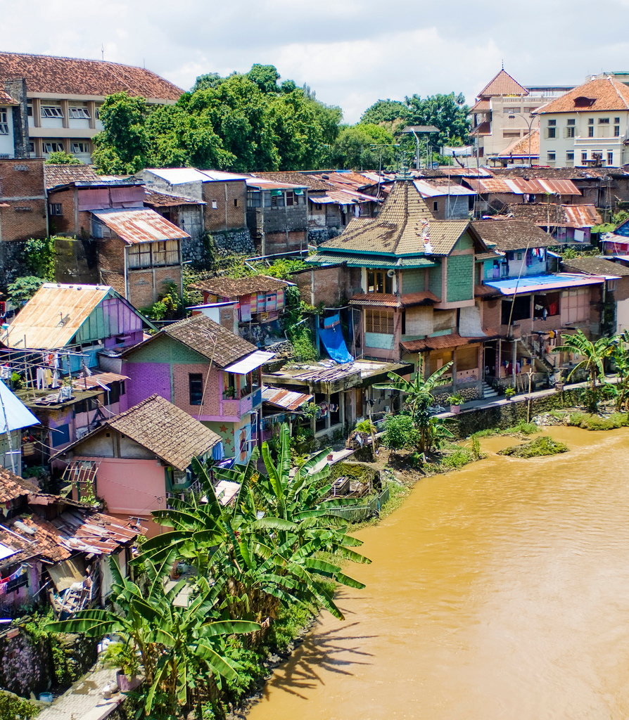
Place What is it like when you get there?
What makes a place different from other places? Differences might be defined in terms of climate, physical features, or the people who live there and their traditions.

Slide 17
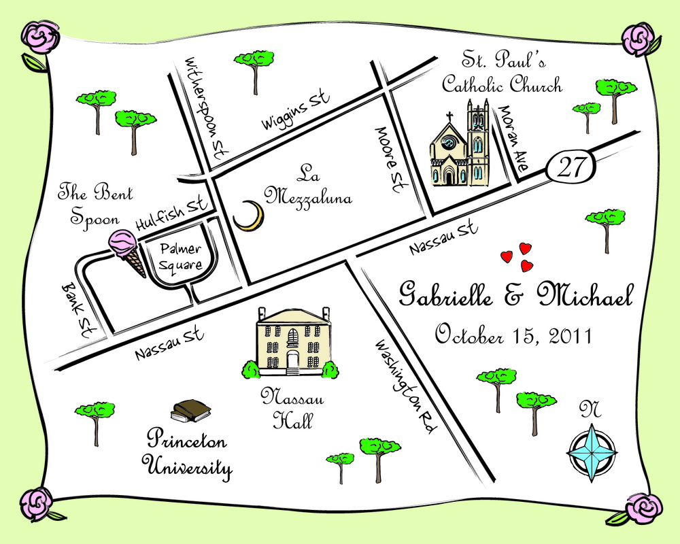
Here is an example

Slide 19
Human Environment Interaction
How do human change the environment - a particular place
How does the environment affect humans - how do people adapt to the environment around them

Slide 20
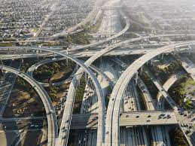
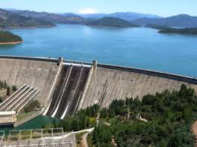
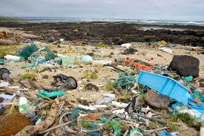
Interaction - How humans change the environment
Canals, roads, building, dams, pollution are some examples.

Slide 21
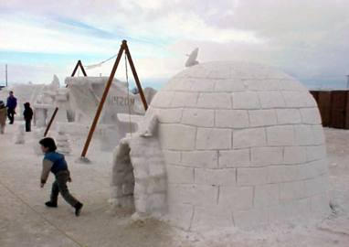
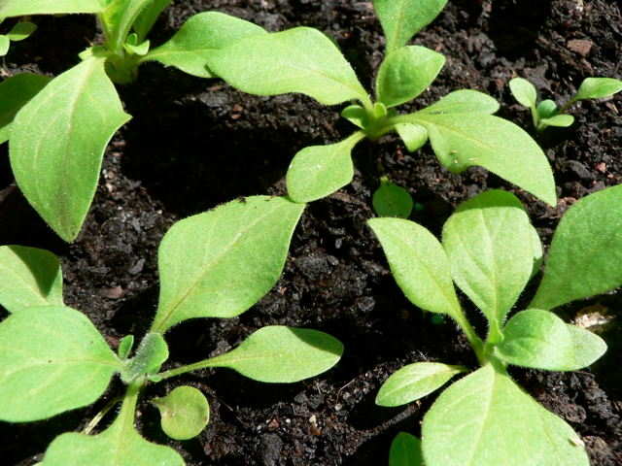
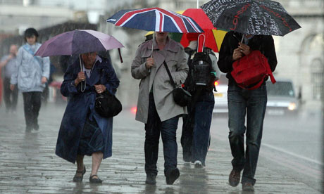
How human adapt or interact with the environment around them
Building shelters, using umbrellas, wearing a jacket are some examples. It also has to do with what the environment does for the people. Give water, soil to grow plants and minerals for use.

Slide 22
Those are the first three themes
We will do the other two on Friday.
Here is a rap for all 5 themes 2.34

Slide 23
Let’s play geographic term Bean bag
I will pick the name of three people to be the score keeper of the games.
You will have one toss.
In order to get a point you must correctly identify the definition of the term you land on. (If you land on Fjord, you may pick any term and give the definition for it.)

